Slide 1
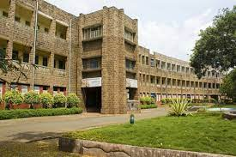
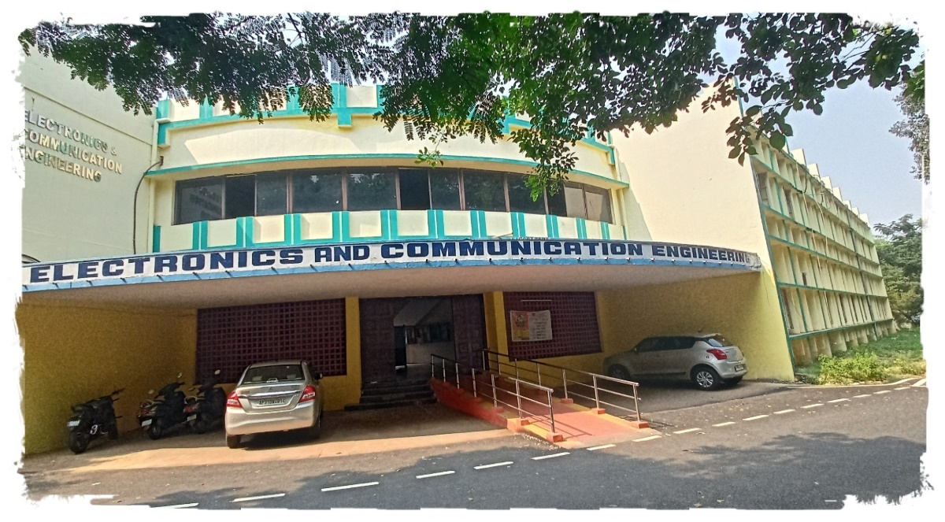
Hearty Welcome To
NAAC PEER TEAM
Department of Electronics and Communication Engineering
AUCE, Andhra University, Visakhapatnam.

Slide 2
OVERVIEW
Vision & Mission
Department Profile/History/Achievement
Teaching & learning
Research, Innovation and Extensions
Curricular Aspects
Students support and Progression
Infrastructure and learning resources
Governance, leadership and Management
Institutional values and best practices
Progressive Plan

Slide 3
Vision & Mission:
Department of Electronics and Communication Engineering
Vision:
To become a global leader in Electronics and Communication Engineering for technological advancement through academic excellence, start-up innovation and social responsibility.
Mission:
To produce graduates with the best technical standards with ideal conduct and character.
To promote interest in research, National Integration, Spirit of sportsmanship and sense of service to the motherland.

Slide 4
UALITY POLICY
The Department achieves its mission through a well-defined quality policy which reads as
Imparting Globally Focused Education
Creating World Class Professionals
Developing State of the Art Infrastructure and well-Endowed Faculty
Imparting Knowledge Through Team Work and Incessant Efforts.

Slide 5
Department Profile & Milestones
Profile
B.Tech ECE Programme Accredited by NBA for 6 Years for the period of 2017-2023.
Department has well equipped laboratories for Microwave Engineering Lab, Signal Processing Lab, Electronics Lab, Communications Lab, Instrumentation Lab and VLSI Lab.
Department of ECE established in the year 1983 after trifurcation.
Implemented OBE Programmes UG.
B.Tech ECE Programme Started in 1972.
1972
1983
2013
1987
2000
2004
2010
Introduced M.Tech EI
Introduced M.Tech R&M
Introduced M.Tech BME
Introduced B.Tech + M.Tech
Introduced M.Tech VLSI
ECE Programme
Started
Trifurcated from EEE

Slide 6
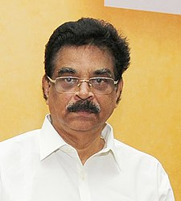
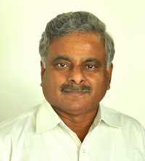
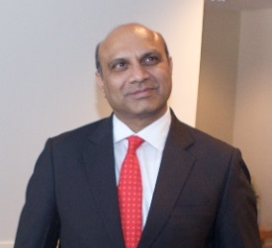
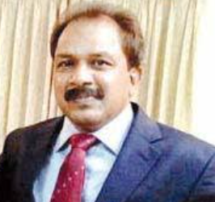
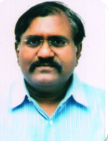
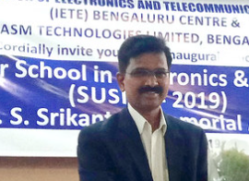
Prominent Alumni
Dr K. Hari Babu,
Governor of Mizoram, India.
Prof R.V. Raja Kumar, Director, IIT-Bhubaneswar.
Sri M.M. Pallam Raju,
Former Union Minister for MHRD.
Sri T. Dharma Rao,
IAS, Commissioner of Industries, Govt. of M.P.
Sri G. Sai Prasad,
IAS, Secretary to CM, Govt. of AP.
Dr. P Radha Krishna,
Director, LRDE- DRDO, Bangalore.

Slide 7
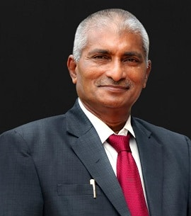
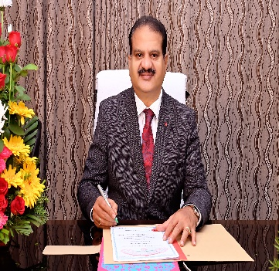
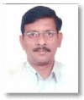
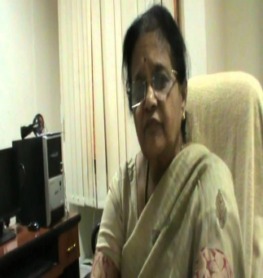
Prominent Alumni
Prof G.S.N.Raju,
Former Vice Chancellor,
Andhra University,
Chancellor Centurion University.
Prof. K. Padma Raju,
Vice Chancellor Adikavi Nannayya University.
Dr. M Chakravarthi,
Director, DLRL-DRDO, Hyderabad.
Prof. K. Raja Rajeswari ,
Governing Council Member , IETE.

Slide 8
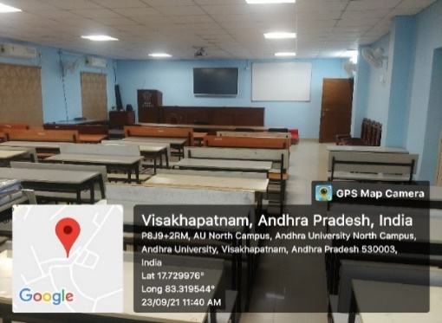
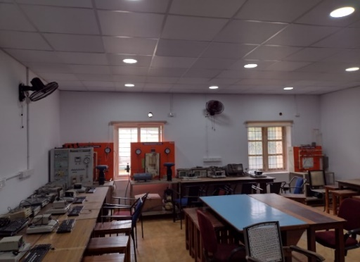
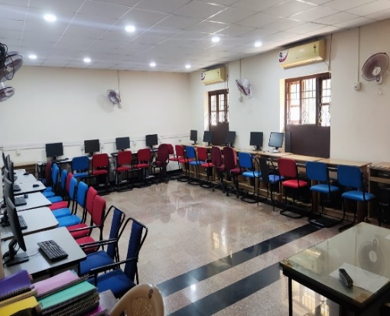
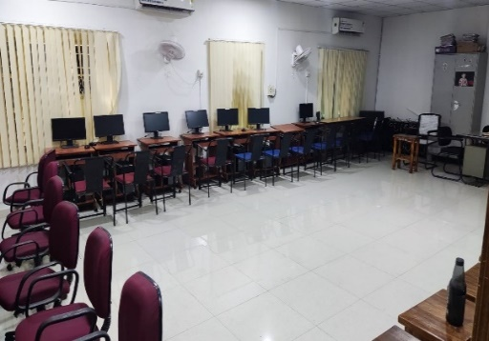
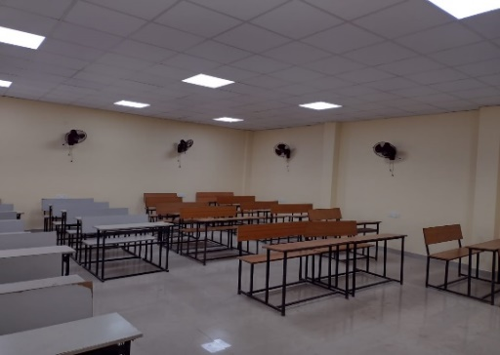
Alumni Contributions
ECE Dept. Alumni has contributed for:
Renovation of Digital Signal Processing Laboratory - 4.25 Lakhs.
Renovation of HDL Programming Laboratory - 3 Lakhs.
Renovation of Seminar Hall - 2 Lakhs.
Renovation of Smart Class Room - 4.5 Lakhs.
Renovation of Instrumentation Laboratory – 2.5 Lakhs.
100 Wooden Stools - 1 Lakh.
Seminar Hall
Instrumentation Lab
HDL Laboratory
DSP Lab
Smart Class Room

Slide 9
MOU’s & Collaboration
MOU
&
Collaboration
Department of ECE has an MOU with Blekinge Institute of Technology Sweden. In the assessment period 09 students got admitted in this Scheme.
M.Tech SATCOM & GNSS offered at ISRO Ahmedabad under UNESCO program in collaboration with our department.
The MOU between Andhra University and Indian Army for the establishment of Centre for Defence Studies.
MOU between the Bureau of Indian Standards (BIS), Ministry of Consumer Affairs, Food & Public Distribution, Govt. of India and Andhra University College of Engineering.
Naval Dockyard Visakhapatnam and Andhra University, paving the way for an internship program for B.Tech students.

Slide 10
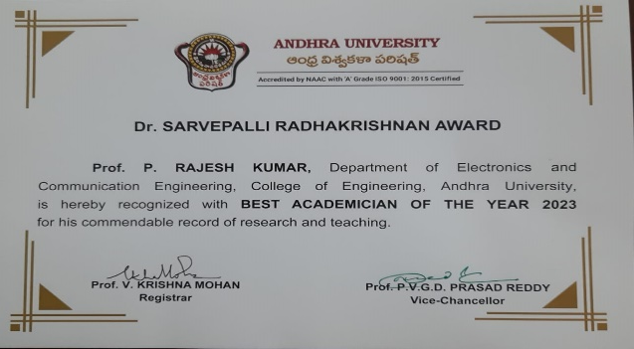
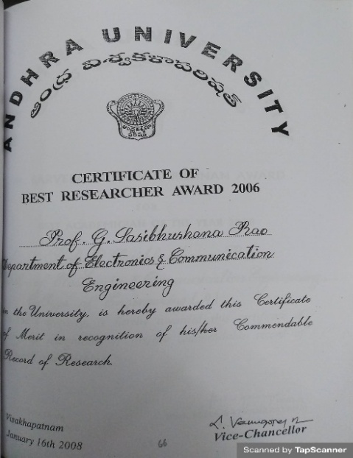
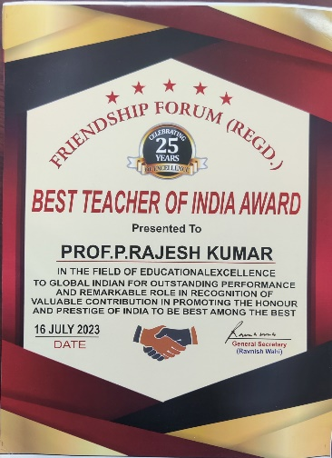
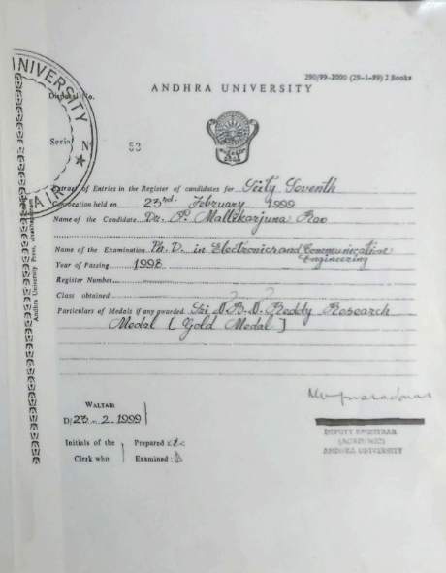
Faculty Achievements
Sr. Prof. G. Sasibhushana Rao Awarded Best Researcher.
Awarded Best Academician.
Prof. P. Rajesh Kumar
Awarded Best Academician.
Awarded Best Teacher of India Award.
Prof. P. Mallikarjuna Rao Awarded Best Ph.D.
Former Prof. GSN. Raju
Awarded State Best Techer, Best Academician & Best Researcher.

Slide 11
Teachers Profile
S.No | Name | Qualification | Research Areas | Designation | Experience
1 | Dr. G. Sashibhushana Rao | Ph.D | GPS | Sr. Professor | 17 Years
2 | Dr. P. Rajesh Kumar | Ph.D | Radar Signal Processing | Professor | 27 Years
3 | Dr. P. Mallikarjuna Rao | Ph.D | Antennas arrays, EMI/EMC, Modern Communication technology | Professor | 32 Years
4 | Dr. P. V. Sridevi | Ph.D | Microwave, Communications, Planar array, VLSI. | Professor | 35 Years
5 | Dr. M. Satya Anuradha | Ph.D | Antenna Arrays (PLANAR), Communications | Professor | 25 Years
6 | Dr. S. Aruna | Ph.D | Antenna Arrays, Planar & co-planar | Associate Professor | 17 Years
Overall on an average teachers are having more than 17 years of experience in the University.

Slide 12
Tenure Track Faculty Profile
S.No | Name | Qualification | Research Areas | Designation
7 | Dr. G.S.N Raju | Ph.D | Antennas, EMI/EMC | Emeritus Professor
8 | Dr. K.V.V.S. Reddy | Ph.D | Signal Processing | Honorary Professor
9 | Dr. V. Malleswara Rao | Ph.D | VLSI | Adjunct Professor
10 | Dr. G. Rajeswara Rao | Ph.D | Wireless Communication | Adjunct Professor
11 | Dr. K. Chiranjeevi | Ph.D | Signal Processing | Adjunct Professor
12 | Dr. R. Rama Brahmam | Ph.D | VLSI | Professor of Practice
13 | Dr. Ch. Praveen Babu | Ph.D | Signal Processing | AdHoc Professor
14 | Dr. T. Roopa Rachel | Ph.D | Bio medical signal processing | Contract Faculty

Slide 13
Tenure Track Faculty
S.No | Name
15 | Mr. D. Lakshmi Narayana
16 | Mr. V. Sandeep Kiran
17 | Mr. G. Prabhu Teja
18 | Ms. K. Deepthi
19 | Ms. T. Shanmukha Prasanthi
20 | Ms. K.S.S.S.B.S. Milinda
21 | Ms. R. Swarajya Madhuri
22 | Ms. B. Teena Ratna Prasuna
23 | Ms. Ch. Jyotsna Rani
24 | Ms. T. Vidhya Catherine
25 | Ms. P. Saraswathi
26 | Mr. A. Prem Sudheer
27 | Ms. V. Swetha
28 | Ms. P. Sujatha
29 | Ms. Florence
30 | Mr. R. Surya Prakash
31 | Mr. K. Ravi Kumar
32 | Mr. M. Rajasekhar
33 | Mr. Sk. Ebraheem
34 | Mr. T. Anand Babu
S.No | Name
35 | Mr. D. Krishna
36 | Mr. Kiran Kumar Patro
37 | Mr. P. Jagan Mohan Rao
38 | Mr. Md. Hayath Rajvee
39 | Mr. H. Srinivasa Vara Prasad
40 | Mr. V. Surya Narayana
41 | Mr. R. Manoj Kumar
42 | Ms. H. Sudha
43 | Ms. R. Suneetha
44 | Ms. L. Alekhya
45 | Mr. V. Sateesh
46 | Mr. P. Santosh
47 | Mr. B. Ashok Kumar
48 | Mr. B. Chandra Kiran Patrudu
49 | Mr. B. Kondalu
50 | Y. Lakshmi Lavanya
51 | Mr. A. Venkata Sriram
52 | Ms. Jalaja Rajana
53 | Mr. K. Venkata Ashok

Slide 14
Student Faculty Ratio
Programme/Academic Year | 2017-18 | 2018-19 | 2019-20 | 2020-21 | 2021-22
B.Tech (ECE) | 153 | 142 | 176 | 193 | 214
B.Tech+M.Tech (ECE) | 120 | 120 | 120 | 117 | 117
M.Tech (EI) | 25 | 28 | 21 | 25 | 29
M.Tech (R&M) | 32 | 23 | 26 | 33 | 28
M.Tech (VLSI) | 29 | 23 | 22 | 13 | 13
M.Tech (BME) | 20 | 18 | 18 | 22 | 12
Total No. of Students | 379 | 354 | 383 | 403 | 413
Total No. of Faculty | 30 | 30 | 28 | 27 | 25
Student – Faculty Ratio | 13 | 12 | 14 | 15 | 16

Slide 15
Faculty Administrative Positions
Sr. Prof. G. Sashibhushana Rao
Principal, AUCE.
Chairman-Board of Studies, Dr. B.R Ambedkar University.
Chairman-Board of Studies, Adikavi Nannaya University.
Served as Chairman-Board of Studies Dept of ECE, AUCE.
Prof. P. Mallikarjuna Rao
Served as HOD, Dept of ECE, AUCE.
Served as Chairman-Board of Studies Dept of ECE, AUCE.
Prof. M. Satya Anuradha
Chairperson-Board of Studies Dept of ECE, AUCE.
Prof. P. Rajesh Kumar
HOD, Dept. of ECE, AUCE.
Chairman- IETE Visakhapatnam centre.
Chairman-Board of Studies, Krishna University.
Served as Asst, Principal AUCE.
Served as Chairman-Board of Studies Dept of ECE, AUCE.
Prof. P. V. Sridevi
Served as Chairperson-Board of Studies Dept of ECE, AUCE.

Slide 16
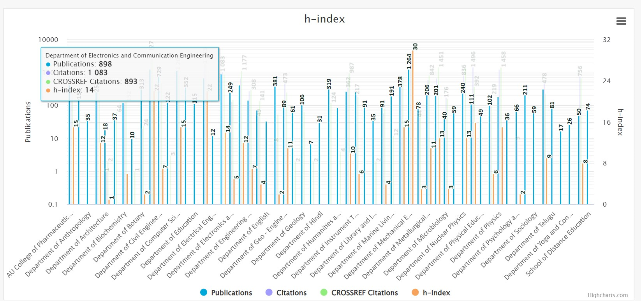
Department H-index

Slide 17
Thrust Areas
Communications
Multiuser and mm-wave MIMO
SDN/NFV for 5G network.
Antennas
UWB antennas for ground penetrating RADAR and Biomedical Imaging Applications.
Antenna design techniques and measurement for 5G systems.
Biomedical Signal Processing
Processing of bio electrical signals like EEG and ECG.
Machine learning including deep learning for biomedical applications.
Machine learning algorithms and implementation over wireless communication networks.
Biomedical Image Processing
Radiotherapy image segmentation and Multi-Modal Image Reconstruction.
Machine Learning for Image Reconstruction.
VLSI Design
Chips optimized for IoT-enabled device.
VLSI for AI and ML algorithms.

Slide 18
Ph.D’s Awarded
Total Ph. D’s from the Department in the assessment period: 103
Year | 2017-18 | 2018-19 | 2019-20 | 2020-21 | 2021-22
Ph.D Awarded | 22 | 21 | 22 | 20 | 18

Slide 19
Number of JRF/SRF/PDF/RA
 | UGC-NET | RGNF | MANF | R-CET | Visveswaraya
2017-18 | 10 | 06 | 01 | 01 | 02
2018-19 | 09 | 05 | 01 | 04 | 02
2019-20 | 07 | 04 | 01 | 04 | 02
2020-21 | 06 | 03 | - | 11 | 01
2021-22 | 04 | 02 | - | 05 | -
Scheme | Amount (Rupees)
 | JRF | SRF
UGC-NET, RGNF & MANF | 31,000 | 35,000
Visveswaraya | 38,750 | 43,750
TEQIP Phase -II | 18,000 | 18,000
TEQIP Phase -III | 10,000 | 10,000

Slide 20
Research, Innovations and Extensions
Total no. of Journals: 279
Total no. of Conferences: 102
Journals | National | International
2017-18 | 33 | 22
2018-19 | 21 | 23
2019-20 | 18 | 38
2020-21 | 30 | 32
2021-22 | 36 | 26
Conferences | National | International
2017-18 | 06 | 09
2018-19 | 04 | 20
2019-20 | 03 | 24
2020-21 | 02 | 11
2021-22 | 03 | 10

Slide 21
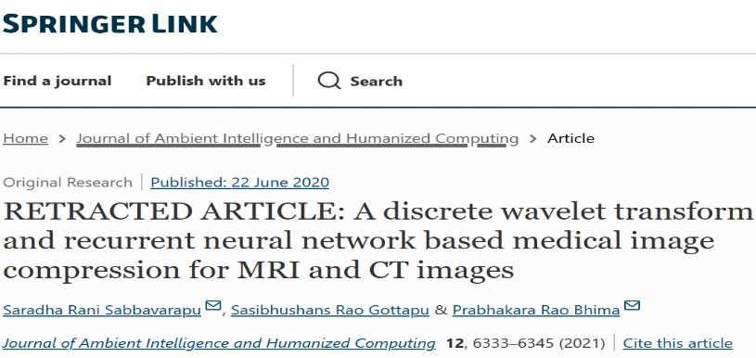
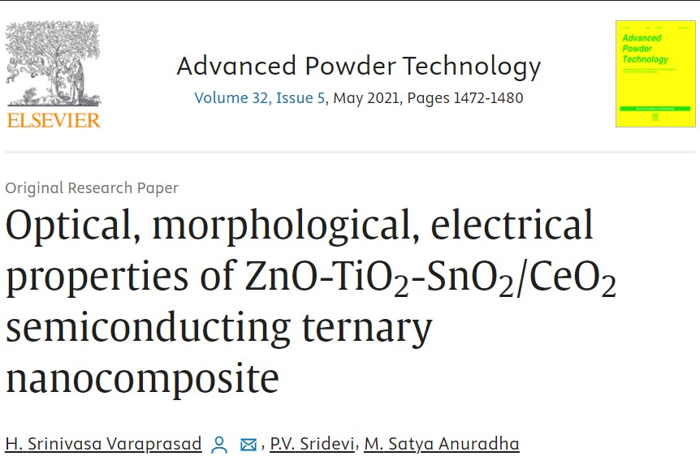
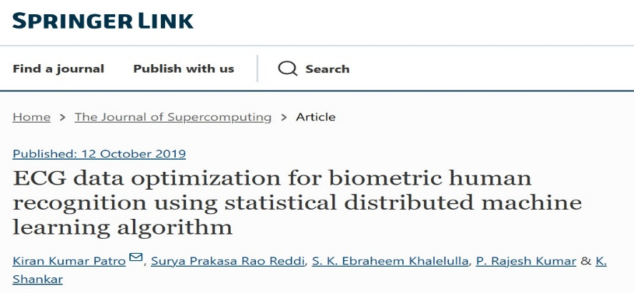
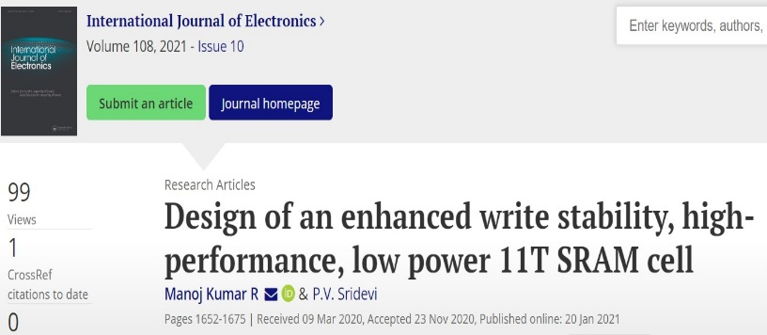
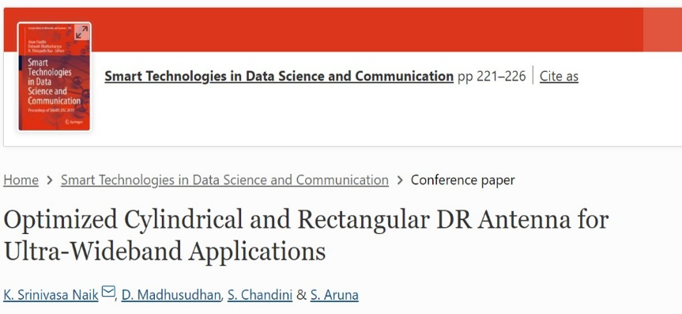
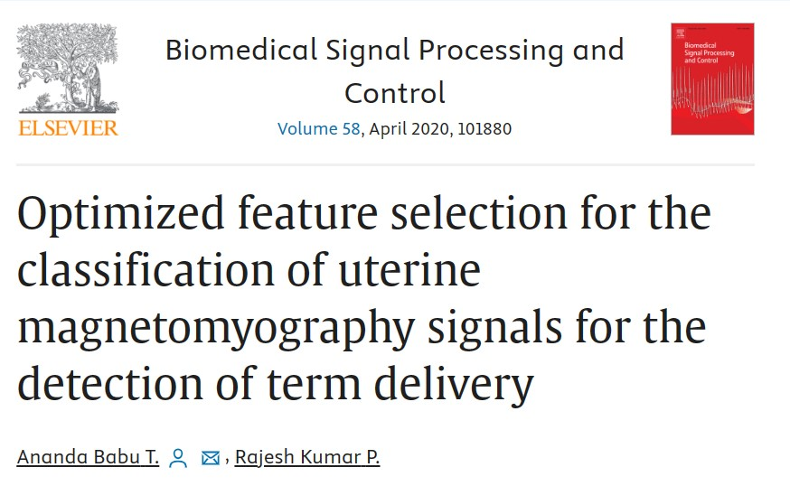
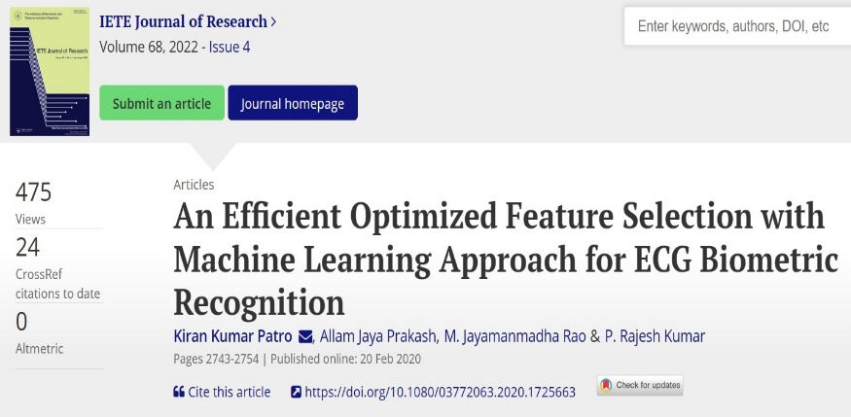
Research, Innovations and Extensions
SCI Publications

Slide 22
Patents Published
Total no. of Patents Published are: 09
Name of the Patentees | Patent Number | Title of the patent | Year of Award / published of patent
M N V S S Kumar Koduri Sreelakshmi Gottapu Sasibhushana Rao | Patent No. 24/2021 | Multi -Band Reconfigurable and Flexible Antenna | 11-06-2021
Satish Virothu, M Satya Anuradha & RoopaRechal T | 202141041812 A | Flexible CPW fed21 MIMO antenna for 5G V2XA applications | 29-10-2021
RoopaRechal Tanikonda Prof. P. Rajesh Kumar DR. SK Ebraheem Khaleeulla | 202141041813 A | Electroencephalographic signal classification via optimised feature selection algorithms for recognition of ASD | 12-11-2021
Koduri sreelakshmi & Gottapu Sasibhushana Rao | 2021101248 | A Reconfigurable quad-band antenna device for wireless communication | 12-11-2021
GottapuSasibhushana Rao, Koduri sreelakshmi | 2021105541 | A Flexible and reconfigurable multiband antenna | 27-11-2021
Pavada Santosh, Swetha Velicheti, Dr. P. Mallikarjuna Rao, Dr. M. S. Anuradha | 202341013662 A | A Compact Inset-Fed-2X2 E-Shaped Patch Antenna Array with and without DGS for High Frequency | 17-03-2023
Swetha Velicheti, Pavada Santosh, Dr. P. Mallikarjuna Rao, Dr. M. S. Anuradha | 202341013737A | Conformal Log Periodic Array Antenna with rectangular patch top loading for Multiband Applications | 17-03-2023
Mrs. Sharon Rose Victor Juvvanapudi, Prof. P. Rajesh Kumar, Prof. K.V. V. S. Reddy | 202241046901 A | Combined integer and discrete wavelet transform with HARRIS hawks optimization for color image watermarking. | 02-09-2022
CH.S.S. Balaji, Dr. M. Satya Anuradha, Dr. T.RoopaRechal, | 202341050867 A | A System for Multi-Layer File Sharing Through a Network and Method Thereof | 01/09/2023

Slide 23
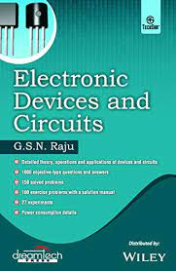
Text Books authored by the Faculty
Total no. of Text Books Authored are: 09
Prof. M. Satya Anuradha
Sr. Prof. G. Sashibhushana Rao
Sr. Prof. G. Sashibhushana Rao
Prof. G.S.N. Raju

Slide 24
Book Chapters by the Faculty:
Total Book Chapters Published in the assessment period are 44
Sl. No. | Name of the Author | Title of the paper | Year of publication | Name of the publisher
1 | Prof. G. Sasibhushana Rao | Comparison of Various Algorithms for Side Lobe Level Reduction in 5G Antenna Arrays | 2020 | Springer
2 | Prof. G. Sasibhushana Rao | GA Tuned Kalman Filter for Precise Positioning | 2020 | Springer
3 | Prof. G. Sasibhushana Rao | Estimation of FSO Link Availability for Visakhapatnam Coastal Region | 2020 | Springer
4 | Prof. G. Sasibhushana Rao | Nature-Inspired Biogeography-Based Optimization for Estimation of GPS Receiver Position in Low Latitude Regions of the Indian Subcontinent | 2020 | Springer
5 | Prof. G. Sasibhushana Rao | TEC Variation Analysis During Near Peak Solar Year Activity Over Indian Subcontinent | 2020 | Springer
6 | Prof. P. Mallikarjuna Rao | Design, Simulation and Experimental Validation of Patch Antenna in S-Band Satellite Communication | 2020 | Springer
7 | Prof. P. Mallikarjuna Rao | An Analytical Review on Log Periodic Dipole Antennas with Different Shapes of Dipole Elements | 2020 | Springer
8 | Prof. P. Mallikarjuna Rao | Multi-Beam Generation Using Quasi-Newton method and Teaching Learning Based Optimization algorithm | 2020 | Springer
9 | Prof. P. Rajesh Kumar | Image Fusion of X-ray Mammography Using Weighted Averaging GA-Based SWT Technique | 2020 | Springer
10 | Prof. P.V. Sridevi | Design of look-up table with low leakage power enhanced stability 10 T SRAM cell | 2021 | Springer
11 | Prof. P.V. Sridevi | Comparison of Uplink Spectral Efficiency in Massive MIMO Systems | 2021 | Springer
12 | Prof. P.V. Sridevi | Plasmonic square ring resonator-based band-stop filter using MIM waveguide | 2020 | Springer
13 | Prof. P.V. Sridevi | Intensity Inhomogeneity Correction for Magnetic Resonance Imaging of Automatic Brain Tumor Segmentation | 2019 | Springer
14 | Prof. M. Satya Anuradha | Cloud Security, Concepts, Applications and Perspectives | 2021 | CRC Press
15 | Prof. M. Satya Anuradha | Network-on-Chip Xilinx Implementation of WBCDMA System and Its AWGN Performance Analysis | 2020 | Springer
16 | Prof. M. Satya Anuradha | Comparison of Conformal and Planar CPW-Fed Circularly Polarized UWB Square Slot Antennas for WLAN, WiMAX, and 5G Applications | 2020 | Springer
17 | Prof. M. Satya Anuradha | CPW-Fed Monopole Antenna for RCS Reduction in X-Band Applications | 2020 | Springer

Slide 25
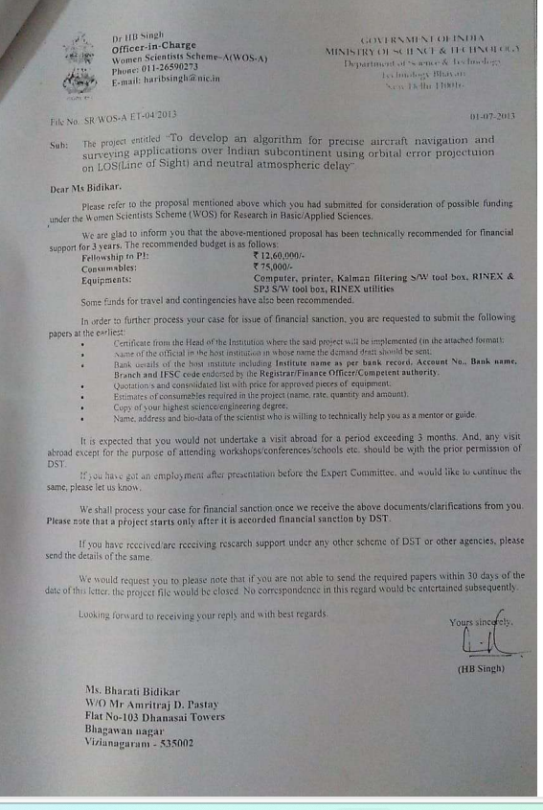
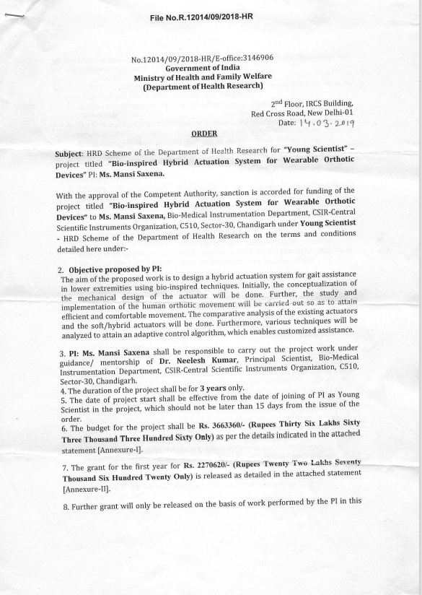
Research Projects Completed /ongoing and Research Grants received
No. of Research Projects in the assessment period: 02
Name of the Scheme/Project/ Endowments/ Chairs | Name of the Principal Investigator/ Co Investigator (if applicable) | Name of the Funding agency | Type (Government/Non-Government) | Department | Year of Award | Funds provided (INR in lakhs) | Duration of the project | Total amount Sanctioned | Received
Women Scientist Scheme | Bharathi Bidikar | DST | Government | Dept. of Science and Technology | 2014 | 21,00,000/- | 3 Years | 21,00,000/- | YES
Young Scientist | Manasi Saxsena | DHR | Government | Dept. of Health Research | 2019 | 36,63,360/- | 3 Years | 36,63,360/- | YES
DST Project
DHR Project

Slide 26
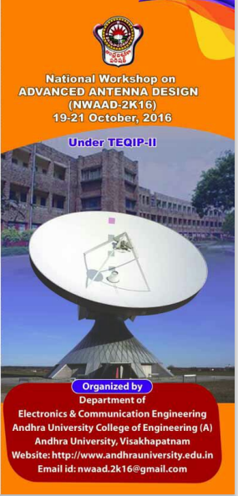
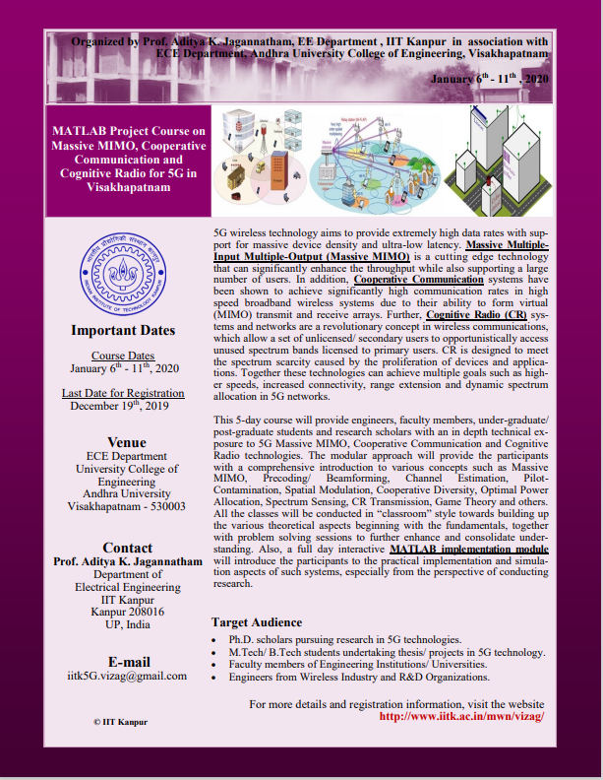
Conferences /workshop conducted and attended
Workshops Conducted in the department in the assessment period: 03
NWAAD- 2K16
NWLABVIEW-2K17
Massive MIMO – 2K20
Workshops Attended
Name of the Faculty | Conferences /workshop attended
Prof. P.V. Sridevi | Attended National Productivity council program: " Digital Transformation for Organization" at Port Blair On 18-11-2019 Sponsored by TEQIP Phase III
Prof. P.V. Sridevi | Attended Residential Training Program on "Digital Transformation for Organization held at Port Blair During 18-11-2019 to 22-11-2019
Prof. M. Satya Anuradha | Attended One week Capacity Building Workshop on " Outcome Based Education and Accreditation Process" Which was conducted by Bharathi Vidhyapeeths Institute of Computer Applications and Management (BVICS) New Delhi 27-07-2020- to 31-07-2020

Slide 27
FDP’s Attended
Total no. of FDP’s attended in the assessment period: 82
Name of the Faculty | Title of the Program | Organized by | Duration
Prof. P.V. Sridevi | Design of Microwave and Antennas for Wireless Communications Applications | IIT Kharagpur | 21-08-2017 to 26-08-2017
Prof. P.V. Sridevi | Digital Transformation for Organization | National Productivity Council | 18-11-2019 to 22-11-2019
Prof. P.V. Sridevi | Model Learning Management System | JNTUH College of Engineering, Sultanpur | 10-06-2020 to 15-06-2020
Prof. P.V. Sridevi | Design and Simulation of Miniature Antenna for IOT Applications | MVGR College of Engineering | 29-06-2020 to 04-07-2020
Prof. M. Satya Anuradha | Outcome Based Education (OBE) and NBA Accreditation Process | BVICAM, New Delhi | 27-07-2020 to 31-07-2020
Dr. S. Aruna | Internet of Things (IoT) | IIIT Nagpur | 25-04-2020 to 29-04-2020
Dr. S. Aruna | Pedagogy for effective use of ICT in Engineering Education | Dr. Ambedkar Institute of Technology | 23-11-2020 to 28-11-2020

Slide 28
Faculty Centric Policies & Utilization
Facilities
Gratuity, PF, Group Insurance, Loan, Accidental Insurance, Subsidized Transport Facility, ESI, etc.,
Encouragement
Corporate Training, Research work with on-duty leave, Consultancy Projects, Writing Research Papers, etc.,
Financial Assistance
Medical Bill Reimbursement, Filing Patents, Publishing Papers, Attending FDP, Workshop & Seminars, etc.,
Leave Provision
Maternity Leave, Perennity Leave, Study leave, CL, EL,PL.
Fee Concession
Tuition Fee & Transport Fee for Children of Staff.

Slide 29
CURRICULAR ASPECTS
Programmes offered - CBCS/AICTE/APSCHE/OBE Scheme:
Number of all Programmes offered by the institution during the last five years.
Programme Code | Programme name | Year of Introduction | Status of implementation of CBCS/Elective course system (Yes/No) | Year of revision (if any)
3-1-12 | B.Tech – Electronics & Communication Engineering | 1972 | YES | 2019-20 – 10% 2020-21 – 10% 2021-22 – 5% 2022-23 – 20%
3-5-07 | B.Tech + M.Tech - Electronics & Communication Engineering | 2010 | YES | 2019-20 – 10% 2020-21 – 10% 2021-22 – 5% 2022-23 – 20%
3-2-22 | M.Tech - Electronic Instrumentation | 1987 | YES | 2019-20 - 10%
3-2-23 | M.Tech – RADAR & Microwave | 2000 | YES | 2019-20 - 10%
3-2-24 | M.Tech – Biomedical Engineering | 2004 | YES | 2019-20 - 10%
3-2-40 | M.Tech - VLSI | 2013 | YES | 2019-20 - 10%

Slide 30
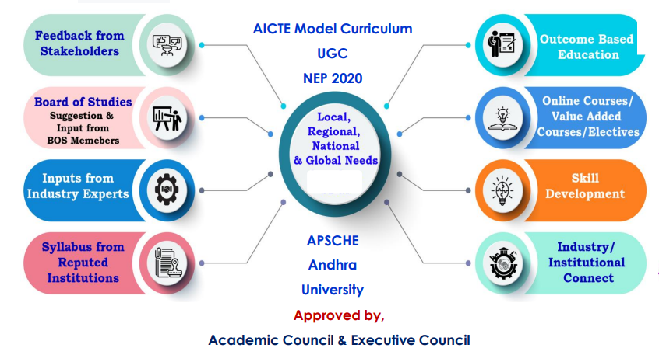
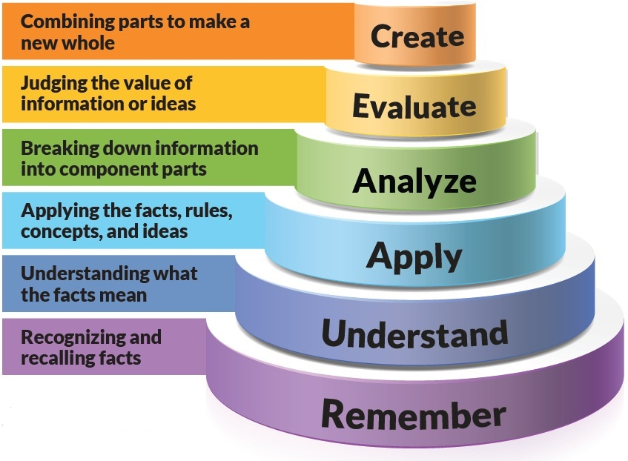
CURRICULAR ASPECTS: Curriculum Design & Development process
Bloom’s Taxonomy
National Education Policy (NEP) In Curriculum:
OBE Framework: Outcome Based Education ensuring that the outgoing students are well equipped with skills
and effective knowledge to pursue their careers in their future endeavors.
Academic Bank of Credits (ABC)
Skill Development: Skill Courses, Skill Labs etc.
Online Education: Online Platforms, E- Content etc.

Slide 31
Feedback for curriculum collected and analysed report
Feedback
Faculty
Students
Employer
Alumni
Student Feedback on Curriculum - 76
Teachers Feedback on Curriculum - 115
Parents Feedback on Curriculum - 42
Alumni Feedback on Curriculum - 33

Slide 32
Feedback for curriculum collected and analysed report

Slide 33
Curriculum Design
BOS of AU-ECE will prepare the Curriculum Schemes by referring to
AICTE/UGC/APSCHE/AU/CBCS/NEP Guidelines
Professional body Guidelines such as CMSI/SAE
Current requirements of the Industry
Stake Holders’ Inputs
Revision of the Curriculum
Industry/Market Requirements
Feedback from Stakeholders
Once in Six Months
Minor Changes In Curriculum
Introduction of New Electives
Academic Flexibility
Choice Based Credit System
Credits
2019-20 Batch - 160 (As per AICTE Guidelines)
2021-22 Batch – 160
Courses offered with 1/2/3/4 credits
Additional credits can be earned from add- on courses
Provision for transfer of credits when the students migrate
Majors & Minors
Vertical mobility within the programmes

Slide 34
Programme Specific Outcomes (PSO’s)
PSOs are statements that describe what the graduates of a specific subject or program should be able to do.
PSO | ECE Graduate will be able to:
PSO 1 | Graduates will be able to apply fundamental knowledge of Electronics and Communication Engineering to identify, investigate and solve various real-life problems in the field of Electronics.
PSO 2 | Graduates will be able to design and develop systems in the emerging electronics and communication allied disciplines to meet out the industry challenges.
PSO 3 | Graduates will be able to demonstrate the leadership qualities and strive for the betterment of organization, environment and society with professional and ethical responsibilities.

Slide 35
Programme Educational Objectives (PEO’s)
 | ECE Graduate will be able to:
PEO 1 | To provide an in-depth knowledge in the fundamental and advanced areas of electronics and communication engineering and there by excel in professional career and/or higher education.
PEO 2 | To train students in the software/hardware design of electronics and communication systems and can promote the development of research activity as well as innovation and entrepreneurship that caters to the need of Industry and Society.
PEO 3 | To develop technical skill set for solving real life problems.
PEO 4 | To develop qualities like creativity, leadership, team work, and professional ethics for contributing towards the growth and development of society.
PEO 5 | To inculcate in students professional and ethical attitude, and an ability to relate engineering issues to broader social context.

Slide 36
Program Outcomes |  | ECE Graduates will be able to
PO 1 | Engineering knowledge | Apply the knowledge of mathematics, science, engineering fundamentals to real time electronics and communication problems.
PO 2 | Problem analysis | Provide solutions for ECE problems by Identify, formulate, review literature, analyze, designing and conducting experiments, interpreting and reporting the results.
PO 3 | Design/development of solutions | Design and develop solutions for complex engineering problems at feasible and optimal solutions that meet the specified needs with appropriate consideration for the public health and safety, and the cultural, societal, and environmental considerations.
PO 4 | Conduct investigations of complex problems | Use research-based knowledge and research methods including design of experiments, analysis and interpretation of data, and synthesis of the information to provide valid conclusions.
PO 5 | Modern tool usage | Select and apply appropriate techniques, resources, and modern engineering and IT tools including prediction and modeling to complex engineering activities with an understanding of the limitations.

Slide 37
PO6 | The engineer and society | Apply contextual knowledge to assess industrial, societal and safety related issues and understand consequent relevance to the professional engineering practice.
PO 7 | Environment and sustainability | Understand the impact of the professional engineering solutions in societal and environmental contexts, and demonstrate the knowledge of, and need for sustainable development.
PO 8 | Ethics | Apply ethical principles and commit to professional ethics and responsibilities and norms of the engineering practice.
PO 9 | Individual and team work | Function effectively as an individual, and as a member or leader in diverse teams, and in multidisciplinary settings.
PO 10 | Communication | Communicate effectively on complex engineering activities with the engineering community and with society at large, such as, being able to comprehend and write effective reports and design documentation, make effective presentations, and give and receive clear instructions.
PO 11 | Project management and finance | Demonstrate knowledge and understanding of the engineering and management principles and apply these to one’s own work, as a member and leader in a team, to manage projects and in multidisciplinary environments.
PO 12 | Life-long learning | Recognize the need for, and have the preparation and ability to engage in independent and life-long learning in the broadest context of technological change.

Slide 38
Course Outcomes (CO’s) – Bloom’s Taxonomy
CO 1 | Understand & Remember | Explain ideas or concepts Classify, describe, discuss, explain, identify, locate, recognise, report, select, translate. Recall facts and basic concepts Define, duplicate, list, memorize, repeat, state.
CO 2 | Apply | Use information in new situations Execute, implement, solve, use, demonstrate, interpret, operate, schedule, sketch.
CO 3 | Analyse | Draw connections among ideas Differentiate, organize, relate, compare, contrast, distinguish, examine, experiment, question, test.
CO 4 | Evaluate | Justify a stand or Decision Appraise, argue, defend, judge, select, support, value, critique, weigh.
CO 5 | Create | Produce new or original work Design, assemble, construct, conjecture, develop, formulate, author, investigate.

Slide 39
CURRICULAR ASPECTS
Link to Syllabus
B.Tech ECE, B.Tech + M.Tech ECE:
2015-2016 - https://drive.google.com/file/d/1PByBPh7PeaS9GX09F5O6Q6nMj2HWA0wa/view?ts=652f9dfe
2019-2020 - https://drive.google.com/file/d/1dOpsxLLK1NhoJ9lTGHGsk2PLY9HsMFLL/view?ts=652f9dd2&pli=1
2020-2021 - https://drive.google.com/file/d/1XtqjqN-v8yY_LffPrs1AlO1eX8fsiZOC/view?ts=652f9e26
2021-2022 - https://drive.google.com/file/d/1yy53fAZeXRx9sveYYtpS2G2OyR65G3N3/view?ts=652f9e4b
2022-2023 - https://drive.google.com/file/d/1_VlAywNywPwuM6_qwpVawZnnNtfHqgqd/view?ts=652f9e6e
List of Courses/topics related to gender, human values, environment and sustainability in the syllabus.
S. No | Course | Course Code | Year/Semester | Credits
1. | Professional Ethics and Moral Values | ENG 1108 | 1st Year – 1st Semester | 0
2. | Environmental Studies | ECE 2206 | 2nd Year - 2nd Semester | 0

Slide 40
List of courses having employability, skill development and entrepreneurship
S.No | Course | Course Code | Year/Semester | Credits
1. | Computer Programming using C & Numerical Methods | ENG 1204 | 1st Year - 2nd Semester | 3
2. | Computer Programming using C & Numerical Methods Lab | ENG 1208 | 1st Year - 2nd Semester | 1.5
3. | Programming skills for problem solving | EC-2109 | 2nd Year- 1st Semester | 2
4. | Python Programming | EC-2208 | 2nd Year- 2nd Semester | 2
5. | OOPS through JAVA | EC-3108 | 3rd Year- 1st Semester | 2
6. | Artificial Neural Network | EC-3205 | 3rd Year- 2nd Semester | 3
7. | Soft Skills | EC-3209 | 3rd Year- 2nd Semester | 2
8. | Computer Networks | EC-4105 | 4th Year- 1st Semester | 3
9. | Industrial Management & Entrepreneurship | EC-4106 | 4th Year- 1st Semester | 3
10. | Internet of Things | EC-4107 | 4th Year- 1st Semester | 2
List of Value-added courses offered during last five years
S. No | Course | Course Code | Year/Semester | Credits
1. | Professional Ethics and Moral Values | ENG 1108 | 1st Year – 1st Semester | 0
2. | Environmental Studies | ECE 2206 | 2nd Year - 2nd Semester | 0
3. | Swatch Bharat
4. | NCC/NSS

Slide 41
Elective Courses
Professional Electives | Global Positioning System | Radar Engineering | Cellular Mobile Communication | Electronic Measurements and Instrumentation | Micro Electronics | EMI/EMC | Digital Image Processing
 | Internet and Web Technology | Information Theory and Coding | Smart Antenna Systems | TV and Satellite Communication System | Transducers and Signal Conditioning | Low Power VLSI Design | Advanced Microprocessors
Open Electives | VLSI Design | Wireless Sensor Networks | Computer Networks | DSP Processors and Architectures | Embedded System Design | Bio-Medical Instrumentation | Mobile Communications
 | FPGA Design | Speech Processing | Control Systems | Internet of Things and Applications | Artificial Neural Networks
HSS | Industrial Management & Entrepreneurship | Organizational Behavior | Operations Research

Slide 42
CO-PO Mapping Table of Antenna Wave Propagation
CO | Overall CO Attainment Level | PO 1 | PO 2 | PO 3 | PO 4 | PO 5 | PO 6 | PO 7 | PO 8 | PO 9 | PO 10 | PO 11 | PO 12
 |  | CO-PO Mapping Levels: 1: Slight (Low), 2: Moderate (Medium), 3: Substantial (High)
CO1 | 3 | 3 | 3 | 2 | 1 |  |  |  |  |  |  |  | 3
CO2 | 3 | 3 | 3 | 2 | 1 |  |  |  |  |  |  |  | 3
CO3 | 3 | 3 | 3 | 3 | 3 | 2 |  |  |  |  |  |  | 3
CO4 | 3 | 3 | 2 | 2 | 2 |  |  |  |  |  |  |  | 2
CO5 | 3 | 3 | 2 | 2 | 2 |  | 2 | 2
Attainment Levels | % of Attainment
1 | 60 – 69
2 | 70 -79
3 | >=80
Final CO Calculation
Course Outcomes | Overall CO Attainment | Level Attained 1/2/3
CO1 | 98.67 | 3
CO2 | 98.67 | 3
CO3 | 98.67 | 3
CO4 | 98.67 | 3
CO5 | 98.67 | 3
 | Final CO attainment of Course Name | 3

Slide 43
PO Attainment Level
 | PO 1 | PO 2 | PO 3 | PO 4 | PO 5 | PO 6 | PO 7 | PO 8 | PO 9 | PO 10 | PO11 | PO 12
Average PO Attainment of ECE Programme | 3.00 | 3.00 | 2.98 | 3.00 | 3.00 | 3.00 | 2.98 | 2.96 | 2.98 | 2.95 | 2.97 | 3.00

Slide 44
Admission Policy
The admission policy is strictly according to the Constitutional provision for reservations for all the programmes and admissions are done through a centralized online counselling process based on the common entrance examination conducted at State Level by regulatory body.
The high demand ratio for a vast spectrum of UG, PG programmes stands testimony to the loftiest priority accorded to Teaching, Learning and Evaluation by University.
The Eligibility Criteria for B.Tech ECE is 10+2 with 45% aggregate and the Accepting exams are EAMCET.
Based on the MOU with Blekinge Institute of Technology Sweden we offer B.Tech + MS Programme in Sweden.
The Admission Criteria for M.Tech ECE is through GATE/PGCET.

Slide 45
Student’s Demand Ratio
Programme name / Academic Year | 2017-18 | 2018-19 | 2019-20 | 2020-21 | 2021-22
B.Tech ECE
Seats Available | 30 | 30 | 50 | 50 | 50
Applications Received | 145428 | 132281 | 133003 | 133072 | 133702
Demand Ratio | 4847 | 4409 | 2660 | 2661 | 2674
M.Tech. (Electronics Instrumentation)
Seats Available | 18 | 18 | 18 | 18 | 18
Applications Received | 26677 | 23831 | 20986 | 40913 | 40913
Demand Ratio | 1482 | 1323 | 1165 | 2272 | 2272
M.Tech. ( Radar & Microwave)
Seats Available | 18 | 18 | 18 | 18 | 18
Applications Received | 26677 | 23831 | 20986 | 20165 | 20165
Demand Ratio | 1482 | 1323 | 1165 | 1145 | 1145
M.Tech (VLSI)
Seats Available | 18 | 18 | 18 | - | 18
Applications Received | 26677 | 23831 | 20986 | - | 20165
Demand Ratio | 1482 | 1321 | 1165 | - | 1120
M.Tech (Biomedical Engineering)
Seats Available | 18 | 18 | 18 | 18 | -
Applications Received | 26677 | 1702 | 20986 | 20165 | -
Demand Ratio | 1482 | 95 | 1165 | 1120 | -

Slide 46
Student’s Diversity
Programme name / Academic Year | 2017-18 | 2018-19 | 2019-20 | 2020-21 | 2021-22
B.Tech ECE
Male | 21 | 18 | 34 | 35 | 35
Female | 16 | 14 | 23 | 22 | 23
Foreign | 02 | 02 | 03 | 03 | 02
Total | 39 | 34 | 60 | 60 | 60
B.Tech + M.Tech ECE
Male | 19 | 18 | 44 | 18 | 16
Female | 11 | 12 | 24 | 09 | 14
Total | 30 | 30 | 30 | 27 | 30
M.Tech. (Electronics Instrumentation)
Male | 07 | 07 | 04 | 07 | 05
Female | 05 | 04 | 06 | 08 | 09
Total | 12 | 11 | 10 | 15 | 14
M.Tech. ( Radar & Microwave)
Male | 10 | 07 | 07 | 08 | 06
Female | 07 | 04 | 08 | 10 | 04
Total | 17 | 11 | 15 | 18 | 10
M.Tech (VLSI)
Male | 08 | 05 | 08 | - | 05
Female | 06 | 04 | 05 | - | 08
Total | 14 | 09 | 13 | - | 13
M.Tech (Biomedical Engineering)
Male | 04 | 05 | 06 | 08 | -
Female | 06 | 03 | 04 | 04 | -
Total | 10 | 08 | 10 | 12 | -

Slide 47
Seats Filled against Reservation Categories
Programme name / Academic Year | 2017-18 | 2018-19 | 2019-20 | 2020-21 | 2021-22
B.Tech ECE
SC | 05 | 05 | 10 | 08 | 09
ST | 02 | 03 | 05 | 03 | 04
OBC | 14 | 17 | 27 | 33 | 38
B.Tech + M.Tech ECE
SC | 06 | 07 | 02 | 01 | -
ST | 01 | 03 | - | - | -
OBC | 15 | 14 | 20 | 12 | 18
M.Tech. (Electronics Instrumentation)
SC | 03 | 01 | 02 | 02 | 05
ST | - | - | - | - | 01
OBC | 07 | 07 | 07 | 12 | 07
M.Tech. ( Radar & Microwave)
SC | 01 | 02 | 06 | 02 | 02
ST | - | 01 | - | 01 | -
OBC | 06 | 04 | 08 | 07 | 08
M.Tech (VLSI)
SC | - | 01 | 02 | - | -
ST | 01 | - | - | - | 02
OBC | 08 | 06 | 11 | - | 11
M.Tech (Biomedical Engineering)
SC | 01 | 01 | 02 | 03 | -
ST | - | 02 | 02 | 01 | -
OBC | 05 | 04 | 05 | 07 | -

Slide 48
Teaching Methods
Teaching
Methods
Teacher
Centred
Instruction
Student
Centred
Learning
Experimental Learning
Problem
Based Learning
Online learning
Project
Based learning
Apart from Lecture Method:
Practical classes/Field study/ industrial visit/Science Exhibition/group discussion/creative writing.
ICT mode teaching.
E-learning ,virtual groups.
Co- Curricular activity for holistic development.
Dance/music/Art & painting for nurturing creativity.
Continuous examination and evaluation.
Mentoring.
Project Preparation & Seminar.

Slide 49
Process for identification of learning levels of the students
Mentoring From Mentors
Mid
Examinations
Assignments
Laboratory
Continuous
Assessment
Semester End
Examinations

Slide 50
Students categorisations (Advanced learners/slow learners)
Students are categorised based on their mid and end-semester marks. Students secured ‘F’ Grade are considered as slow learners.
Activities for slow learners:
Providing handwritten notes for easy understanding.
Giving counselling for slow learners.
Group study methodology.
Giving additional learning materials like question bank, university question papers etc.
Year | Identification and Progress
2nd Year | 9 out of 15 have passed in the supplementary examination after Remedial Classes.
3rd Year | 18 out of 20 have passed in the supplementary examination after Remedial Classes.
4th Year | 03 out of 03 have passed in the supplementary examination after Remedial Classes.
Activities for advanced learners:
Students are motivated to participate in various technical events online courses like Udemy, Course era, Solo learn, Industrial visit, value added course etc, which are held both within and outside the institution.
Encouraging students to participate in research and innovation projects.

Slide 51
Students Result Analysis & Pass Percentage
Pass Percentage of students
Year 2019-20
Programme Code | Programme Name | No. of Students Appeared in the Final Year Examination | No. of Students Passed in the Final Year Examination | Pass Percentage
3-1-12 | B.Tech (ECE) | 66 | 62 | 93.9%
3-5-7 | B.Tech+M.Tech (ECE) | 30 | 22 | 73.33%
3-2-22 | M.Tech (EI) | 14 | 14 | 100%
3-2-23 | M.Tech (R&M) | 14 | 14 | 100%
3-2-24 | M.Tech (BME) | 11 | 11 | 100%
3-2-40 | M.Tech (VLSI) | 09 | 09 | 100%

Slide 52
Number of students undertaking field projects or research projects or internships.
Projects / Internships

Slide 53
Placements & Higher Education
Highest Package: 22 lakhs, G. Usha Mounica
Average Package: 11 lakhs
Lowest Package: 5 lakhs

Slide 54
Students Support:
Scholarship received:
2017-18 | POST METRIC Scholarship | 139 (B.tech), 10(M.Tech) | 10000 (per year)
 | MHRD (AICTE) Scholarship | 34 | 12400(per month)
2018-19 | POST METRIC Scholarship | 128(B.tech), 09(M.Tech) | 10000(per year)
 | MHRD (AICTE) Scholarship | 30 | 12400(per month)
2019-20 | Jagananna vidya deevina and vasathi deevina | 168(B.tech), 14(M.Tech) | 30000(per year)
 | MHRD (AICTE) Scholarship | 29 | 12400(per month)
2020-21 | Jagananna vidya deevina and vasathi deevina | 102(B.tech), 34(M.Tech) | 30000(per year)
 | MHRD (AICTE) Scholarship | 31 | 12400(per month)
2021-22 | Jagananna vidya deevina and vasathi deevina | 98(B.tech), 25(M.Tech) | 30000(per year)

Slide 55
Students Support
The department encourages students in personality development, skill development, employability and progression to higher education through a strong support system which includes Placement and Career Counselling Cell, Skill Development Centres, Office of Dean Student Affairs, Office of Dean Foreign Students. Physical Education Department, Students’ Societies, Women Grievance Redressal Committee, Anti-Ragging Committee and a registered AU Alumni Association headed by GMR group Chairman GM Rao.
Campus Recruitment Training
Year | Name of the resource person and corresponding address | Name of the Activity conducted by the HEI to offer guidance for career counselling offered by the institution during the last five years
 |  | Details of career counselling | Number of students attended / participated
2019-20 | Suraj Chawla | CRT classes | 92

Slide 56
Skill Development Program
Name of the capability enhancement program | Date of implementation (DD-MM-YYYY) | Number of students enrolled | Name of the agencies/consultants involved with contact details (if any)
Soft Skills | 20-09-2021 | 143 | Andhra University
Soft Skills | 14-12-2020 | 90 | Andhra University
Soft Skills | 07-01-2019 | 92 | Andhra University
RES-APIS initiative Program for PG & Research Scholars | 23-07-2019 | 60 | Conceptual Research Experience
SIEMENS Skill Development | 29-07-2019 | 90 | Siemens Industry Software Pvt. Ltd.
Guidance for NET/SLET/GRE and other competitive examinations
The faculty of the ECE department advise and guide students U.G and P.G students to pursue higher education and take special classes to achieve a good score in competitive exams.

Slide 57
Awards and Recognition
Name of the awards/ for research/ innovation by exams / students/ scholars/ student( Best poster/PPT/Meber-awards) | Name of the Awardee | Name of the Awarding Agency with contact details | Year of Award | Category- institution/teacher/research scholar/student
Essay Writing | A Siva Santoshi | ABEYAANTRIC 2K17 | 2017 | Student
Power Point Presentation | B. Jasmine Rose | AU (Technova ) | 2018 | Student
Innovative technology projects | P. Preetam Raj | Jnanabheri | 2018 | Student
Automatic streetlighting system | Tarun | AU | 2019 | student
Automatic fire sensor model | S mounika | AU | 2019 | student
IoT | Md Ayesha | AU | 2019 | Student
Topper of the Year 2022 | T. Vishnu Priya | Prof. K. Rama Sudha | 2022 | Student
Every Year topper of the outgoing batch will be receiving Best Outstanding Student Award by Prof. K. Rama Sudha on the remembrance of Former Prof. K. Venkatrao, from the department of ECE.

Slide 58
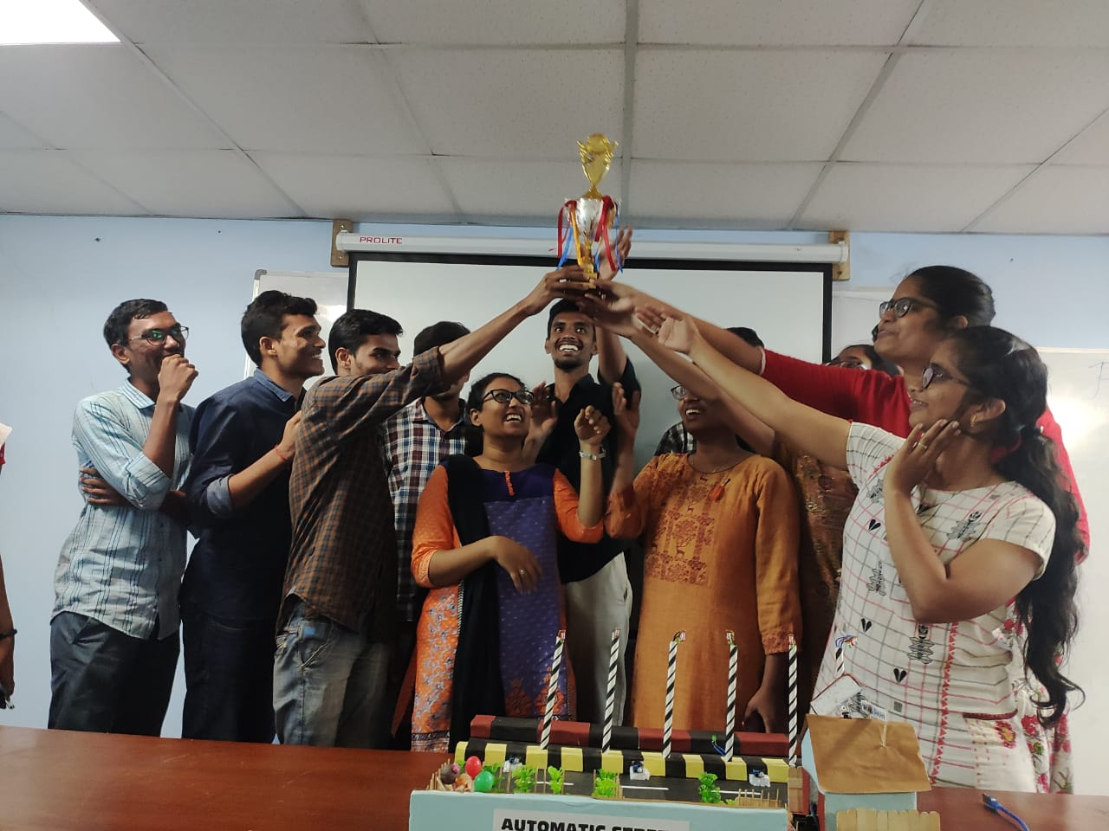
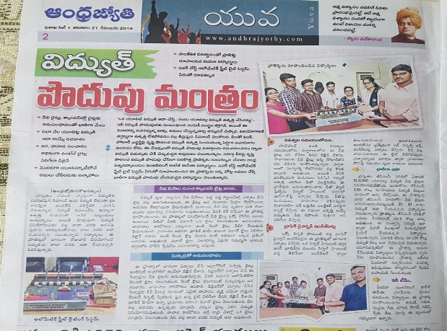
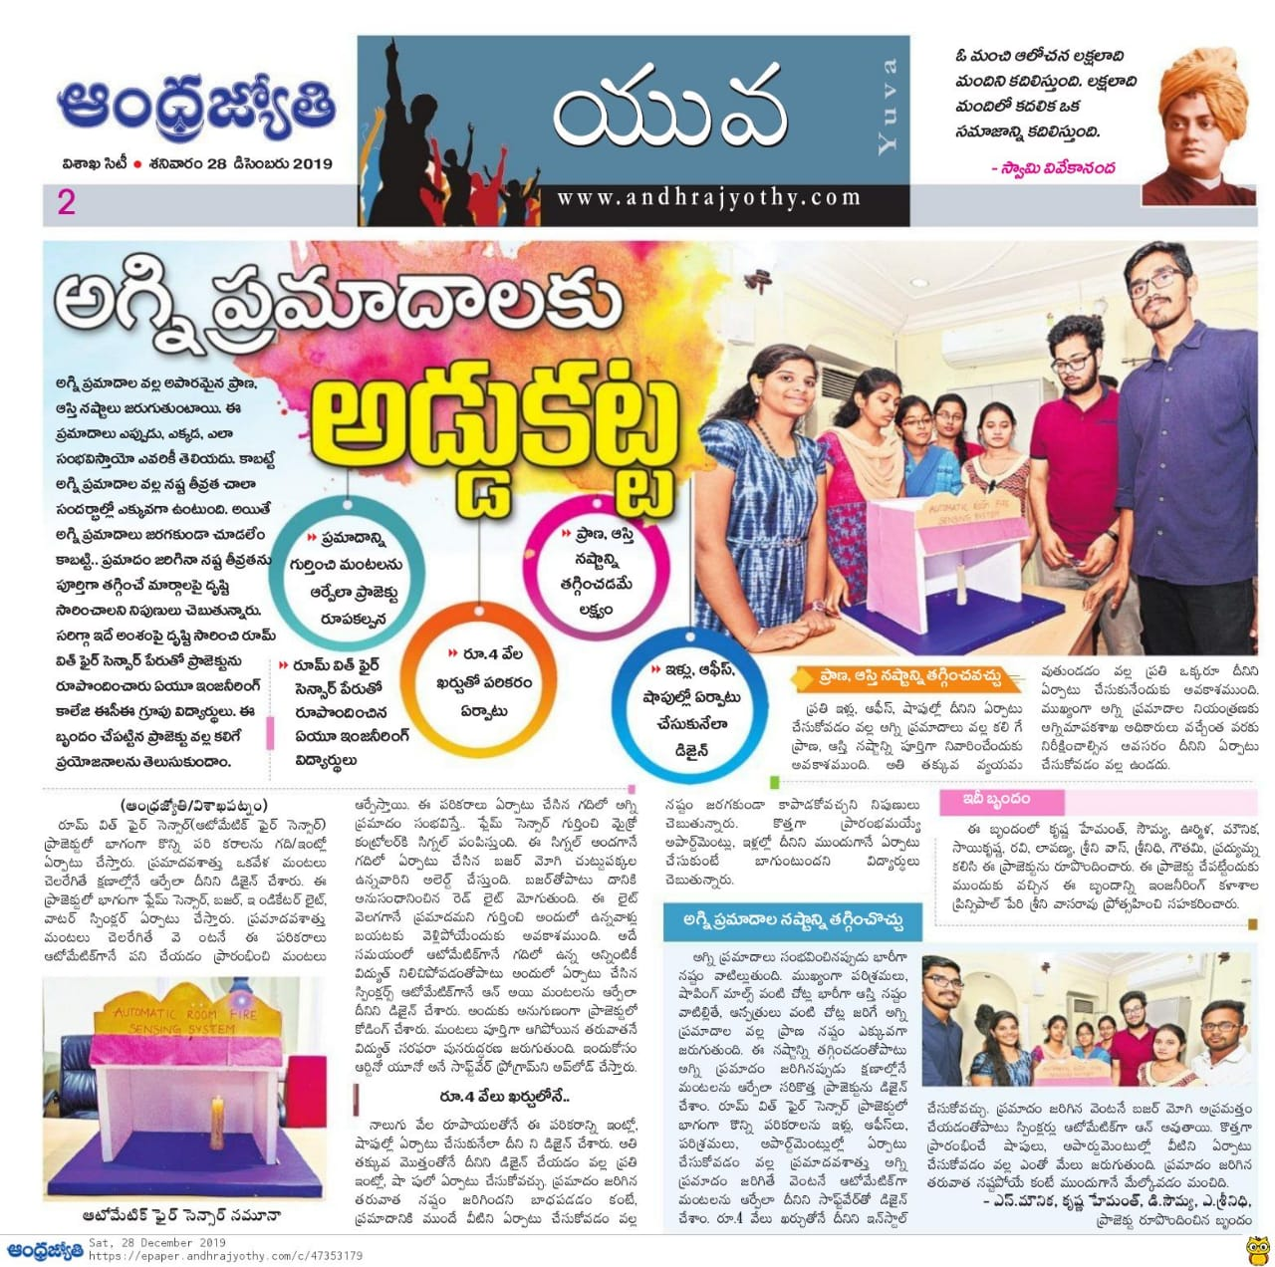
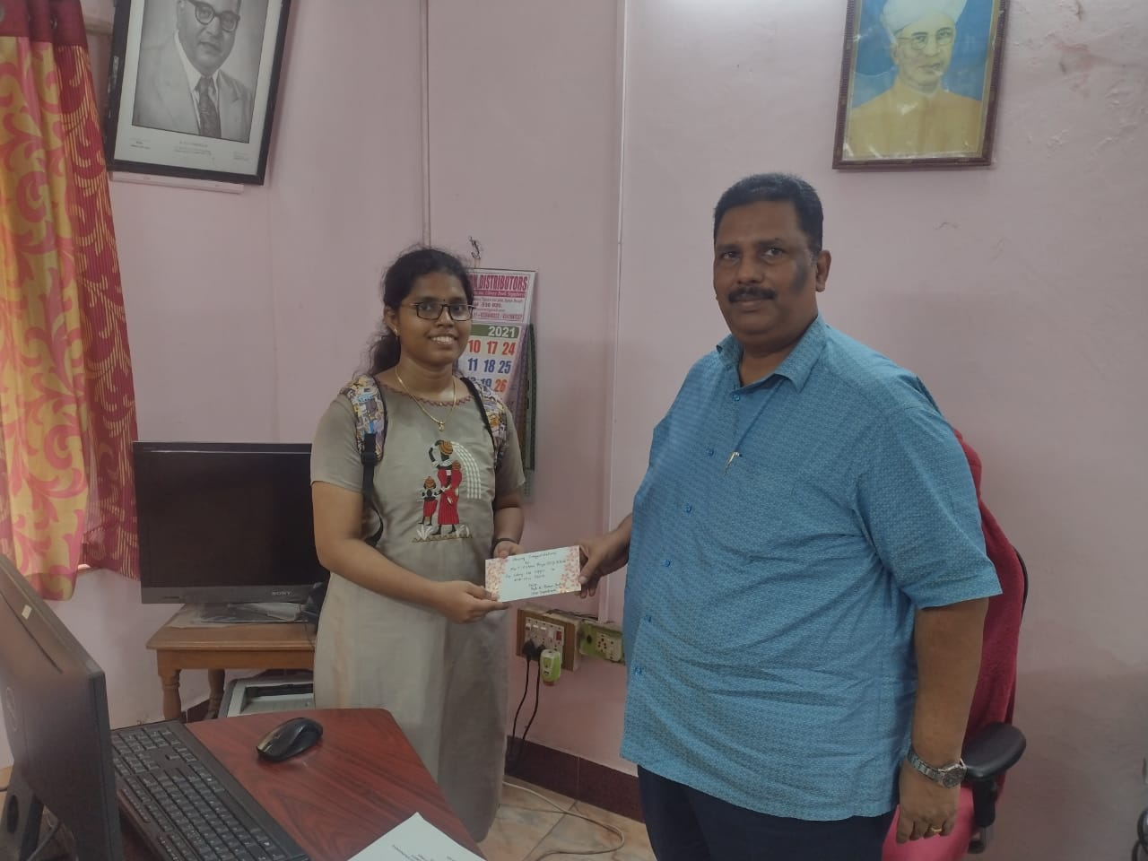
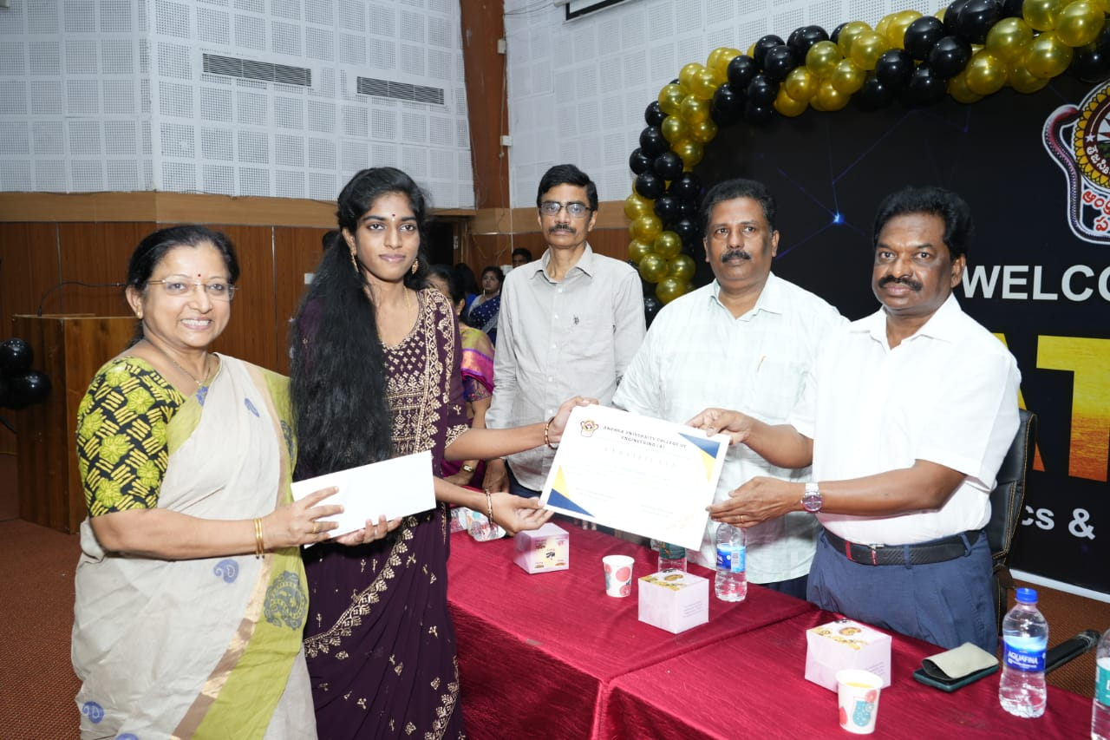
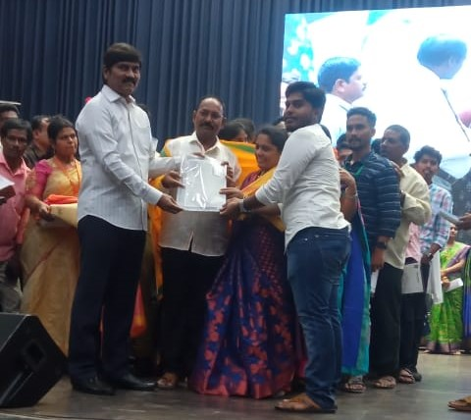
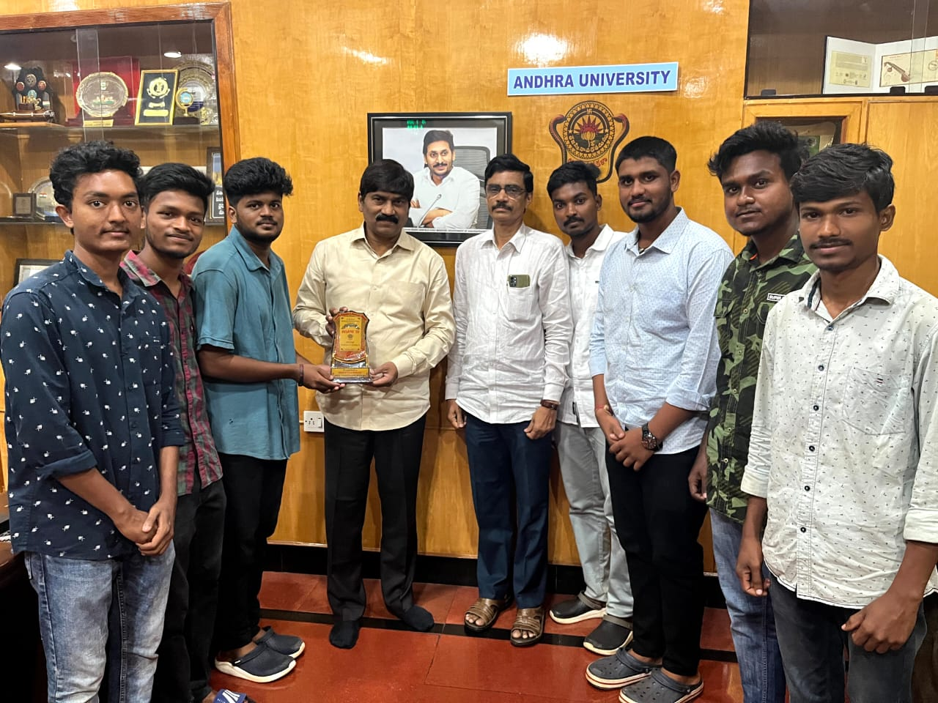
Awards and Recognition
Automatic Street lighting System
Automatic Fire Sensor
Best Outstanding Student
Best Outstanding Student
Achievers Day
Eclantic 23

Slide 59
Student to Mentor Ratio
The mentor-mentee system that has been in practice in the department has benefitted the students enormously.
It has helped both the quick learners and the slow learners by equipping them with the skills required in completing the program and for the overall personality development through participation and through peer learning.
Programme/Academic Year | 2017-18 | 2018-19 | 2019-20 | 2020-21 | 2021-22
B.Tech (ECE) | 153 | 142 | 176 | 193 | 214
B.Tech+M.Tech (ECE) | 120 | 120 | 120 | 117 | 117
M.Tech (EI) | 25 | 28 | 21 | 25 | 29
M.Tech (R&M) | 32 | 23 | 26 | 33 | 28
M.Tech (VLSI) | 29 | 23 | 22 | 13 | 13
M.Tech (BME) | 20 | 18 | 18 | 22 | 12
Total No. of Students | 379 | 354 | 383 | 403 | 413
Total No. of Mentors | 26 | 27 | 22 | 26 | 23
Student – Mentor Ratio | 14 | 13 | 17 | 16 | 18

Slide 60
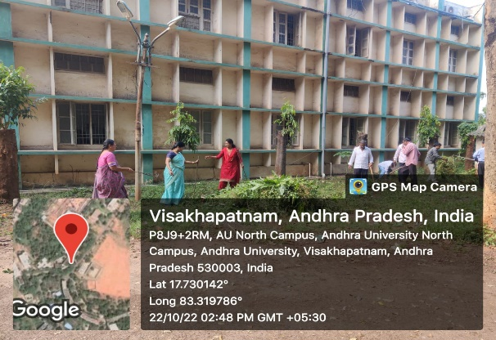
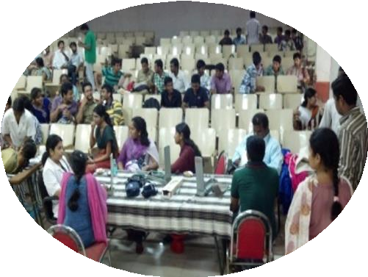
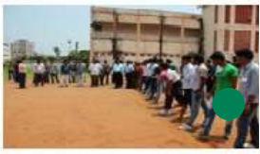
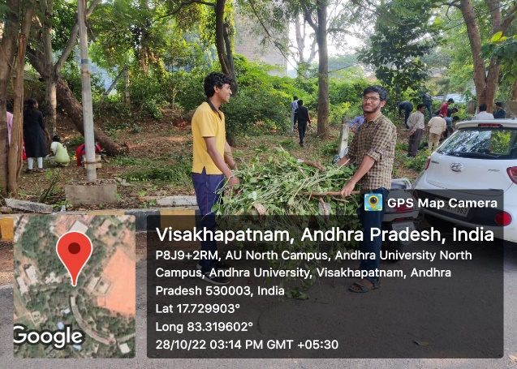
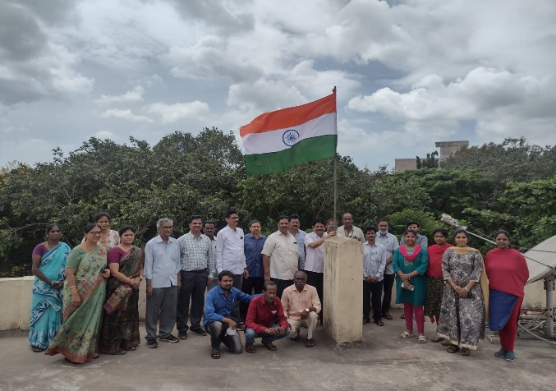
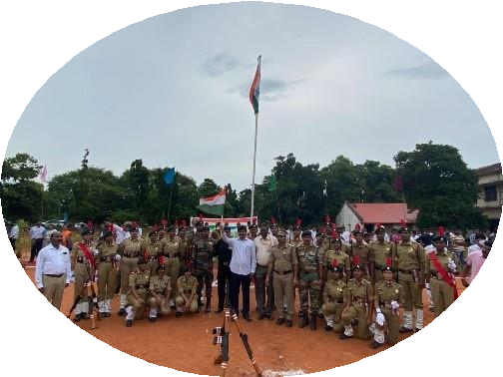
Student Council Activities
Swatch Bharat
Blood Donation
NSS Day
Independence Day
Republic Day

Slide 61
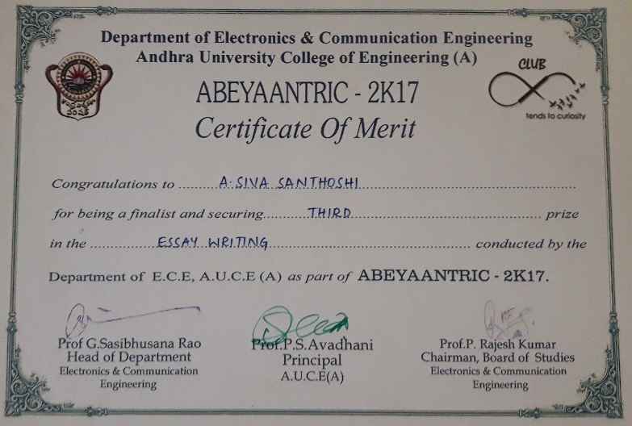
Student Curricular & Co-curricular Activities
Certificate of Merit in Abeyaantric-2K17
Certificate of Merit in Jnanabheri
Certificate for Best Performance in IOT 2019

Slide 62
Innovation, Incubation & Start-up
Department organised Startup Talks with Mr. Ravi Eswarapu, CEO of a-HUB.
To encourage students to become Entrepreneurs.
To encourage students to take-up Research and Development as career options.
Department organised MATLAB HACKATHON to extract the problem solving ability of the student by providing a competitive environment.
Department organised an innovative session on Low Code Technologies and Opportunities in Low Code by Amal Raj. P, COO-HEADFITTED & Founder, THEDIGIFAC.

Slide 63
Student Centric Policies & Utilization
Facilities
Recognition
Best Outstanding Student with Cash Award.
Financial Assistance
Sports and Cultural Activities, Publishing Research papers, etc.,
Grievance Cell, NCC & NSS, A-Hub, etc.,
Membership in professional Bodies.
Digital Initiatives
Digital Libraries, Web based student management system, OBE Analysis, Examination Automation , etc.,
Training and Counseling
Career Guidance, Training and Placement, Internships, NPETL& MOOCS, etc.,

Slide 64
Department Infrastructure & Resources
ICT & Online Resources
Room number or Name of classrooms/Seminar Hall with LCD / Wi-Fi/LAN facilities with room numbers | Type of ICT facility
Room no. 1 ( 2/4 B.Tech ) | Smart TV,LCD Projector
Room no. 2 ( 3/4 B.Tech ) | Smart TV, LCD Projector
Room no. 3 ( 2/6 B.Tech ) | Smart TV,LCD Projector
Room no. 4 ( 3/6 B.Tech ) | Smart TV,LCD Projector
Room no. 5 ( 4/6 B.Tech ) | LCD Projector, Wi-Fi/LAN
Room no. 6 ( M.Tech R&M ) | Wi-Fi/LAN
Room no. 7 ( M.Tech E&I ) | LCD Projector, Wi-Fi/LAN
Room no. 8 ( M.Tech Bio Medical ) | Wi-Fi/LAN
Room no. 9 ( M.Tech VLSI ) | Wi-Fi/LAN
Smart Class Room ( 4/4 B.Tech ) | Smart projector and smart board, Wi-Fi/LAN, audio video
Seminar Hall 1 | LCD Projector, smart TV, Wi-Fi/LAN, audio video
Seminar Hall 2 | LCD Projector, Wi-Fi/LAN, Audio

Slide 65
Department Infrastructure & Resources:
B.Tech Class Room
Seminar Hall
Smart Class Room
B.Tech Class Room
B.Tech Class Room
M.Tech Class Room

Slide 66
Department Infrastructure & Resources:
LICA-PDC/EDC Lab
AC/DC Lab
Microprocessor Lab
SS & DSP Lab
Instrumentation Lab
DIC/HDL Lab

Slide 67
Department Infrastructure & Resources:
Funds / Grants received from non-government bodies, individuals, philanthropists during the last five years for development and maintenance of infrastructure
Year | Name of the government funding agencies | Purpose of the Grant | Funds/ Grants received (INR in lakhs)
2019 | TEQIP Phase III | Procurement of Equipment to Communication Lab in ECE Department | 8,61,231/-
Equipment in Communications lab such as CRO’s, Function Generators, AM-FM Kits, etc.,

Slide 68
Department Infrastructure & Resources:
Department library/e -resources/Wi-fi/internet facilities/Bandwidth/link to library e resources
Andhra University is having 1GBPS leased line.
IEEE & DELNET, Central Funding ( E- Sodhsindhu, E-Sodhganga) J-Gate, Inflibnet.
https://www.andhrauniversity.edu.in/library
E-Journals – IEEE, ASME etc.
Apex Journals
DELNET - http://delnet.in/
SHODHGANGA - https://shodhganga.inflibnet.ac.in/
SHODHGANGA – Electronics and Communication Engineering - 190

Slide 69
Department library/e -resources
New books acquired and E-content development
Journals | IEEE and DELNET | 6640
E – Journals | IEEE and DELNET | 4366
E- Books | IEEE and DELNET | 3570
E-ShodhSindhu | Free Access | Free Access
Shodhganga | Free Access | Free Access
Databases | Free Access | Free Access
Digital Library is Available for accessing E-journals (IEEE, Elsevier, Springer etc..)
Total No. of Books : 6640
Total No. of Reference Books : 1735
Total No. of Magazines : 28
All M.Tech & Ph.D Theses are available from 2005 onwards.

Slide 70
Academic Audit, Quality Audit Records
IQAC is instrumental in implementing several Quality measures through internalization of quality culture and adopting best practices like Green Campus, Energy and Environment audits, Academic audits annually, ISO9001:2015 Internal and External Surveillance audits,
Academic Audit From 2017-2022

Slide 71
Institution values and Social responsibilities:
Gender Sensitization
All the Female students in the department are accessing Disha App.
Department strictly follows for redressal of student grievances including sexual harassment and ragging.
Separate Counselling sessions are conducted for female students.
Sample of Disha App Registration

Slide 72
Anti-Ragging
Andhra University student councils play a vibrant medium that emphasizes strengthening their leadership qualities, co-circular activities.
The councils are much associated with anti-ragging committees, internal student complaints, encouraging active interaction with university administration to cope up with student grievances.
It further facilitates the holistic environment in the university and it acts as a bridge between university authorities and student community Details of student grievances including sexual harassment and ragging cases.

Slide 73
Institution values and Social responsibilities
E-waste management:
The Institution as undertaken a number of E-waste Management initiatives with the objective of creating an eco-friendly environment in the campus.
E-waste such as computers and its peripherals are upgraded regularly to continue usage and to avoid its wastage.
Department follows solid waste and E-waste management system.
Waste Management

Slide 74
Institution values and Social responsibilities
The water conservation facilities like rain water harvesting, bore wells and bunds, open well recharge, Construction of tanks and bunds, waste water recycling and effective water distribution system.
Green Campus
Department of ECE is surrounded by well maintained garden.
Every Saturday, Swachh Bharat campaign is held, and students along with teaching and non teaching faculty participate in maintain the greenery outside the department.

Slide 75
Institution values and Social responsibilities
Disable friendly Environment
The department of ECE, has been renovated to be easily accessible by the disabled personnel.
The department has disabled friendly, barrier free environment with built-in ramps to facilitate differently abled staff and students.
There are accessible ramps with handrail in the entrance of the department and the classrooms.
Accessible ramps with handrail in the entrance
Accessible ramps to classrooms

Slide 76
Best Practice
Students are encouraged to involve in Innovation activities like Hackathon and also the department is organising interactive sessions with incubation and start-up centers.
Our students are not only trained for academic excellence but also moulding them as a Holistic individuals.
Every Year topper of the outgoing batch will be receiving Best Outstanding Student Award.
Interaction between Department and International Institute (BIT) Sweden and Industries Indian Army, Naval Dockyard and Bureau of Indian Standards (BIS) has been provided for students as well as faculty.
Progressive Plan
To meet the curriculum with advanced technology requirements.
To improve the state of the art in the field of RF & Microwave Engineering, wireless communications and VLSI Signal Processing.
Exposing the students to a variety of self-instructional, learner-friendly modes.

Slide 77
Thank You

