Slide 1
Department of Information Technology & Computer Applications AUCE, Andhra University, Visakhapatnam
HEARTY WELCOME
Hon’ble Chairperson and Members of NAAC Peer Team

Slide 2
Overview
Vision & Mission
Department Profile
Curricular Aspects
Teaching & learning
Research, Innovation and Extensions
Student support and Progression
Infrastructure and learning resources
Institutional values and best practices
Progressive plans
Department of Information Technology & Computer Applications

Slide 3
VISION
To facilitate transformation of students into good human beings, competent professionals, focusing on assimilation, generation and dissemination of knowledge in the field of Information Technology and Computer Applications.
Department of Information Technology & Computer Applications

Slide 4
MISSION
Imparting quality education through well-designed curriculum in tune with the challenging needs of the industry and to develop innovative and ethical professionals fit for globally competitive environment.
Carry out Research and Development in computer science and engineering and in leveraging state of the art technologies to serve the societal needs.
Developing effective interactions among faculty and students and foster networking with alumni, industries for mutual benefit.
Department of Information Technology & Computer Applications

Slide 5
QUALITY POLICY
Excellence in teaching, research and consultancy by:
Imparting globally focused education
Creating world-class professionals
Establishing synergic relationships with industry and society
Developing state of art infrastructure and well-endowed faculty
Imparting knowledge through teamwork and incessant efforts.
Department of Information Technology & Computer Applications

Slide 6
Department Profile

Slide 7
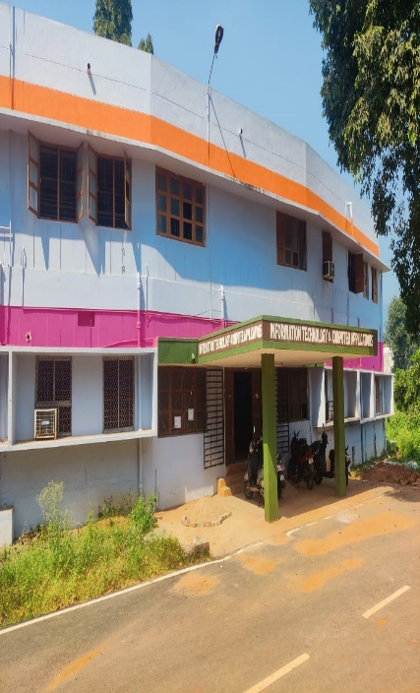
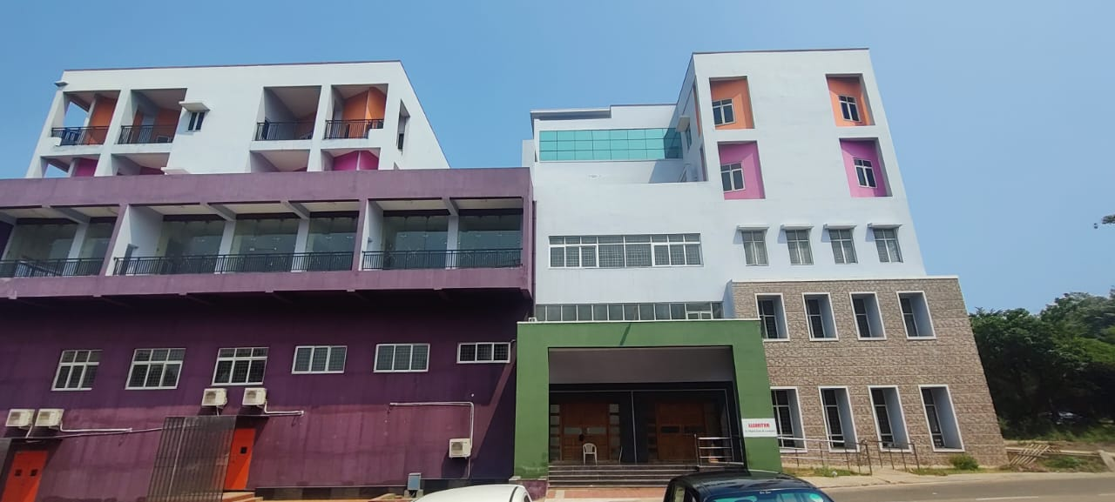
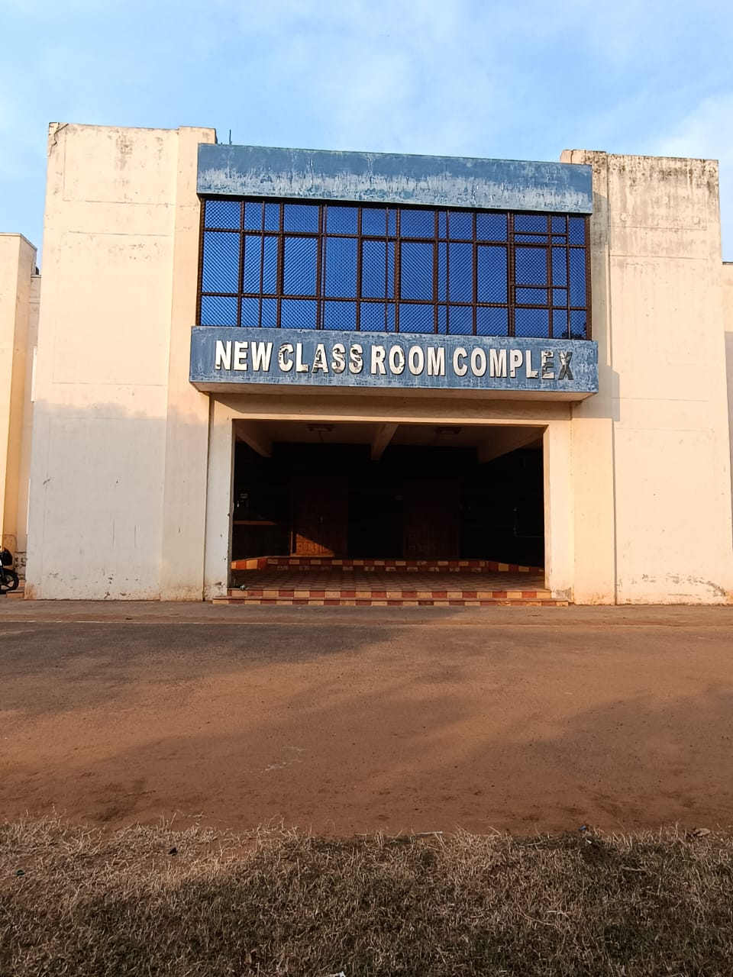
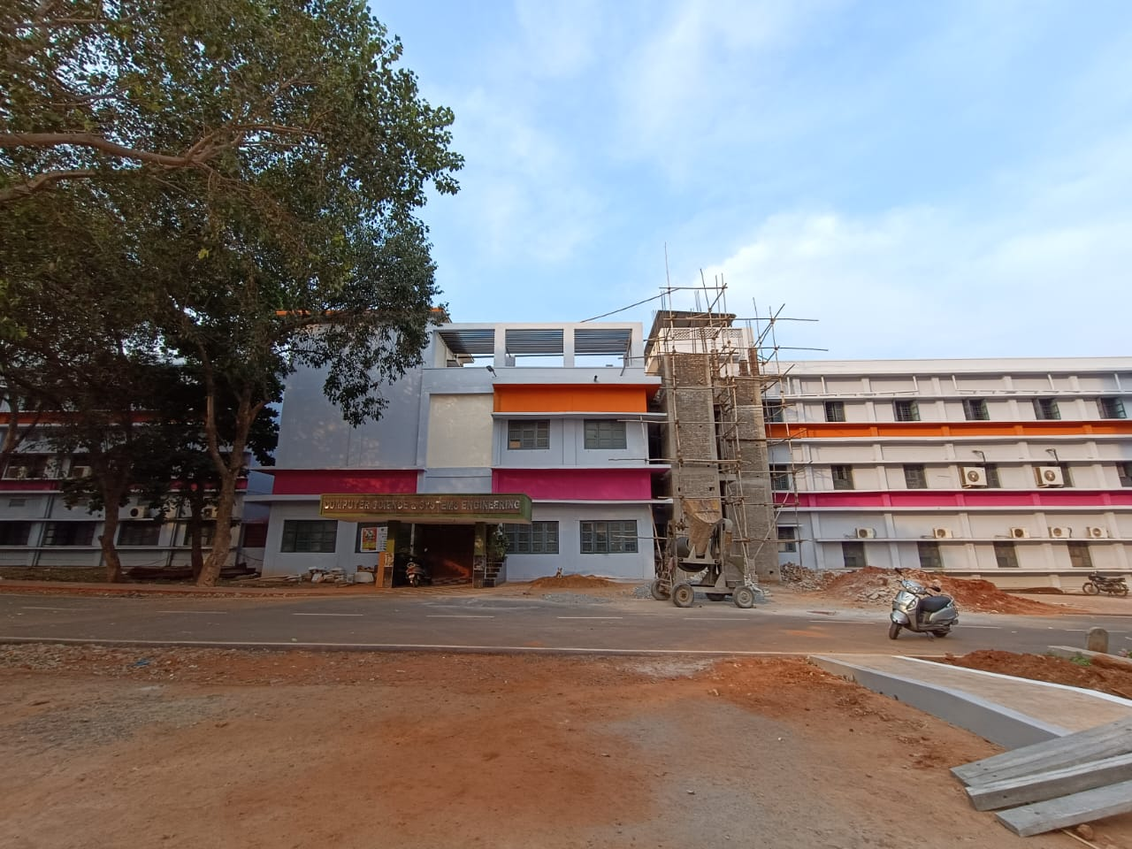
Department Profile
The Department of Information Technology and Computer Applications was formed in the academic year 2018-2019. This department offers one U.G. program (B.Tech. -Information Technology) , Three P.G. programs (M.Tech. - Information Technology, Master of Computer Applications (MCA), M.Sc. (Computer Science) and Doctoral programme(Ph.D).
The Department of Information Technology and Computer Applications has designed a curriculum to apply concepts of Information Technology in collaboration with various inter disciplinary areas.
Department of Information Technology & Computer Applications

Slide 8
Department Profile & Milestone
Programs | Sanctioned Intake in 2022-23 | Students Strength in 2018-22
1. B.Tech. Information Technology | 50 | 338
2. M.Tech. Information Technology | 18 | 68
3. Master of Computer Applications | 40 | 291
4. Master of Science ( Computer Science) | 50 | 245
Profile
Started M. Sc (CS)
1986
1987
Started M. C. A
2001
Started M.Tech.
Information Technology
Started B.Tech (Information Technology)
Milestone
2018
2021
Started Ph.D
Department of Information Technology & Computer Applications

Slide 9
PEO’s
B.Tech (Information Technology)
Programme Educational Objectives (PEO’s) | Description
PEO1 | Apply Concepts of Computer Science blended with mathematics and engineering to model computing systems
PEO2 | Based on requirement specifications, Design, implement, test and maintain software systems.
PEO3 | Communicate effectively with team members, engage in applying technologies and lead teams in industry
PEO4 | Assess the Systems from quality, security, privacy, cost, utility, etiquette and ethics view point
PEO5 | Adapt to changing professional and societal needs by engage in lifelong learning, and career enhancement.
9
9
Department of Information Technology & Computer Applications

Slide 10
Curricular Aspects
The Department adheres to curriculum designed by the University to enhance quality in teaching, research, extension and outreach activities.
By adopting the Choice Based Credit System, Outcome Based Education and NEP 2020.
All the programs have well-defined Program Educational Outcomes, Program Outcomes, Program Specific Outcomes and Course Outcomes.
Board of Studies (BoS) examines the needs of the stakeholders and inducts the same in the syllabi of the respective programs.
Curriculum is designed with a focus on proficiency in the subject along with employability, skill development and mold them to entrepreneurs.
10
10
Department of Information Technology & Computer Applications

Slide 11
OBE Framework
OBE FRAMEWORK
The vision , Mission statements of Department are aligned with Institute statements , PO’s of NBA .
The Department also has PEO ,PSO and COs for each course.
OBE ‘s are implemented in Teaching- Learning process.
The COs are assessed as per the Revised Bloom’s Taxonomy.
The Course Outcomes are then mapped onto Program Outcomes (POs) and Program Specific Outcomes (PSOs).
POs and PSOs are on a scale 1 (Low) to 3 (High).
Course Objectives and Outcomes are pedagogically designed and mapped using a mixture of Direct and Indirect methods considering elements of Employability, Entrepreneurship, Skill Development, relevant to Local, National, Regional, Global needs, Gender, Environment and Sustainability, Human Values, and Professional Ethics.
11
Department of Information Technology & Computer Applications
11

Slide 12
UG Programme Scheme and Syllabi
S. No. | Programme Code | Programme | Link to Course Syllabus
1. | 3-1-11 | B.Tech – Information Technology Syllabus W.E.F. 2021-2022 Academic year | https://www.andhrauniversity.edu.in/syllabus/new/btech-it-final2122.pdf
12
12
Department of Information Technology & Computer Applications

Slide 13
PG Programme Scheme and Syllabi
S. No. | Programme Code | Programme | CodesLink to Course Syllabus
1. | 3-2-16 | M.Tech. Information Technology (IT) Syllabus W.E.F. 2019-2020 Academic year | https://www.andhrauniversity.edu.in/syllabus/new/final%20proof%20it.pdf
2. | 3-2-20 | Master of Computer Applications Syllabus W.E.F. 2020-2021 Academic year | https://www.andhrauniversity.edu.in/syllabus/new/mca-20-21.pdf
3. | 4-2-21 | Master of Science (Computer science) Syllabus W.E.F. 2016-2017 Academic year | https://www.andhrauniversity.edu.in/syllabus/new/CS-FINAL16-17.pdf
13
13
Department of Information Technology & Computer Applications

Slide 14
Curricular Aspects (Cont..,)
Student Project works
14
Department of Information Technology & Computer Applications

Slide 15
Feedback Forms
S.No. | Feedback for curriculum given by | Number of corrected feed backs
1 | Students | 46
2 | Parents | 28
3 | Faculty | 40
4 | Alumni feedbacks | 40
Department of Information Technology & Computer Applications

Slide 16
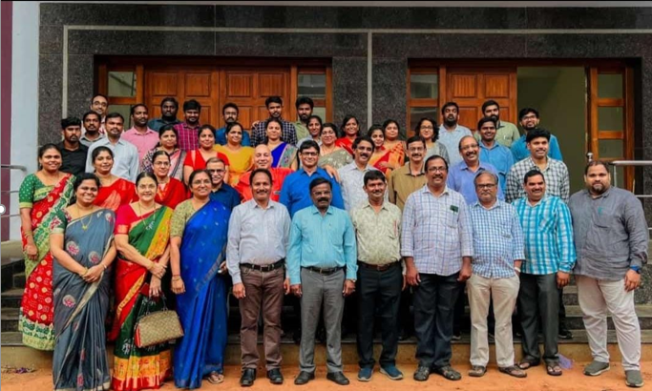
Teacher’s Profile
S.No. | Name | Designation | Qualification | Experience in years
1 | Dr. Kunjam Nageswara Rao | Professor & HoD, | Ph.D. | 23yrs
2 | Dr. M. Ramjee | Adjunct Professor | Ph.D. | 35 yrs
3 | Dr. B. Prakash | Professor (Ad-hoc) | Ph.D. | 18 yrs
4 | Dr. A. Gauthami Latha | Professor (Ad-hoc) | Ph.D. | 15 yrs
5 | Mr. V. Nagaraju | Assistant Professor (contract) | M.Tech | 16 yrs
6 | Dr. K. Swapna | Assistant Professor (Ad-hoc) | Ph.D. | 13 yrs
7 | Dr. Priyanka Kumari Bhansali | Assistant Professor (Ad-hoc) | Ph.D. | 11 yrs
8 | Ms. I. Grace Asha Roy | Assistant Professor (Ad-hoc) | M.Tech | 6 yrs
Department of Information Technology & Computer Applications

Slide 17
Teacher’s Profile
S.No. | Name | Designation | Qualification | Experience in years
9 | Dr. D. Sowjanya | Assistant Professor | Ph. D | 5 yrs
10 | Dr. P. Janardhan Rao | Assistant Professor | Ph. D | 5 yrs
11 | Mrs. M. Prashanthi | Assistant Professor | M.Tech | 6 yrs
12 | Ms. M.P. Radha Kumari | Assistant Professor | M.Tech | 6 yrs
13 | Ms. N .M. Jasmin | Assistant Professor | M.Tech | 5 yrs
14 | Mr. M. Raghuveer | Assistant Professor | M.Tech | 8 yrs
15 | Mr. K. Yogendra | Assistant Professor | M.Sc, (Ph.D) | 3 yrs
16 | Ms. P. Rachel | Assistant Professor | M.Tech | 3 yrs
17 | Ms. D. Divya | Assistant Professor | M.Tech | 3 yrs
18 | Mr. Ch Sampath Kumar | Assistant Professor | M.Tech | 8 yrs
Department of Information Technology & Computer Applications

Slide 18
Teacher’s Profile
S.No. | Name | Designation | Qualification | Experience in years
19 | Ms. K. Prathima | Assistant Professor | M. Tech | 4 yrs
20 | Ms. P. Praveena | Assistant Professor | M.Tech | 6 yrs
21 | Mr. K. Manikanth | Assistant Professor | M.Tech | 3 yrs
22 | Mrs. S. Sirisha | Assistant Professor | M.Tech | 3 yrs
23 | Mr. K. Venkatesh | Assistant Professor | M.Tech | 7 yrs
24 | Ms. B. Sunitha | Assistant Professor | M.Sc, (Ph.D) | 2 yrs
25 | Ms. Venkata Lavanya | Assistant Professor | M.Sc, (Ph.D) | 2 yrs
26 | Ms. P. S. R. Vaghdevi | Assistant Professor | M.Tech | 2 yrs
27 | Mr. S. Sandeep | Assistant Professor | M.Tech | 1 yr
28 | Mr. B. V. Sai Karthik | Assistant Professor | M. Tech | 1 yr
Department of Information Technology & Computer Applications

Slide 19
Student Categorization – Advanced Learners & Slow Learners
Programs For Advanced Learners
Advanced learners are encouraged to attend workshops, interface with specialists in the field.
Workshops (IoT, Cloud Computing, Cryptography)
Skill Development through Web blogs
The faculty members/mentors concerned interact with the advanced learners to identify their competencies and special interest to develop plans for their involvement and participation in various challenging programmes
TECHNOGRAIL, HACKATHON, PERISCOPE
The advanced learners are encouraged to acquire advanced skills in the subject through various online platforms and completion of additional courses.
NPTEL, SWAYAM, MOOC courses, Coursera
Advanced learners: who scored more than 80%.
Slow learners: who scored below 50% and failed students
For 2018-2022 batch
During Academic Year | No. of Students (Advanced Learners)
2018-19 | 11
2019-20 | 09
2020-21 | 13
2021-22 | 13
Programs For Slow Learners
Slow learners are provided support with remedial classes at 4 hours per week.
Assignments and handouts are given to slow learners
Counselling through mentor mentee system.
Additional focus on slow learners and their performance is checked regularly.
During Academic Year | No. of Students (Slow Learners)
2018-19 | 09
2019-20 | 08
2020-21 | 03
2021-22 | 02
Department of Information Technology & Computer Applications
19

Slide 20
Student Demand Ratio
ACADEMIC YEAR: 2018-19
ACADEMIC YEAR: 2019-20
S.No | Programme Code | Programme Name | Number of seats available/ sanctioned | Number of eligible applications received | Number of students admitted | Demand Ratio
1 | 3-1-11 | B.TECH. (INFORMATION TECHNOLOGY) | 60 | 122006 | 60 | 1821
2 | 3-2-16 | M.TECH. (INFORMATION TECHNOLOGY) | 21 | 20786 | 14 | 999
3 | 3-2-20 | M. C. A (MASTER OF COMPUTER APPLICATIONS) | 39 | 20986 | 38 | 538
4 | 4-2-21 | M.Sc. (COMPUTER SCIENCE) | 44 | 20786 | 44 | 476
S.No | Programme Code | Programme Name | Number of seats available/ sanctioned | Number of eligible applications received | Number of students admitted | Demand Ratio
1 | 3-1-11 | B.TECH. (INFORMATION TECHNOLOGY) | 73 | 133003 | 73 | 1821
2 | 3-2-16 | M.TECH. (INFORMATION TECHNOLOGY) | 21 | 20986 | 13 | 999
3 | 3-2-20 | M. C. A (MASTER OF COMPUTER APPLICATIONS) | 39 | 20986 | 38 | 538
4 | 4-2-21 | M.Sc. (COMPUTER SCIENCE) | 44 | 20986 | 44 | 476
Department of Information Technology & Computer Applications

Slide 21
Student Demand Ratio
ACADEMIC YEAR: 2020-21
ACADEMIC YEAR: 2021-22
S.No | Programme Code | Programme Name | Number of seats available/ sanctioned | Number of eligible applications received | Number of students admitted | Demand Ratio
1 | 3-1-11 | B.TECH. (INFORMATION TECHNOLOGY) | 59 | 133072 | 59 | 2255
2 | 3-2-16 | M.TECH. (INFORMATION TECHNOLOGY) | 16 | 20165 | 16 | 1260
3 | 3-2-20 | M. C. A (MASTER OF COMPUTER APPLICATIONS) | 43 | 20165 | 43 | 468
4 | 4-2-21 | M.Sc. (COMPUTER SCIENCE) | 50 | 1690 | 50 | 33
S.No | Programme Code | Programme Name | Number of seats available/ sanctioned | Number of eligible applications received | Number of students admitted | Demand Ratio
1 | 3-1-11 | B.TECH. (INFORMATION TECHNOLOGY) | 54 | 133072 | 54 | 2464
2 | 3-2-16 | M.TECH. (INFORMATION TECHNOLOGY) | 18 | 20165 | 18 | 1120
3 | 3-2-20 | M. C. A (MASTER OF COMPUTER APPLICATIONS) | 57 | 20165 | 57 | 353
4 | 4-2-21 | M.Sc. (COMPUTER SCIENCE) | 52 | 1690 | 52 | 387
Department of Information Technology & Computer Applications

Slide 22
Seats filled against Reserved categories
COURSE | YEAR | Number of seats earmarked for reserved category as per GOI or State Government rule |  |  |  |  | Number of students admitted from the reserved category
 |  | SC | ST | OBC | Gen | Others | SC | ST | OBC | Gen | Others
B.Tech(Information Technology) | 2018-19 | 8 | 7 | 15 | 30 | 0 | 7 | 2 | 15 | 31 | 5
 | 2019-20 | 10 | 8 | 18 | 36 | 1 | 10 | 8 | 18 | 36 | 1
 | 2020-21 | 8 | 3 | 14 | 30 | 4 | 8 | 3 | 14 | 30 | 4
 | 2021-22 | 8 | 3 | 13 | 28 | 2 | 8 | 3 | 13 | 28 | 2
M.Tech(Information Technology) | 2018-19 | 3 | 1 | 5 | 10 | 0 | 2 | 1 | 4 | 9 | 3
 | 2019-20 | 3 | 1 | 6 | 11 | 0 | 2 | 1 | 4 | 10 | 4
 | 2020-21 | 2 | 1 | 4 | 8 | 1 | 2 | 1 | 4 | 8 | 1
 | 2021-22 | 2 | 1 | 5 | 10 | 0 | 2 | 1 | 5 | 10 | 0
M. C. A(Master of Computer Applications) | 2018-19 | 6 | 4 | 8 | 18 | 0 | 6 | 4 | 8 | 18 | 0
 | 2019-20 | 6 | 4 | 9 | 20 | 0 | 6 | 4 | 8 | 20 | 1
 | 2020-21 | 8 | 3 | 12 | 20 | 0 | 8 | 3 | 12 | 20 | 0
 | 2021-22 | 10 | 4 | 15 | 28 | 0 | 10 | 4 | 15 | 28 | 0
M.Sc (Computer Science) | 2018-19 | 4 | 2 | 9 | 15 | 3 | 4 | 2 | 9 | 15 | 3
 | 2019-20 | 6 | 4 | 10 | 24 | 0 | 6 | 4 | 10 | 24 | 0
 | 2020-21 | 8 | 3 | 12 | 25 | 2 | 8 | 3 | 12 | 25 | 2
 | 2021-22 | 8 | 3 | 14 | 25 | 2 | 8 | 3 | 14 | 25 | 2
Department of Information Technology & Computer Applications

Slide 23
Student Diversity
Academic Year | Course | Male | Female | Foreigner | Total
2017 - 2018 | M.Tech | 1 | 12 | - | 13
 | M.C.A | 25 | 21 | - | 46
 | M.Sc | 8 | 20 | - | 28
2018 - 2019 | B.Tech | 37 | 30 | - | 67
 | M.Tech | 4 | 10 | 1 | 15
 | M.C.A | 21 | 19 | - | 40
 | M.Sc | 6 | 27 | 2 | 35
2019 - 2020 | B.Tech | 36 | 37 | 1 | 74
 | M.Tech | 4 | 12 | - | 16
 | M.C.A | 22 | 17 | - | 39
 | M.Sc | 8 | 36 | 1 | 45
2020 - 2021 | B.Tech | 30 | 25 | 4 | 59
 | M.Tech | 03 | 12 | 1 | 16
 | M.C.A | 21 | 22 | - | 43
 | M.Sc | 12 | 37 | 1 | 50
2021-2022 | B.Tech | 36 | 24 | 2 | 62
 | M.Tech | 07 | 09 | 02 | 18
 | M.C.A | 28 | 21 | 08 | 57
 | M.Sc | 17 | 34 | ----- | 51
Department of Information Technology & Computer Applications

Slide 24
Student to Mentor Ratio
 | No. of Students
Course Name | 2018-19 | 2019-20 | 2020-21 | 2021-22
B.Tech Information Technology (4 Yrs) | 60 | 133 | 192 | 246
M.Tech. Information Technology | 19 | 40 | 34 | 36
M.Sc(Computer Science) | 44 | 94 | 102 | 104
M. C. A | 39 | 82 | 100 | 90
Total No. of Students | 162 | 349 | 428 | 476
No. of Mentors | 11 | 22 | 26 | 28
Student – Mentors Ratio | 14:1 | 15:1 | 16:1 | 16:1

Slide 25
UNIVERSITY RESULT ANALYSIS
Department of Information Technology & Computer Applications
25

Slide 26
Programme Outcomes – (POs)
Program Outcomes (POs) | Description
PO1 | Able to apply knowledge of computing, mathematics, & engineering principles.
PO2 | Able to identify, formulate, and solve complex problems related to information technology and computer applications.
PO3 | Able to design, implement, and evaluate a computer-based system, component, processor program to meet desired needs.
PO4 | Able todesign and conduct experiments, as well as to analyze and interpret data in information technology and computer applications.
PO5 | Able to use the techniques, skills, and modern engineering & computational tools which are necessary in the field of information technology and computer applications.
PO6 | Understand the impact of contextual knowledge on socialand cultural issues.
PO7 | Understand contemporary issues related to social & environmental context for sustainable development of engineering solutions.
PO8 | Understand professional & ethical responsibility.
PO9 | Able to function effectively as an individual, as a member / leader in diverse & multidisciplinary teams.
PO10 | To prepare technical presentation and reports for effective communication.
PO11 | Understand engineering & management principles to manage projects.
PO12 | Ability to understand the need for in lifelong learning.
Department of Information Technology & Computer Applications

Slide 27
PSO’s
Program Specific Outcomes (PSOs) | Description
PSO1 | An ability to design hardware and software in emerging technology environments like embedded products and secure systems with new ideas
PSO2 | An ability to demonstrate basic knowledge of Database System, Software Engineering, Computer Networking and Operating System for software applications.
PSO3 | An ability to design & develop program, algorithms and complete projects using open source tools and efficient data structures
Department of Information Technology & Computer Applications

Slide 28
The CO-PO attainment
CO-PO Attainment
Subject Name: DAA attainment
The CO-PO attainment of all Semesters of 2019-20 admitted batch
Department of Information Technology & Computer Applications

Slide 29
Research, Innovations and Extensions
No. of Publications | No. of Patents | PhDs Guided | No. of Research Scholars | No. of Books Published | No. Awards Achieved
114 | 18 | 6 | 28 | 19 | 10
Department of Information Technology & Computer Applications

Slide 30
Research, Innovations and Extensions
ACHIEVEMENTS / JRF / SRFs
S.No. | Category | 2018-19 | 2019-20 | 2020-21 | 2021-22
1 | Ph.Ds pursuing (FT) | - | - | - | 3
2 | JRF/SRFs | - | - | - | 1
S.No. | Name of JRF/SRFs | Agency | Fellowship Amount per month (In INR) | Duration
1 | M. Sireesha | UGC-NET | 31,000 | 2021-22
Department of Information Technology & Computer Applications

Slide 31
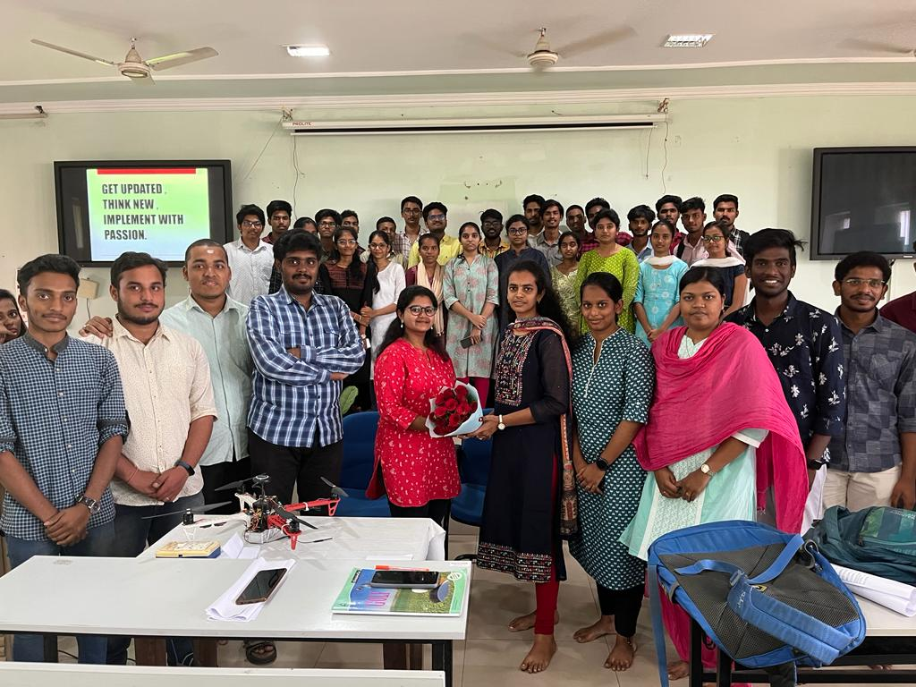
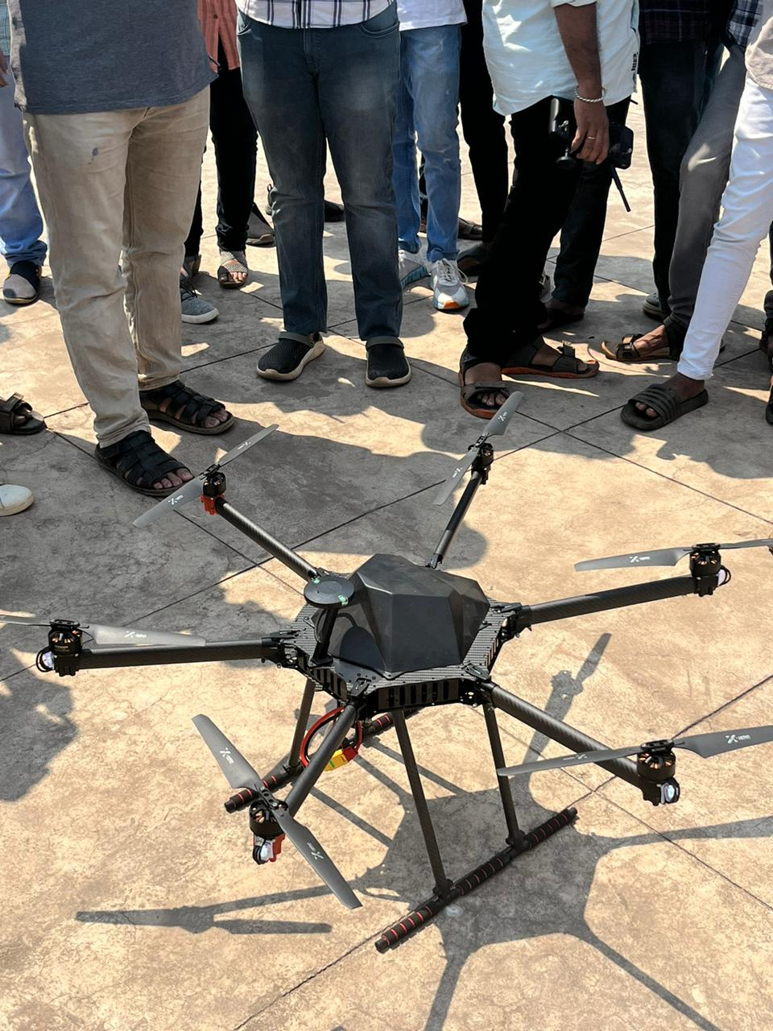
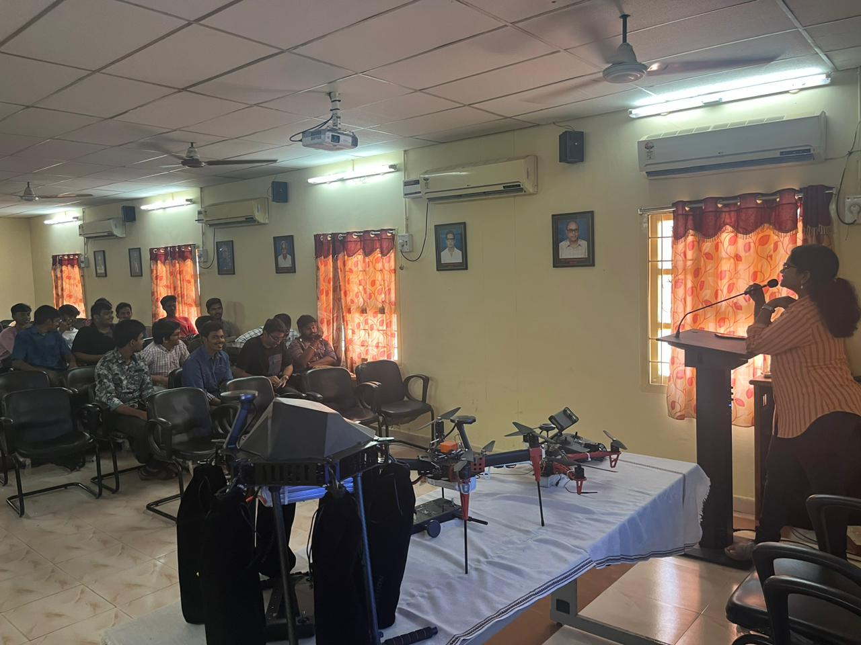
Research, Innovations and Extensions
List of activities / student participation in innovation, incubation centres:
Drone workshop conducted on the occasion of department day.
Department of Information Technology & Computer Applications

Slide 32
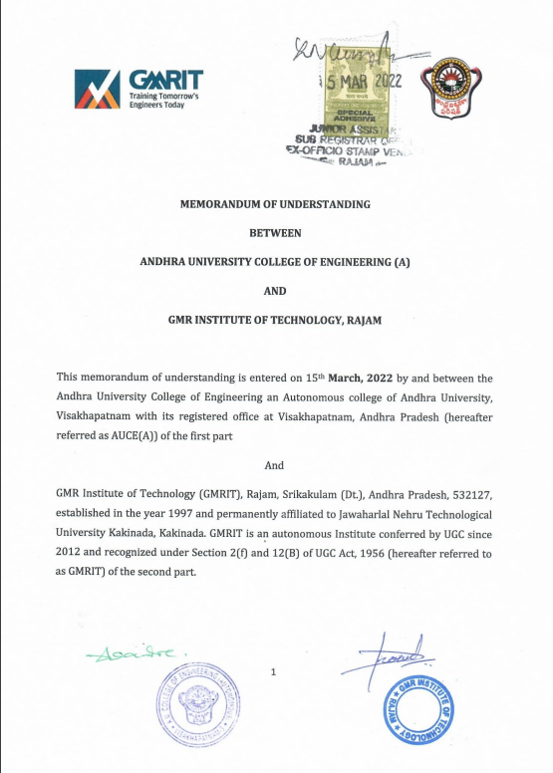
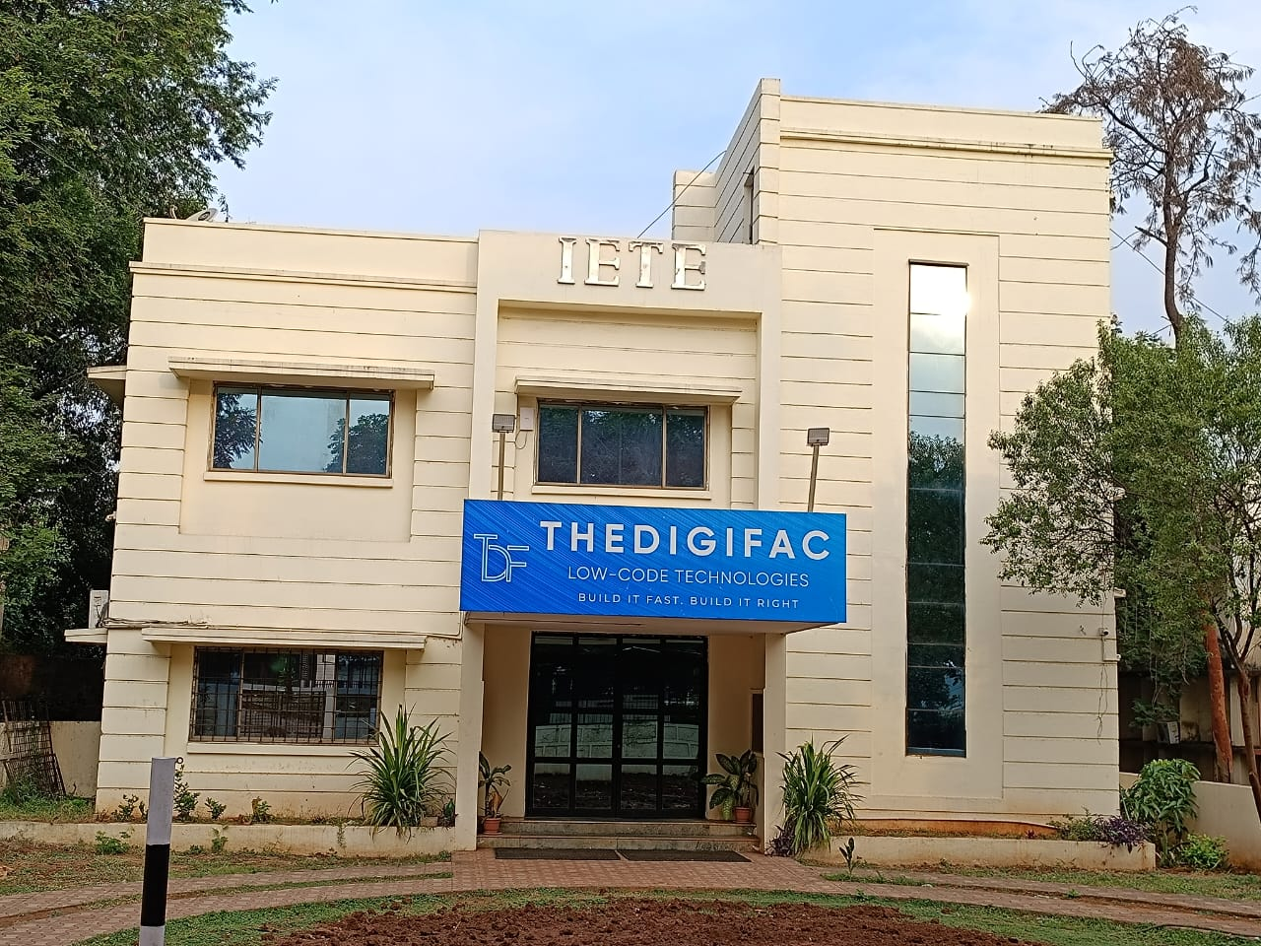
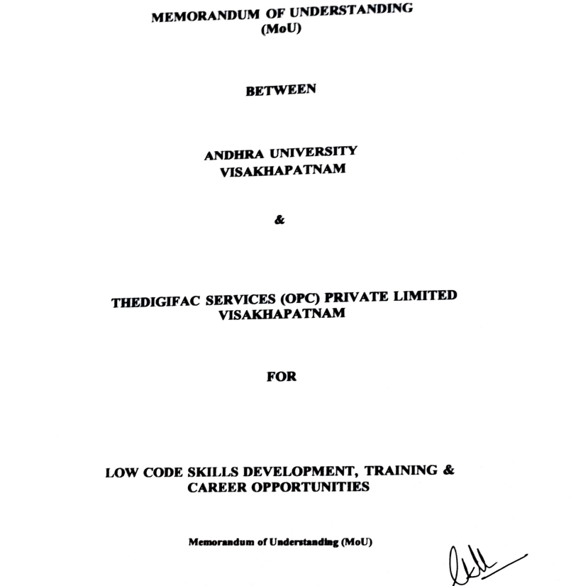
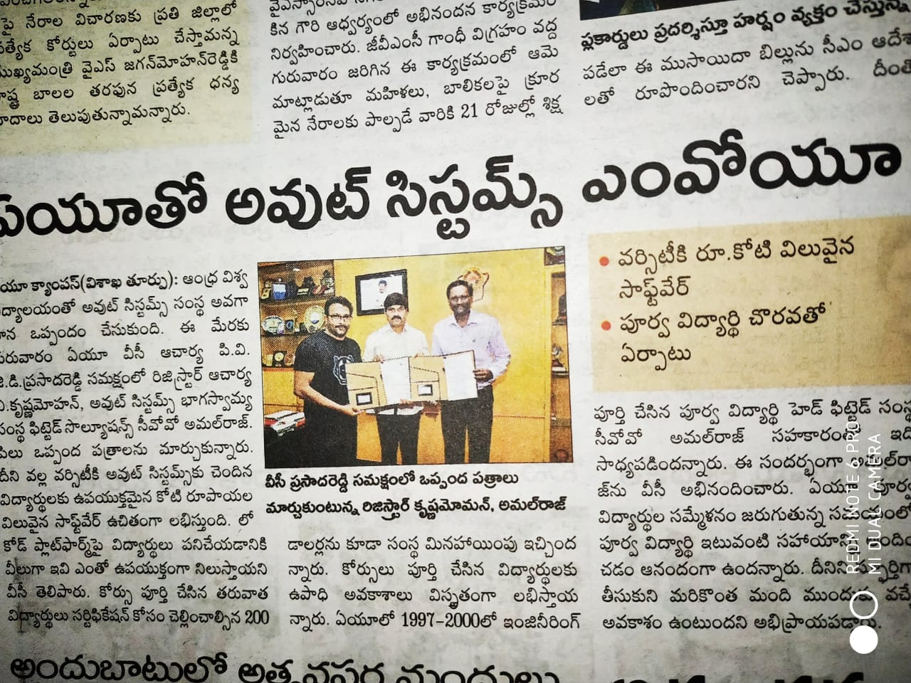
Collaborations & MoU’s
MOU with DIGIFAC to work on the low code platform.
MOU with GMRIT where students are given internships.
Department of Information Technology & Computer Applications

Slide 33
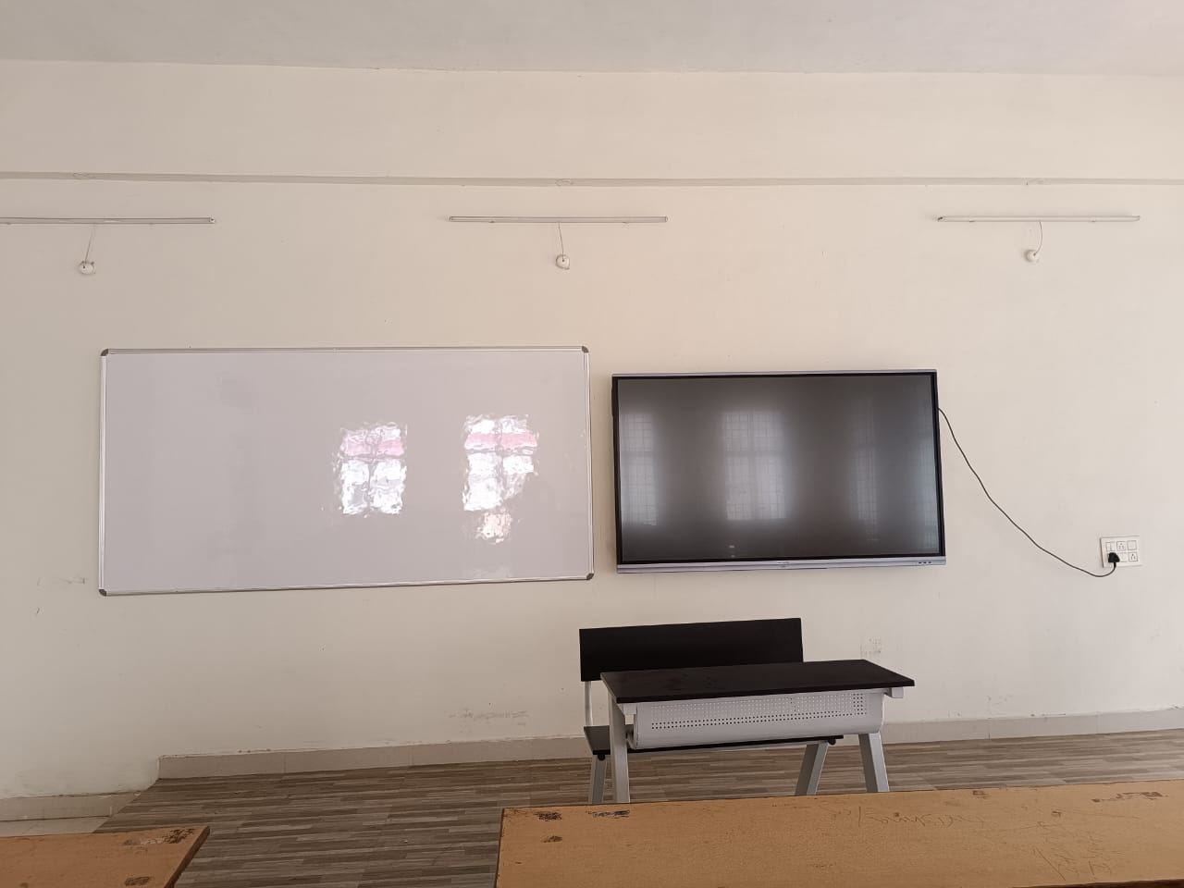
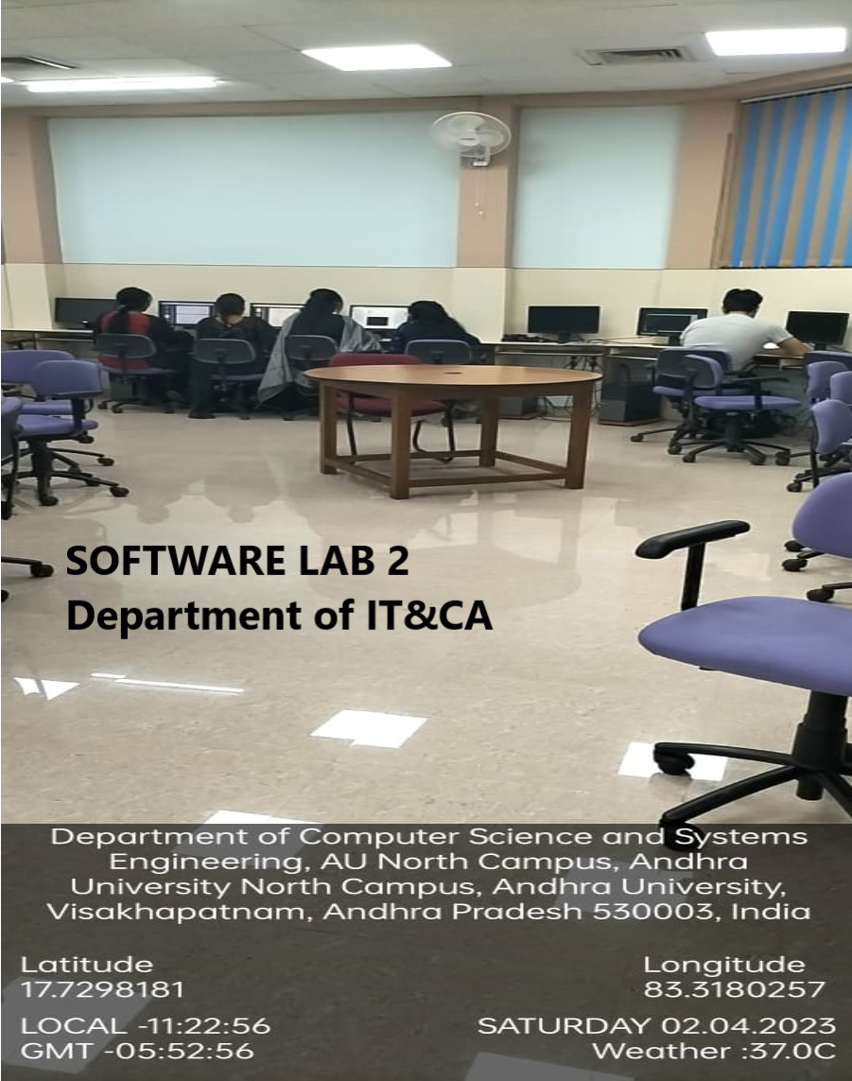
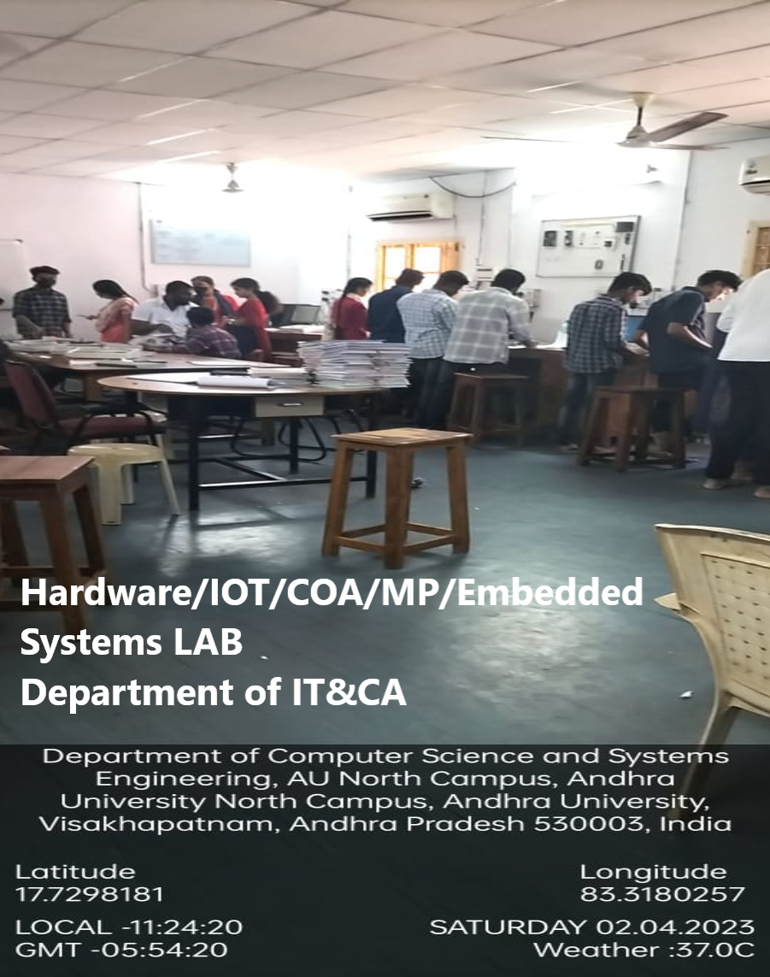
Infrastructure & Teaching Resources
Facility | Quantity
Lecture Halls | 6
ICT Facilitated Lecture Halls | 6
Seminar Hall | 1
Library | 1
Laboratories | 4
E-Classroom | 1
Canteen | 1
Auditorium | 1
E - Classroom
Lecture Halls
Software Labs
Hardware Labs
Department of Information Technology & Computer Applications
33

Slide 34
Other Facilities
RO - Water plant
Canteen
Parking Area
Open Air Auditorium
Department of Information Technology & Computer Applications

Slide 35
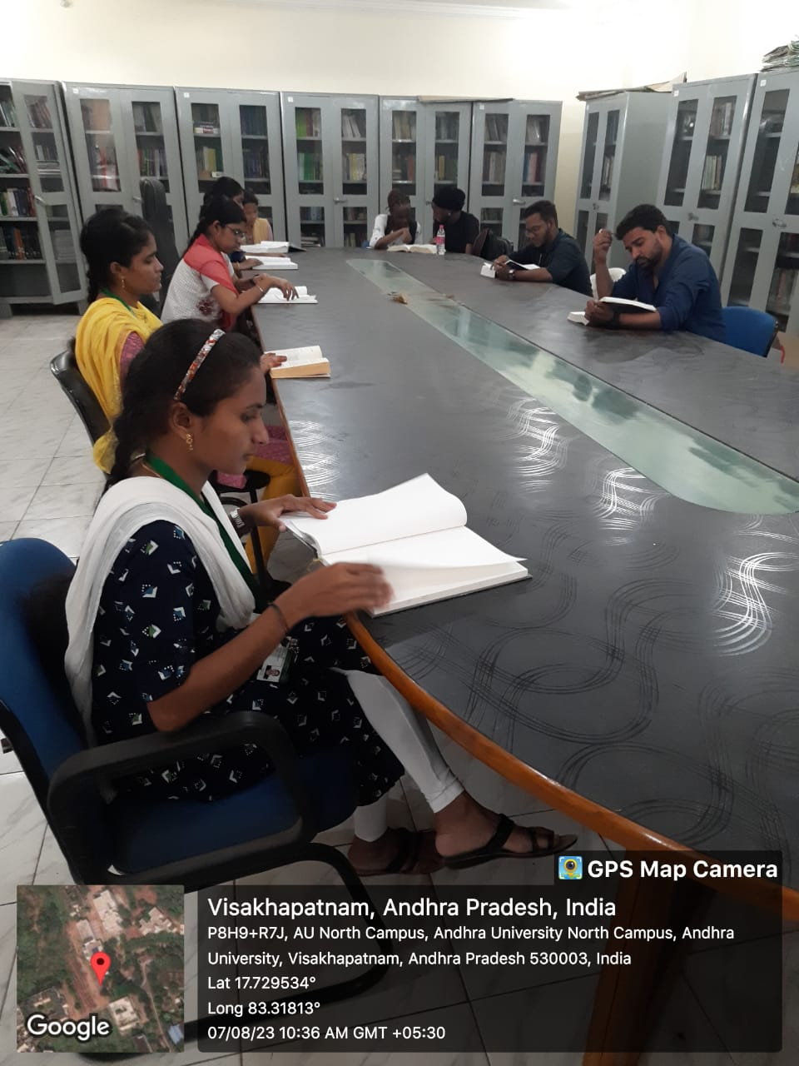
Library and e-Resources
Name of the Publisher | Resources | Link of Access
IEEE | Dr.V.S.Krishna Library self-supported E Resources | IEEE Xplore
Delnet | Delnet.in | Search Home (delnet.in)
NATIONAL DIGITAL LIBRARY | NDL e-Resources | National Digital Library of India (iitkgp.ac.in)
J-Gate | E-Shodhsindu | Login Page (jgateplus.com)
N-List | E-Shodhsindu | https://ess.inflibnet.ac.in/eres.php?memID=2
ACM Digital Library | The world’s largest educational and scientific society, uniting computing educators, researchers and professionals to inspire dialouge, share resources and address the field’s challenges | https://dl.acm.org/do/10.1145/institution-60075905/full/
Knimbus | Knimbus mLibrary is a one-stop solution with rich features to build a powerful and user friendly digital library through which users can seamlessly access the digital resources anytime, anywhere and on any device. | https://www.andhrauniversity.edu.in/library.html
Library and e- Resources
Total Number of Books in Dept. of IT&CA :2,157
Total Volumes: 72
Reference Books: 14
SC & ST Book Bank:-
E-BOOKS :http://community.ebooklibrary.org/?AffiliateKey=WEL-ColEngAndUni
National Journals:2
International Journals : 3
NPTEL Videos (web & Video Lectures)-
Additional information
https://andhrauniversity.edu.in/library/icons1.html
https://services.andhrauniversity.edu.in/filestorage1/iqacfiles/onlineservices.pdf
https://services.andhrauniversity.edu.in/filestorage1/iqacfiles/soul-proof.pdf
https://services.andhrauniversity.edu.in/filestorage1/iqacfiles/shodhganga-proof.pdf
https://services.andhrauniversity.edu.in/filestorage1/iqacfiles/Library.pdf
Paste link for additional information
https://scholarkart.in/AU/publications.
Palm leaf Manuscripts – Andhra University Digital Library (scholarkart.in)
Department of Information Technology & Computer Applications

Slide 36
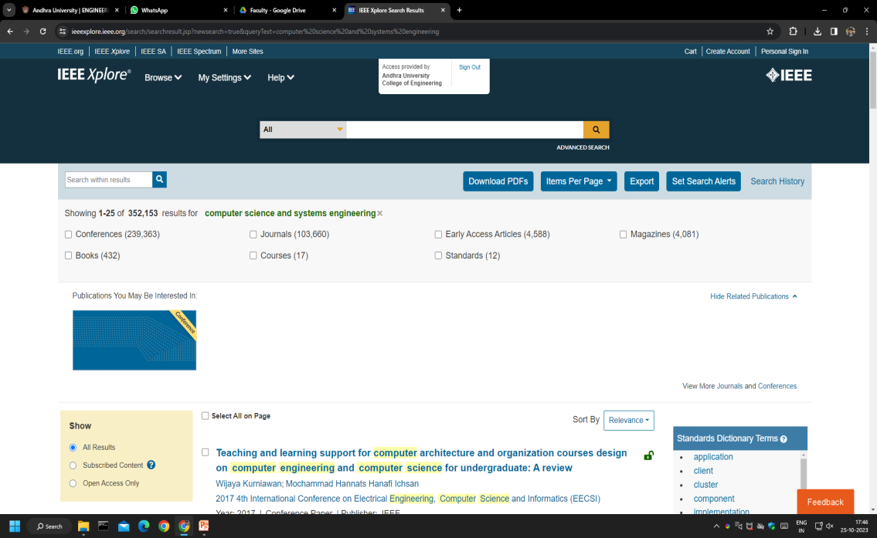
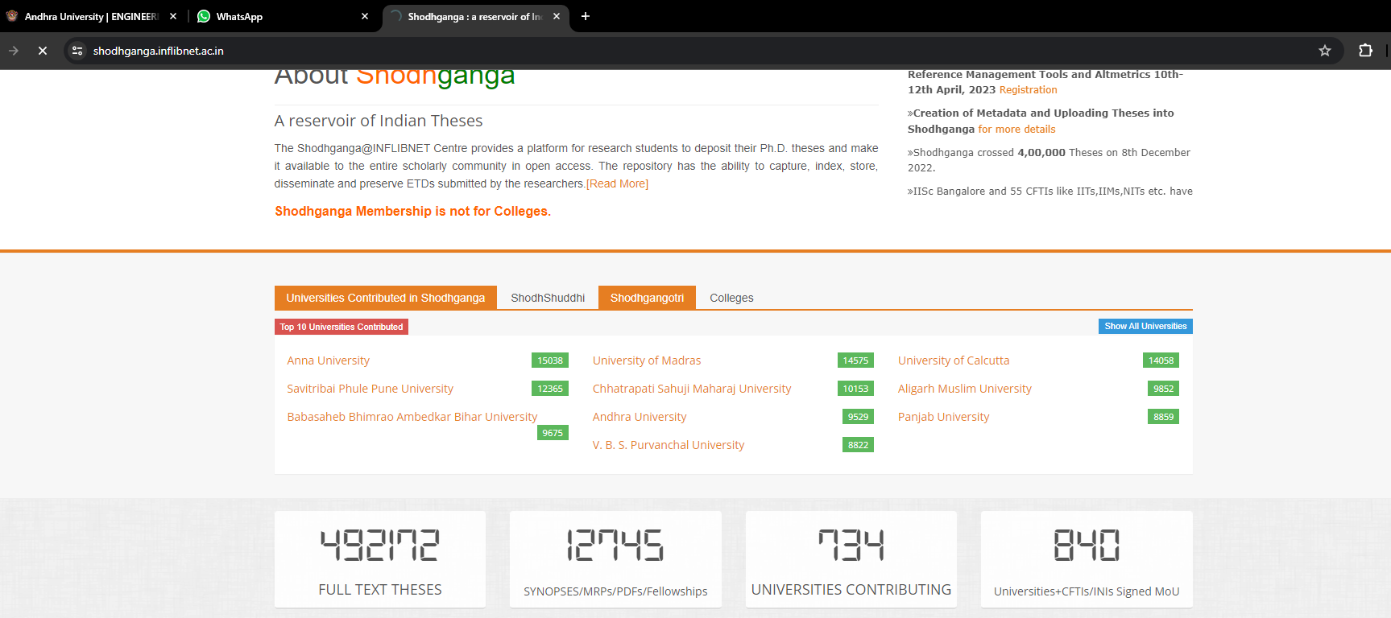
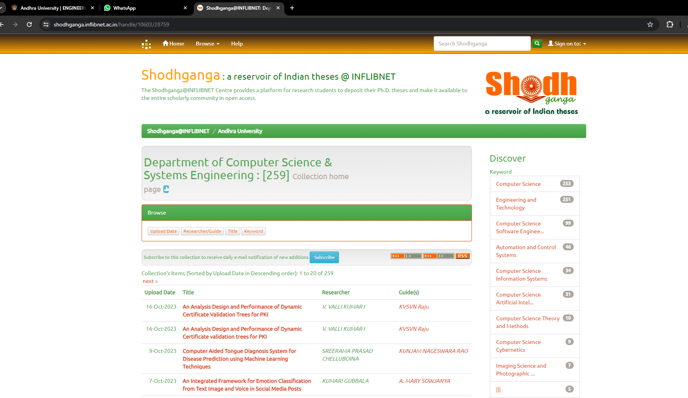
Library and e-Resources
Department of Information Technology & Computer Applications

Slide 37
Student Support and Progression
Scholarship received
Average percentage of students benefited by scholarships, etc. provided by the institution, Government and non-government agencies (NGOs) during the last five years(other than the students receiving scholarships under the government schemes for reserved categories) (10)
Year | Name of the scheme | Number of students benefited by government scheme and amount
 |  | Number of students | Amount(in Rs.)
2019-20 | Jnanabhumi postmetric scholarships(Fees reimbursement) | 61 | 2270100
2020-21 | Jnanabhumi postmetric scholarships(Fees reimbursement) | 140 | 2821849
2021-22 | Jnanabhumi postmetric scholarships(Fees reimbursement) | 156 |  | 6277956
Department of Information Technology & Computer Applications

Slide 38
Student Progression
Guidance for NET/SLET/GRE and other competitive examinations
Number of students appearing in state/ national/ international level examinations (eg: IIT/JAM/ NET / SLET/ GATE/ GMAT/CAT,GRE/ TOEFL/ Civil Services/ State government examinations) year-wise during last five years
Placements
Number of outgoing students placed year - wise during the last five years
Department of Information Technology & Computer Applications

Slide 39
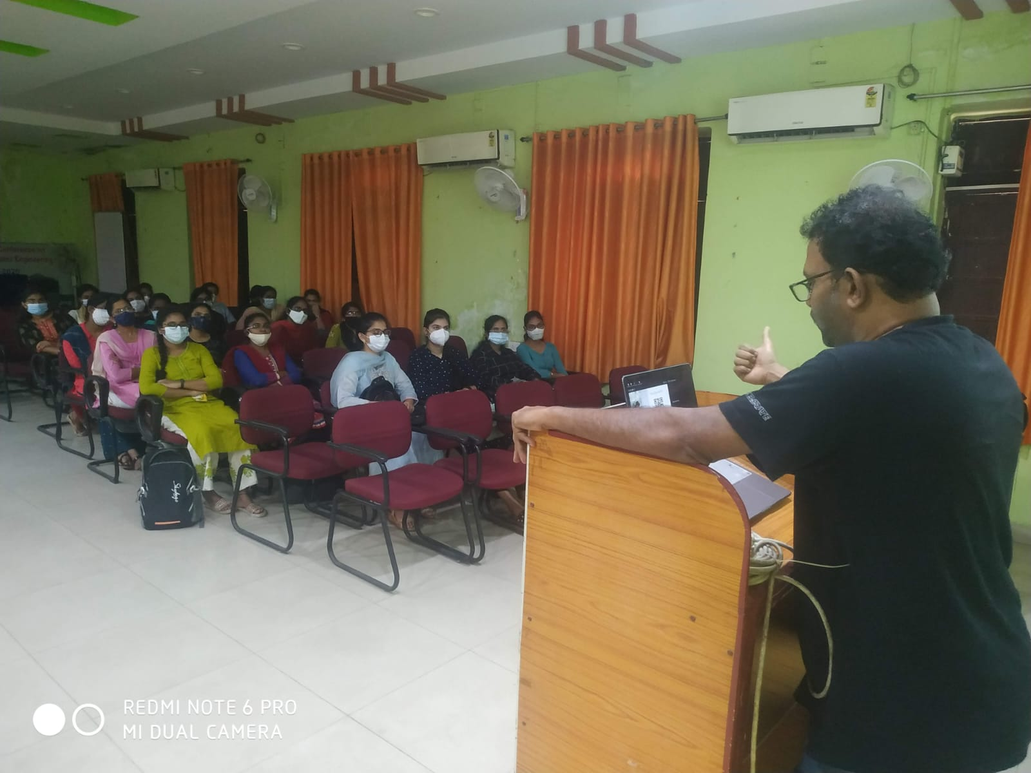
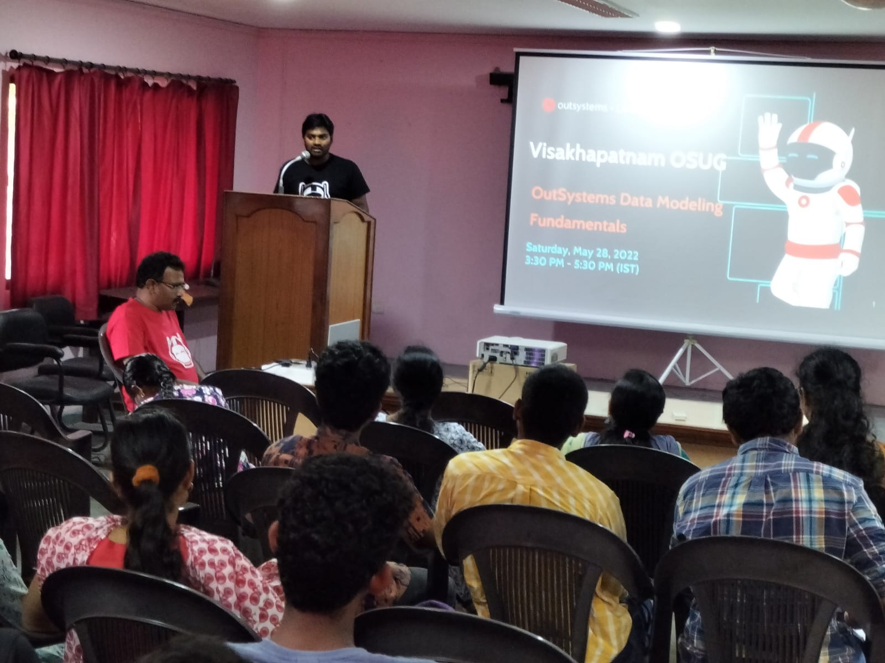
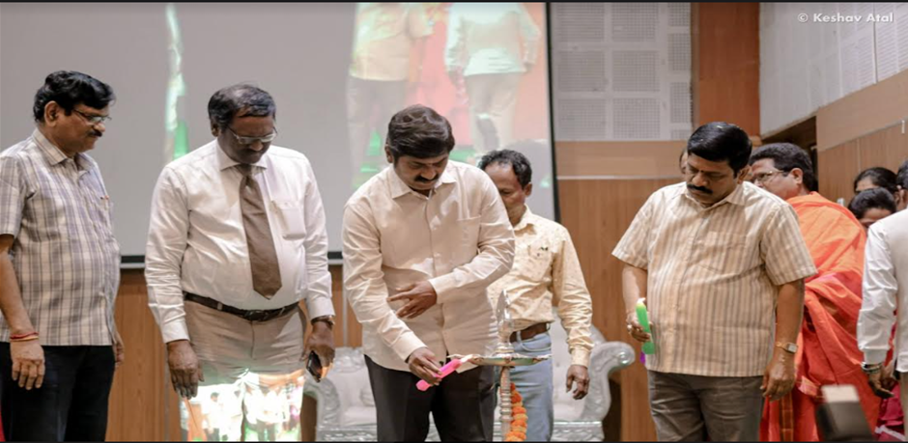
Student Support and Progression
Workshops and Conferences conducted:
A training programme was conducted by DIGIFAC which helped nearly 18 students to secure jobs in different companies.
A national level conference has been held during the PERISCOPE event conducted by the department.
DIGIFAC – Training Programme
PERISCOPE – National Conference
Department of Information Technology & Computer Applications

Slide 40
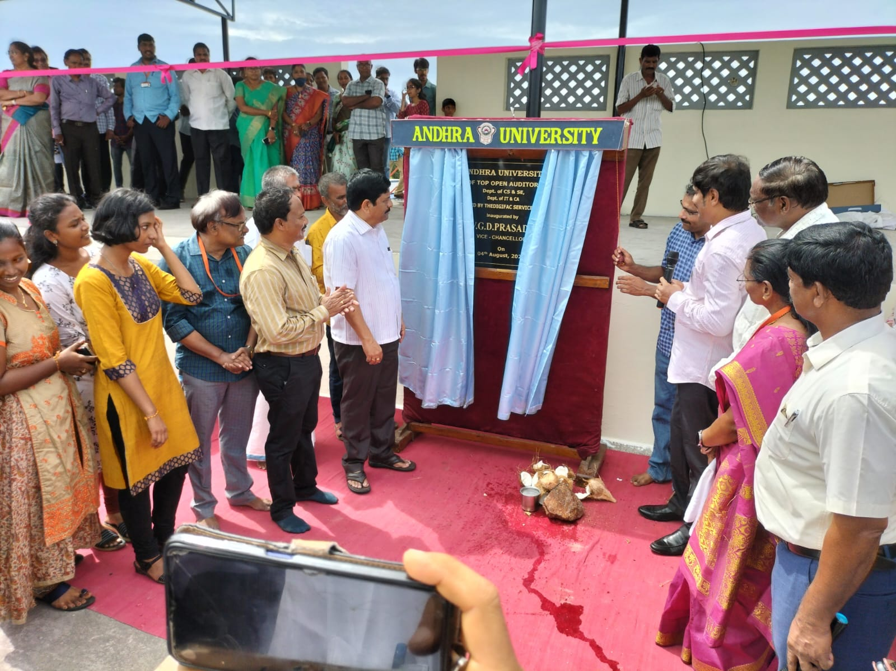
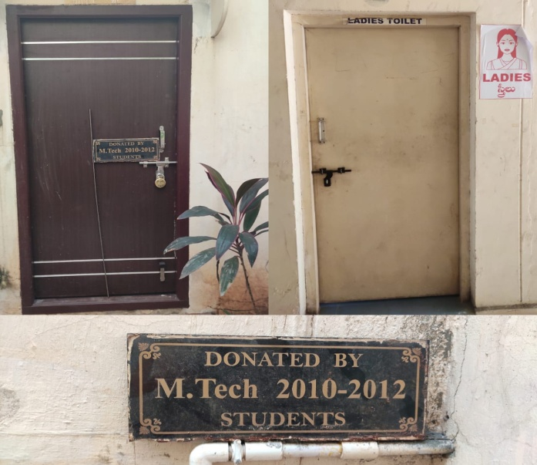
Student Support and Progression
Alumni Contributions
Alumni Association contributes significantly to the development
of the department through financial and other support services
Year | Name of the Alumni Association | Contribution | Purpose for which the contribution
2019-20 | Andhra University Alumni Association (AAA) | Volunteer Contribution by (2010-12) M.Tech Alumni batch | Toilets & Restrooms
2021-22 | Andhra University Alumni Association (AAA) | Volunteer Contribution by (1997-2000) MCA Alumni batch. | Open Auditorium
Department of Information Technology & Computer Applications

Slide 41
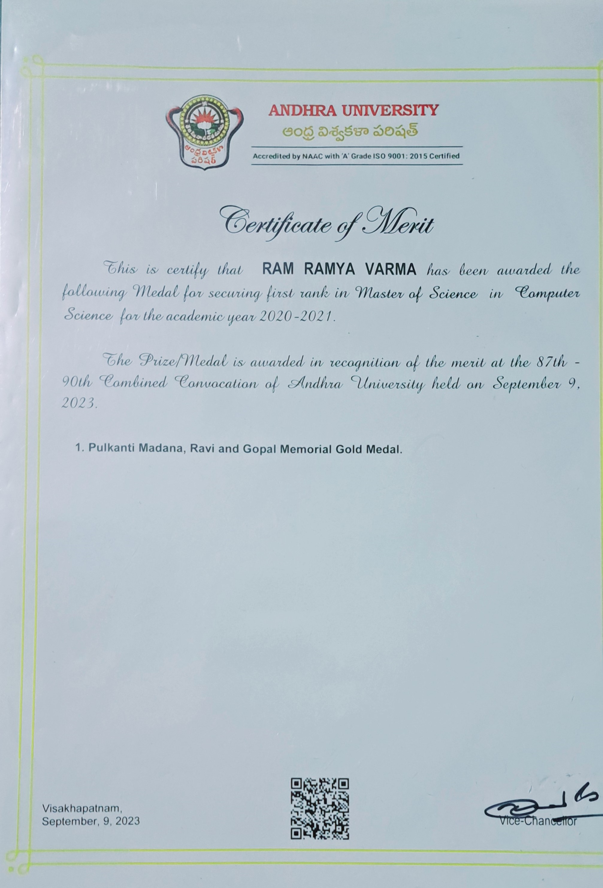
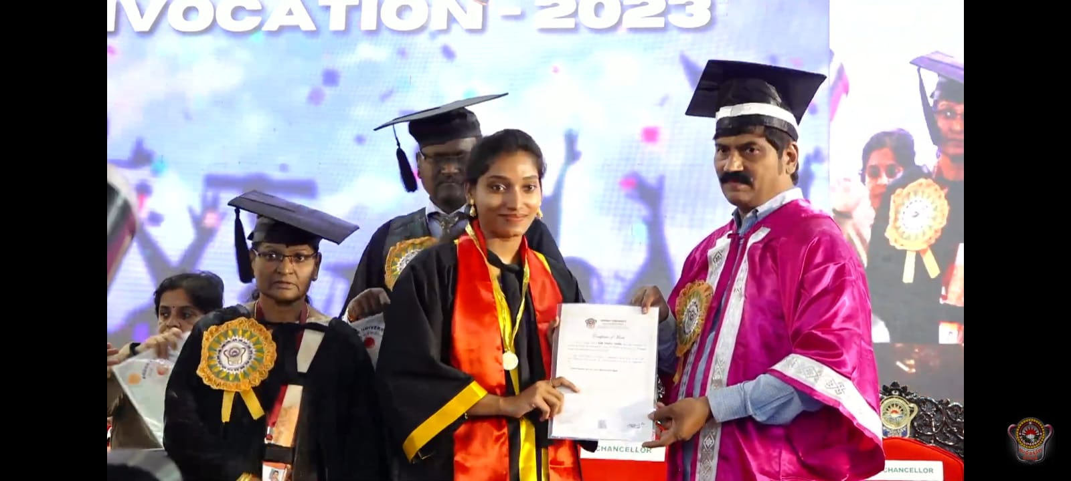
Best practices
Award distribution for the academic toppers in each courses. Such as Pulkanti Madana, Ravi and Gopal Memorial Gold Medal for topper in Master of Science in Computer Science.
Department of Information Technology & Computer Applications

Slide 42
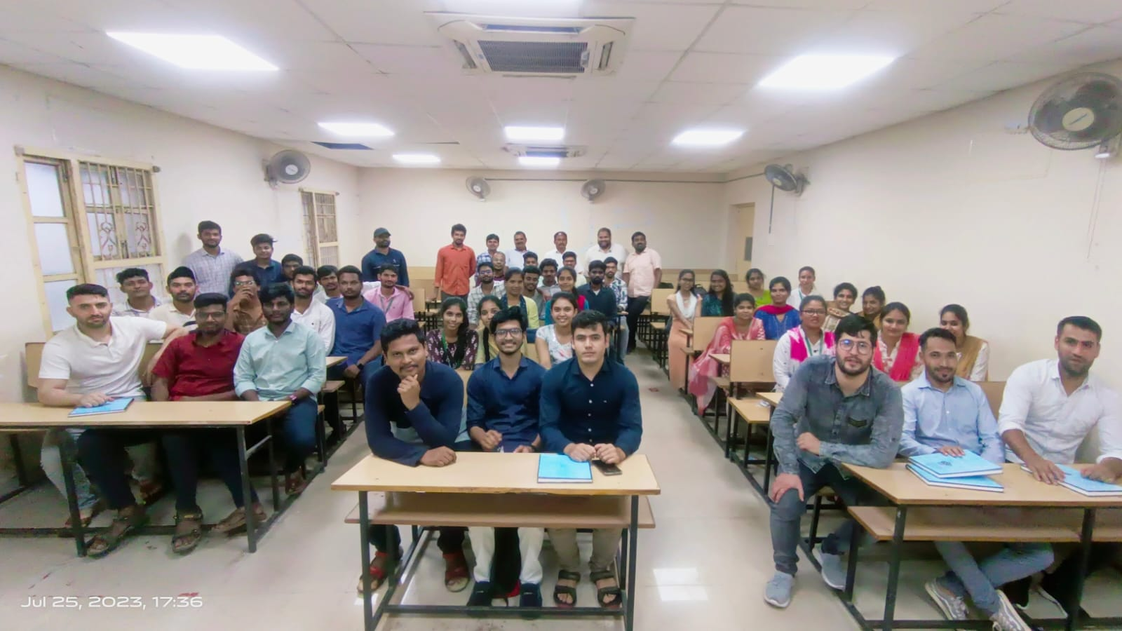
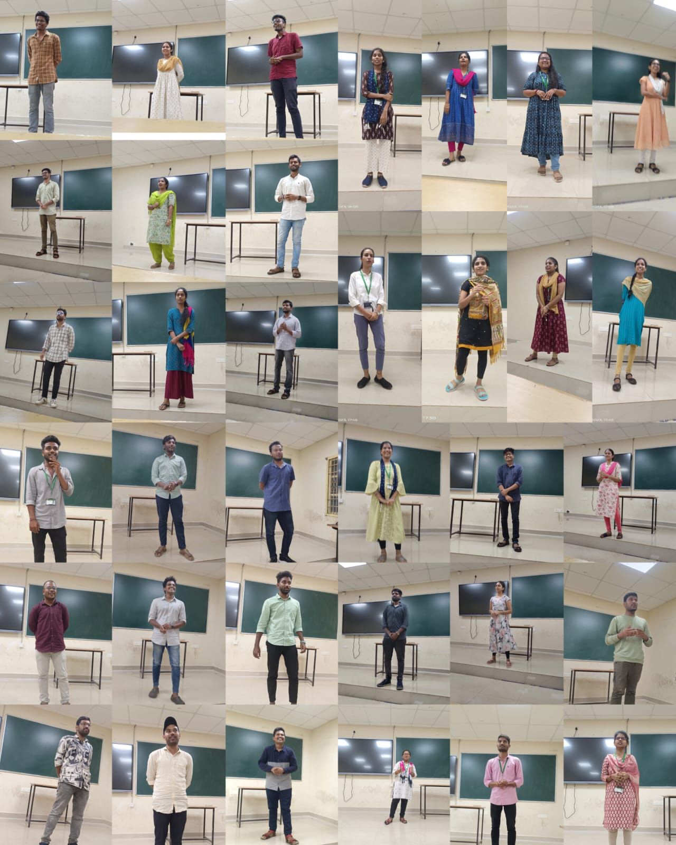
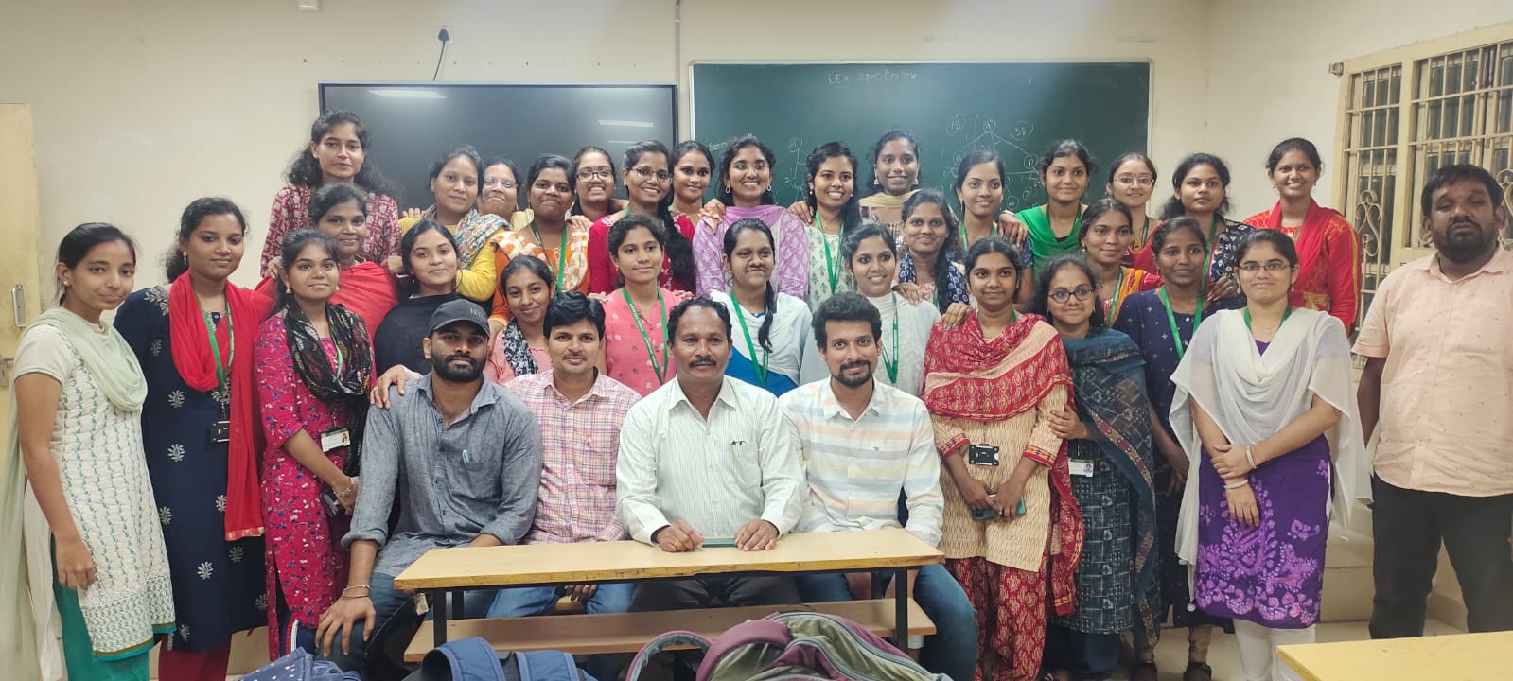
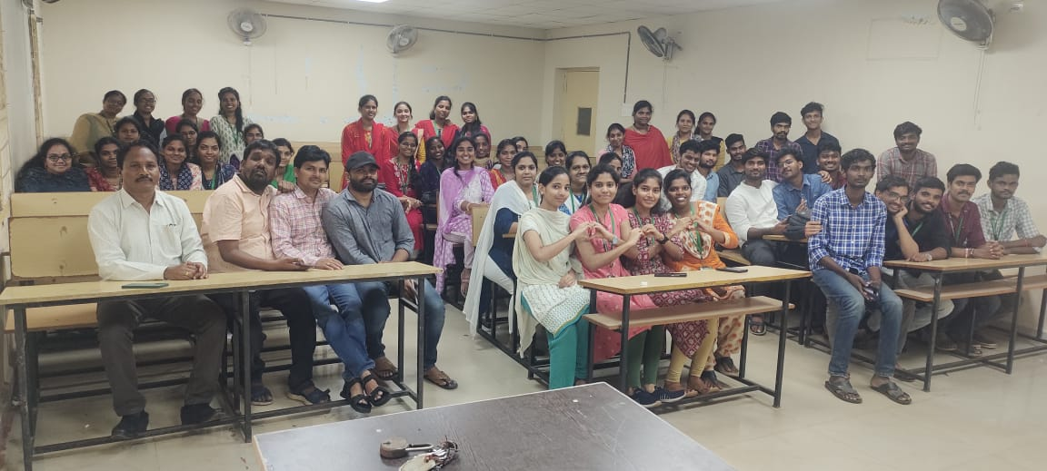
Best practices
Best practices
M. C. A
Farewell
for
M.Sc & M.C A
M. Sc
Department of Information Technology & Computer Applications

Slide 43
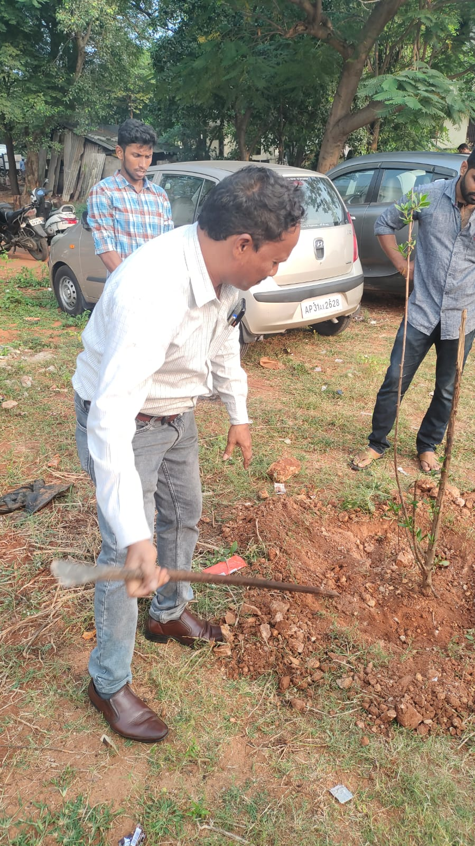
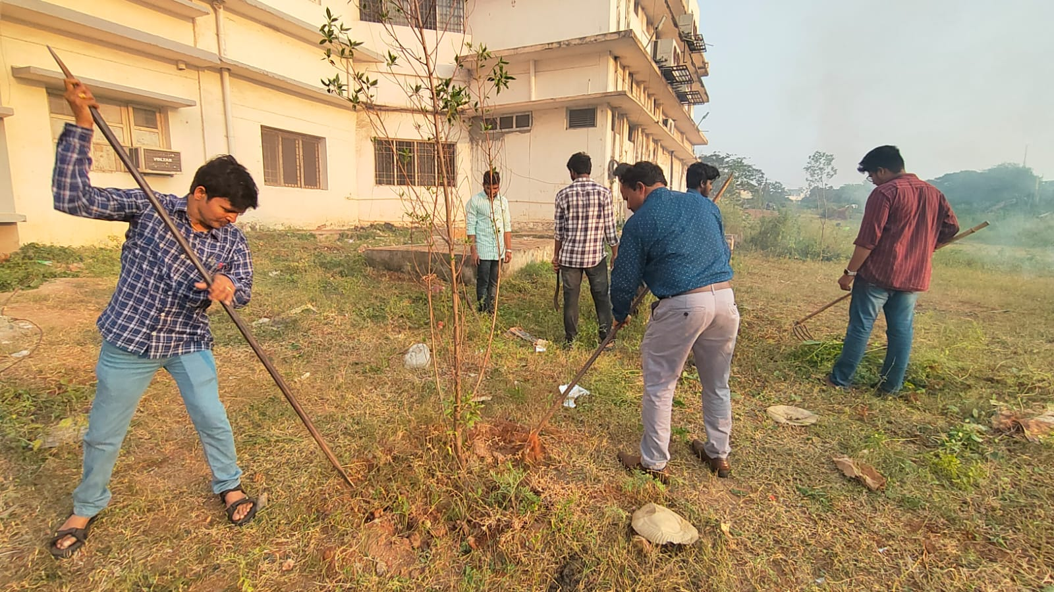
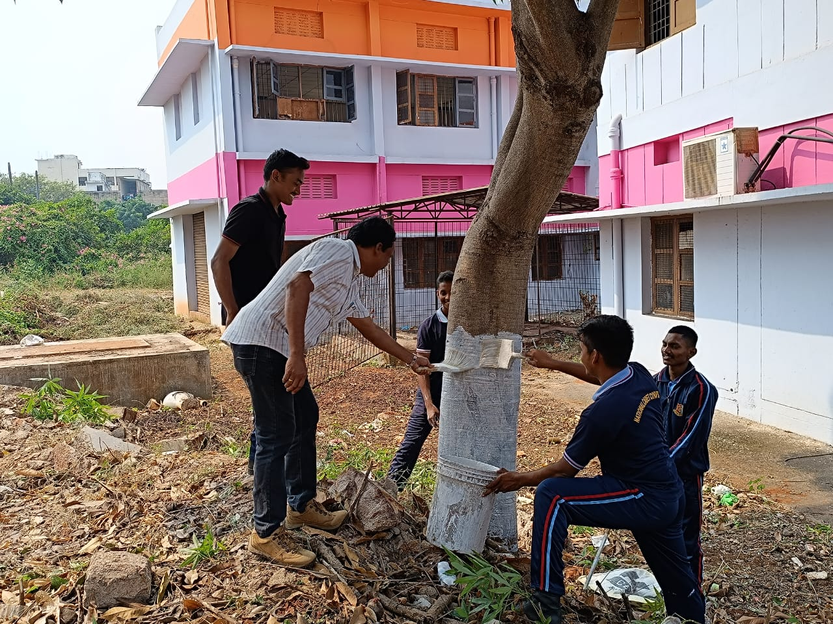
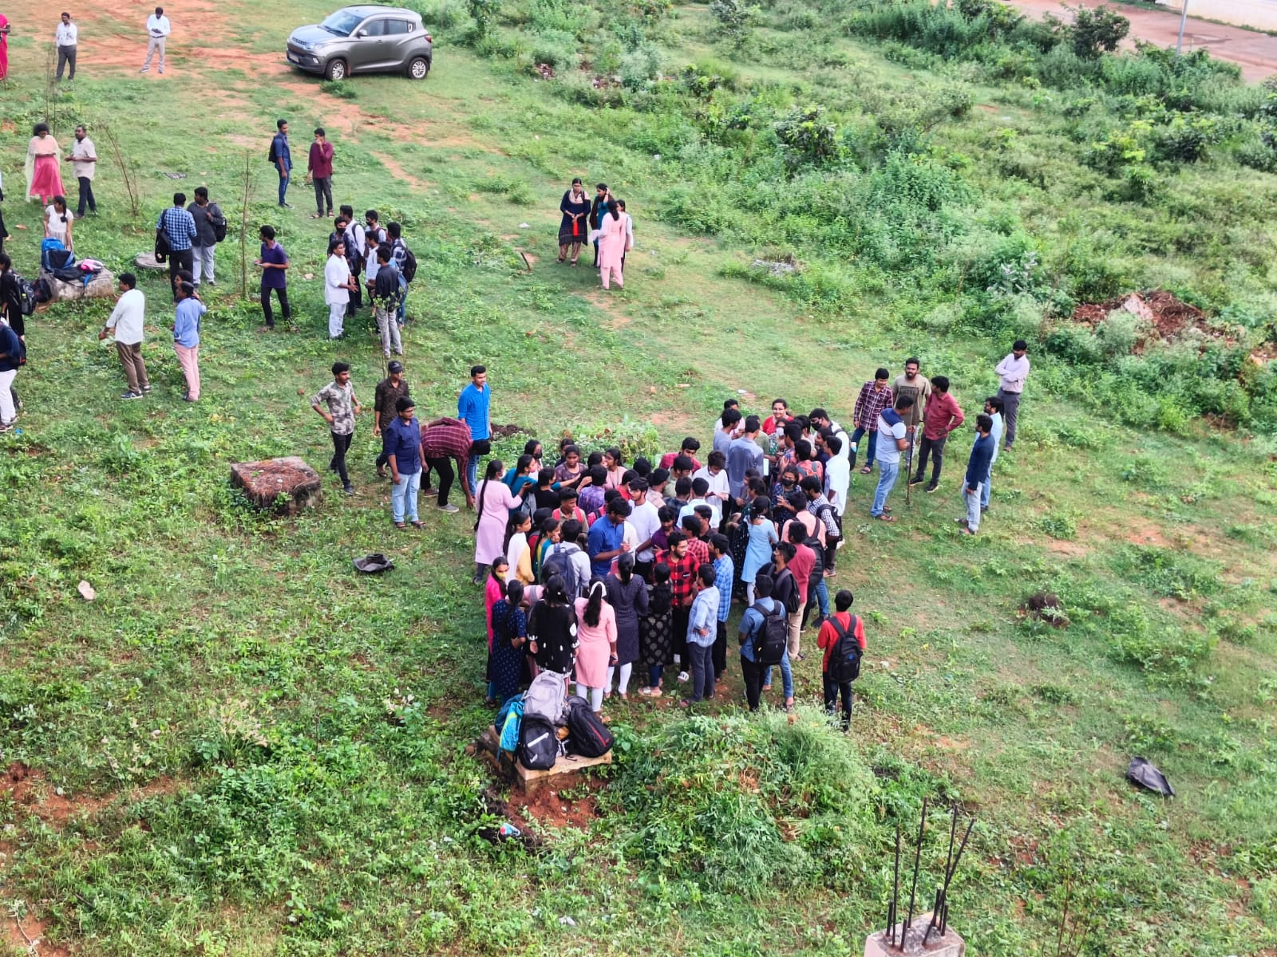
Best practices
Best practices
Alternate sources of energy and energy conservation measures
Solid waste management – GVMC recyclers (at beside IT & CA building)
E - waste management – Recycling of E-waste materials is done in the department.
Some rain water harvesting pits are provided in front of the IT & CA building.
Swachh Bharat programme around the department conducted by students to waste management.
Department of Information Technology & Computer Applications

Slide 44
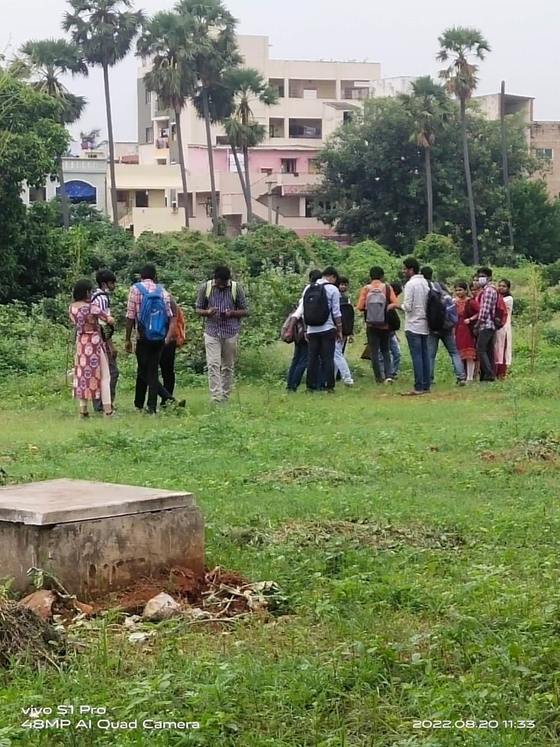
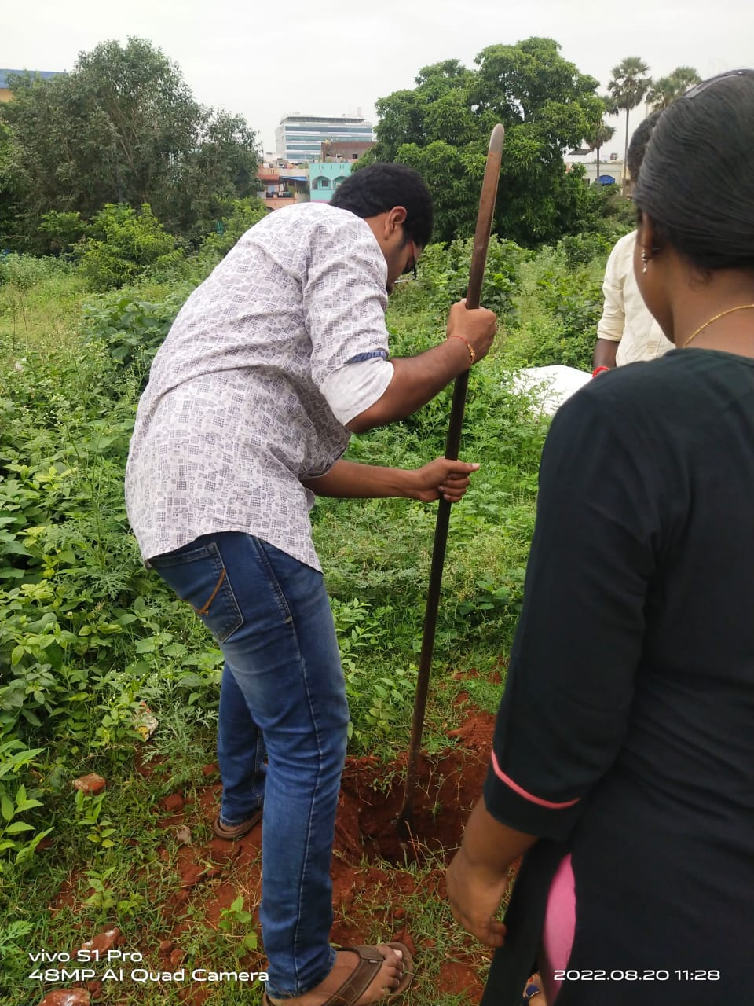
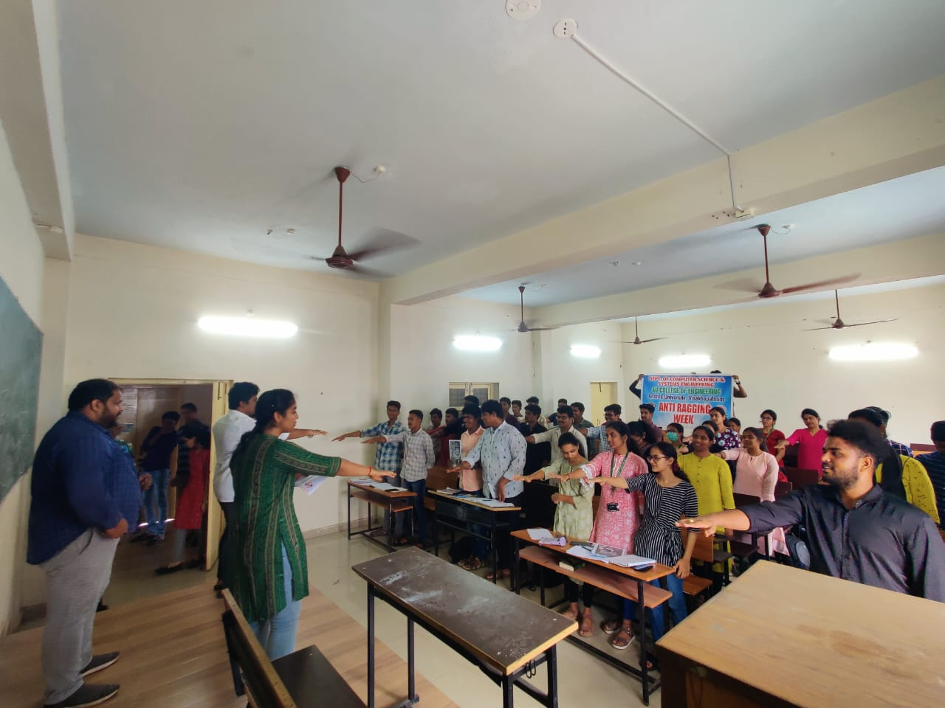
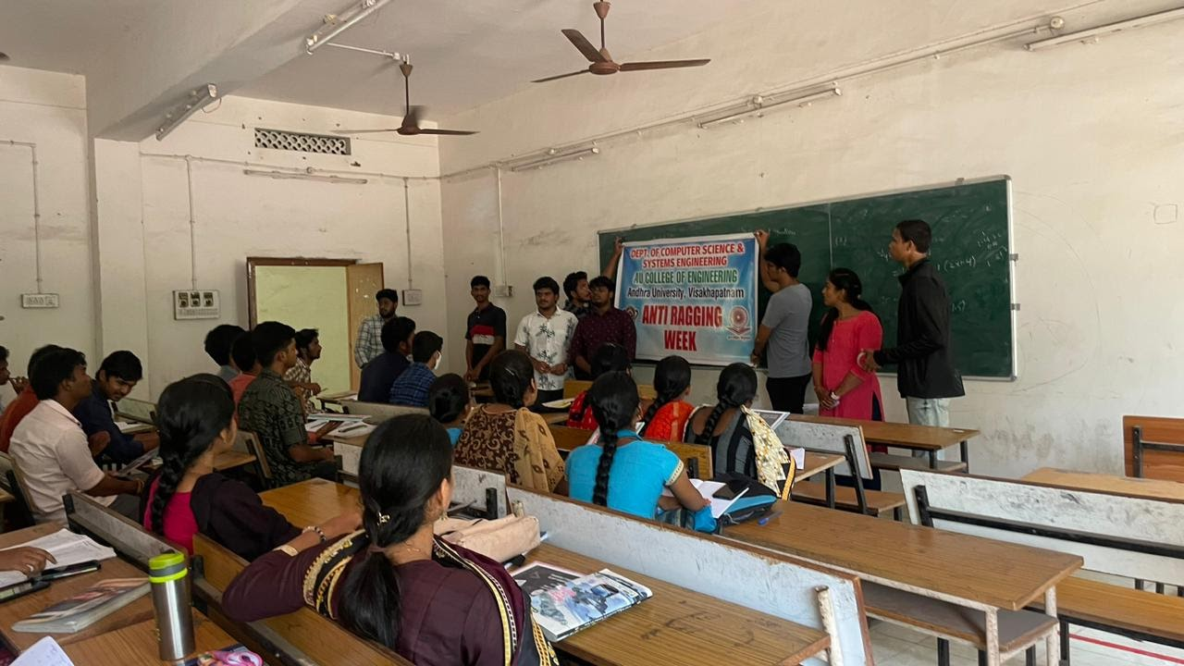
Best practices
Best practices
Plantation programme around the department conducted by students.
Swachh Bharat & plantation
Programme
Anti - Ragging
Programme
Department of Information Technology & Computer Applications

Slide 45
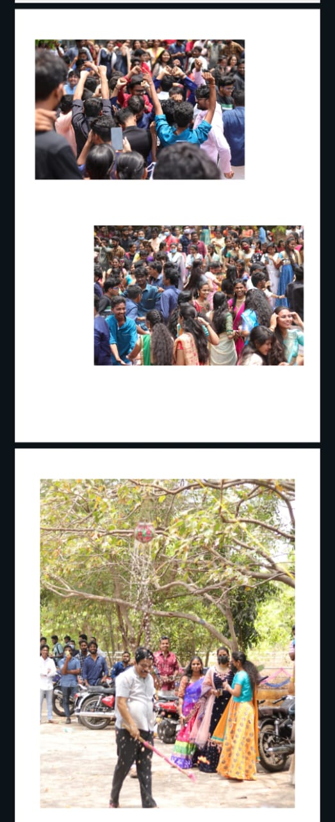
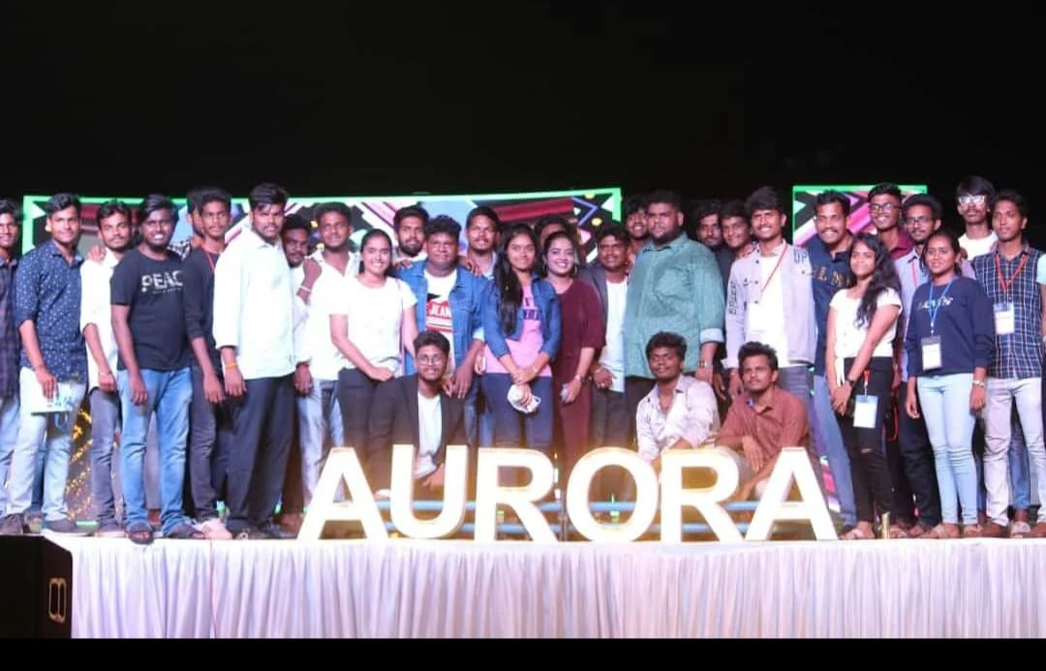
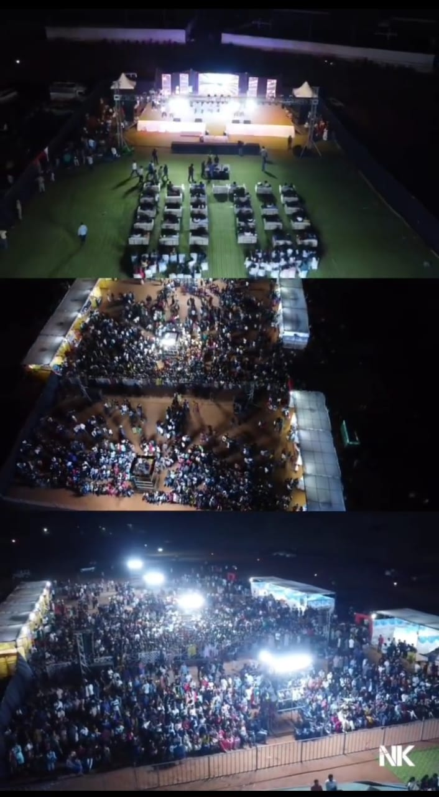
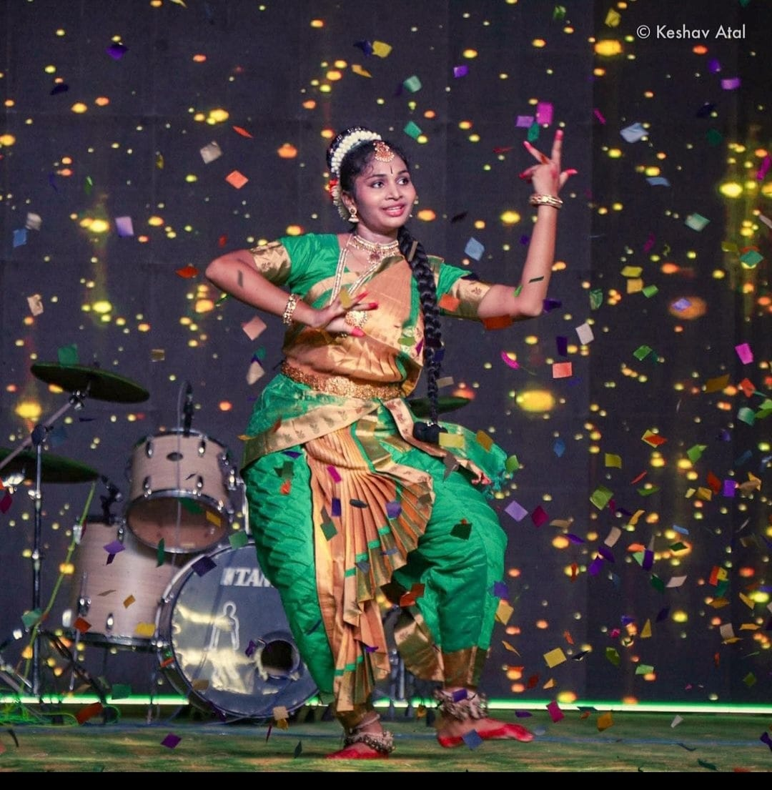
Cultural Activities
AURORA Student Fest
Department of Information Technology & Computer Applications

Slide 46
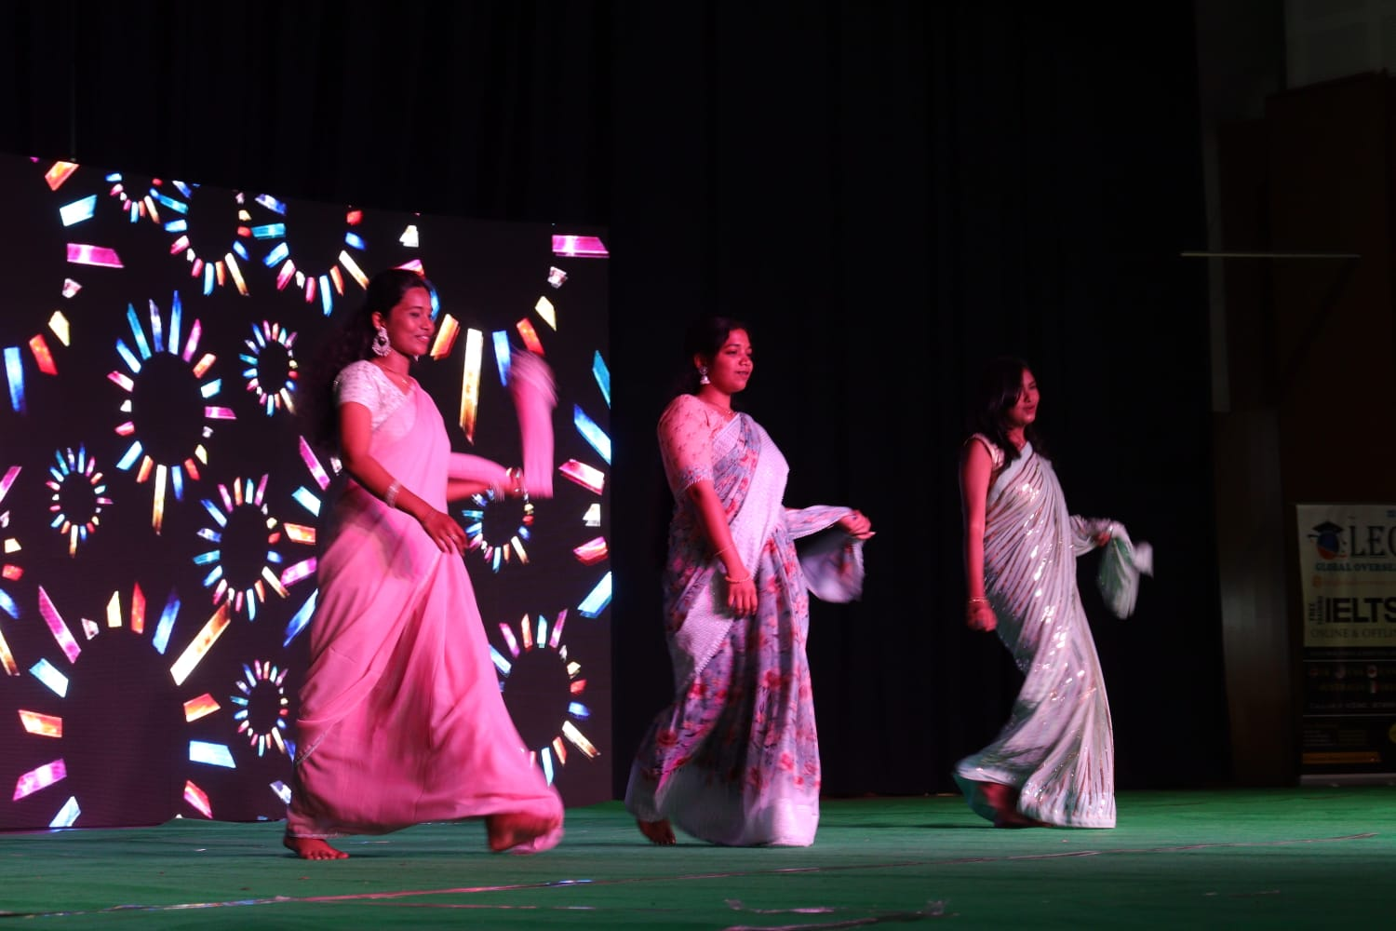
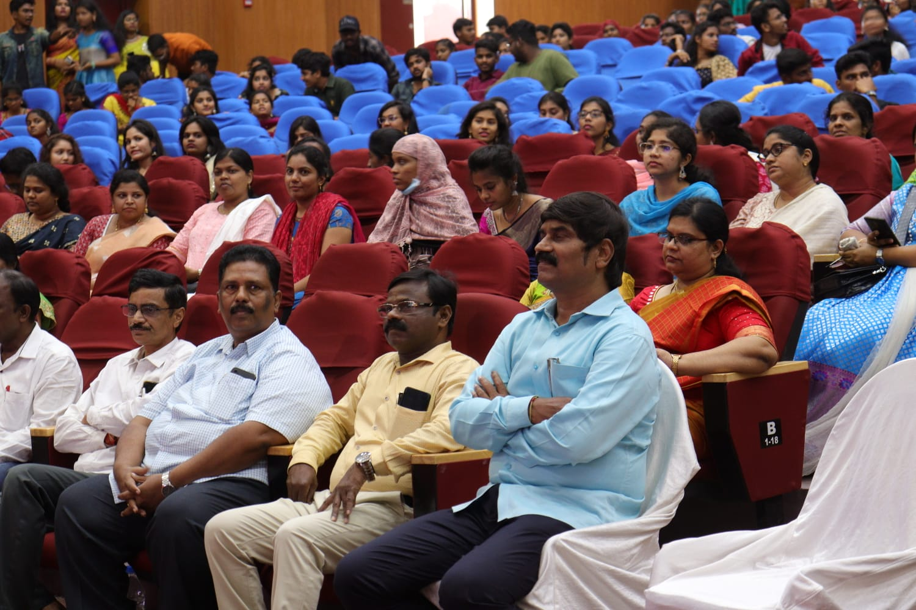
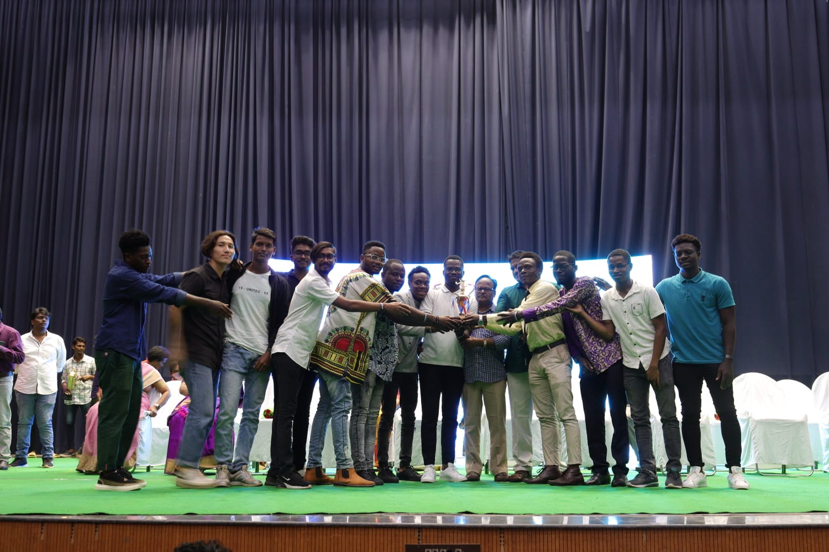
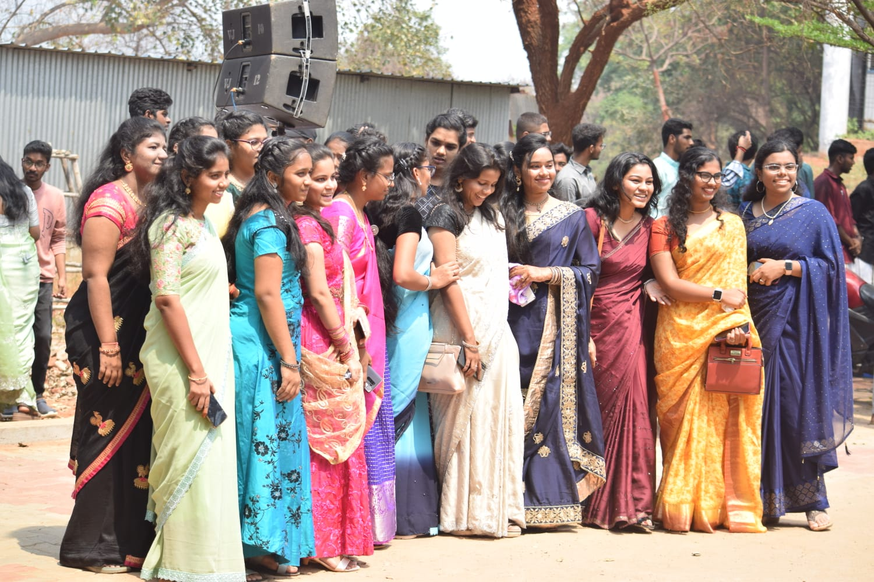
Cultural Activities (cont..,)
Department day celebrations
Department of Information Technology & Computer Applications

Slide 47
Progressive Plans
Planning to train the students towards research & development using latest technology advancements skills and knowledge which is helpful to design applications based on socio requirements.
To motivate students to become entrepreneur.
Department of Information Technology & Computer Applications

Slide 48
THANK YOU
Department of Information Technology & Computer Applications

