Slide 1
WELCOME TO
NAAC PEER TEAM-2023
Department of Applied Mathematics
Andhra University
Visakhapatnam

Slide 2
DEPARTMENT PROFILE
Established: 1942, B.Sc. Honours course in Mathematical Physics, by Prof. Suri Bhagavantham.
M.Sc. Applied Mathematics in 1966.
It was also headed by eminent Professors like
Prof. A. Narasinga Rao
Prof. N. S. Nagendranath
Prof. S. Meenakshi Sundaram
Prof. T. Venkata Rayadu.....

Slide 3
HISTORY / ACHIEVEMENTS
Prof. S. Bhagavantam, Senior Scientific Advisor, Ministry of Defence (1957-1962),
Prof. T. Venkata Rayadu, Visiting Professor at Courant Institute of Mathematics, New York University, USA,
“Theory of Groups and its application to Physical Problems’’ published by Andhra University Press, Academic Press, London, translated to Russian and French Languages.
Prof. S. Meenakshi Sundaram, Visiting Scientist at Princeton University, USA and authored ‘‘Typical Means’’, Oxford University Press.
Prof. N. S. Nagendranath collaborated with Nobel Laureates Sir C. V. Raman and Prof. Maxborn, Cambridge University.
Prof. A. Narasinga Rao, President of Indian Mathematical Society and founder editor for Indian Journal of Mathematics. He is quoted as an eminent teacher by Dr. A. P. J. Abdul Kalam in his autobiography “WINGS OF FIRE”.

Slide 4
VISION
To Create New Frontiers of Knowledge in Quest for Development of a Humane and Just Society.
MISSION
To stimulate the academic for promotion of quality of teaching, learning and research.
To undertake quality related research studies, consultancy and training programmes.
To foster global competencies among students and to inculcate value system in them.
To promote the use of state-of-the-art technology and quest for excellence.
DEPT

Slide 5
CURRICULAR ASPECTS
Programs:
M.Sc. Applied Mathematics
Ph.D.
Thrust Areas:
Boundary Value Problems
Optimization Techniques
Relativity and Cosmology
Numerical Solutions of Partial Differential Equations

Slide 6
CURRICULAR ASPECTS (contd..)
MOOC Courses:
In Third and Fourth Semester of the course work, students must take MOOC course offered by NPTEL /SWAYAM / Equivalent with atleast 8 weeks duration and secure minimun marks
Value Added Courses:
Intellectual Property Rights
Research Methodology

Slide 7
CURRICULAR ASPECTS (contd..)
Course Curriculum
Choice Based Credit System
Basic Structure of the Course
I Semester | II Semester
1. Real Analysis 2. ODE & Integral Equations 3. Classical Mechanics 4. Discrete Mathematical Structures 5. Programming in C 6. Lab: Programming in C | 1. Complex Analysis 2. PDE & Integral Transforms 3. Statistics & Distribution Theory 4. Elasticity and Fluid Dynamics 5. Numerical Analysis 6. Viva-Voce

Slide 8
CURRICULAR ASPECTS (contd..)
Course Curriculum
Choice Based Credit System
Basic Structure of the Course
III Semester | IV Semester
1. Measure Theory 2. Python Programming 3.Techniques of Applied Mathematics 4. Elective – I 5. Elective – II 6. MOOC Course 7. Lab: Python Programming * Electives are selected from the Thrust areas | 1. Functional Analysis 2. Theory of Automata & Formal Languages 3. Elective-I 4. Elective-II 5. MOOC Course 6. Project Work 7. Viva-Voce

Slide 9
CURRICULAR ASPECTS (contd..)
Program Outcomes
PO1: Provide in depth knowledge on the core courses of Mathematical Physics, Applied Mathematics and Computational Mathematics.
PO2: Develop analytical abilities and logical thinking.
PO3: Enable the student to acquire the necessary problem solving skills by participating in tutorials, seminars and completing an assigned project.
PO4: Provide and develop the ability and skills to obtain employment in a chosen field.
PO5: Develop the necessary programming skills to acquire knowledge and excel in software oriented jobs.

Slide 10
ATTAINMENT REPORT FOR COURSE OUTCOMES SEMESTER WISE
CURRICULAR ASPECTS (contd..)

Slide 11
ATTAINMENT REPORT FOR COURSE OUTCOMES SEMESTER WISE
CURRICULAR ASPECTS (contd..)

Slide 12
CURRICULAR ASPECTS (contd..)
Link to COs and POs: To obtain better placement through employability and entrepreneurship and higher education.
CO's PO's 2020-22 CO's PO's 2021-23

Slide 13
CURRICULAR ASPECTS (contd..)
Courses with employability / skill development offered
TEACHING POSITIONS | SOFTWARE | HIGHER STUDIES
Real Analysis Ordinary Differential Equations Discrete Mathematical Structures Complex Analysis Partial Differential Equations Numerical Analysis Statistics Measury Theory Techniques of Applied Mathematics Functional Analysis Optimization Techniques | Programing in C Numerical Analysis Python Finite of Automation and Formal Languages Optimization Techniques | Boundary Value Problems Optimization Techniques Relativity and Cosmology Numerical Solutions to PDE

Slide 14
CURRICULAR ASPECTS (contd..)
Student Project works: In Fourth Semester students are assigned a project work of 4 credits under the supervision of a faculty member.
Riemannian Curvature Tensor and its Applications
Transportation and Assignment Problems through Python Program
Applications of Difference Equations
Higher Even Order Two Point Boundary Value Problems
Finite Difference Approximation for Parabolic and Hyperbolic PDEs

Slide 15
CURRICULAR ASPECTS (contd..)
FEEDBACK ON CURRICULUM
Curriculum-2017-18
Curriculum-2018-19
Curriculum-2019-20
Curriculum-2020-21
Curriculum-2021-22
The Feedback received from students, faculty, Alumni, and parents are analysed and they will be discussed in annual board of studies meeting which includes faculty members of the department, external experts from universities , scientific organisations and modifications in course syllabus are carried out.
After Chandrayaan-3, we received suggetion from an Alumni who worked in ISRO, it is discussed in recent BOS meeting and introduced new electivies namely ORBITAL MECHANICS and SPACE DYNAMICS which will create placement opportunities in Space Science Organizations.

Slide 16
Teaching, Learning and Evaluation (contd..)
Faculty– Profile:
Faculty Name | Vidwan Link
Prof. V. Uma Maheswara Rao, Relativity and Cosmology | (Retired in 2019)
Prof. K. Rajendra Prasad, Boundary Value Problems | K. Rajendra Prasad
Prof. M. Vijaya Santhi, Relativity and Cosmology | M. Vijaya Santhi
Prof. P. Vijaya Laxmi, Operations Research | P. Vijaya Laxmi
Dr. T. Vinutha, Assistant Professor (UGC-FRP), Relativity and Cosmology | T. Vinutha
Dr. M. Tripathy, Assistant Professor (UGC-FRP), Numerical Analysis | M. Tripathy

Slide 17
Teaching, Learning and Evaluation (contd..)
Awards, Recognitions/fellowship:
Prof. K. Rajendra Prasad, BOYSCAST Fellowship, DST, Auburn University, USA for collaborative research with Prof.Johnny Henderson.
Life Member: Indian Science Congress Association,
International Society for Difference Equations, USA
Member : American Mathematical Society, USA from 1999 onwards
Dr. T. Vinutha: Visiting Associate, IUCAA, Pune.
Dr. Madhusmita Tripathy, Postdoc, DFG, Germany.

Slide 18
STUDENTS FEEDBACK
Teaching, Learning and Evaluation (contd..)
All the staff members got good feed back from the students. Average total index of the faculty is around 92%.
K.RAJENDRA PRASAD
M.VIJAYA SANTHI
P.VIJAYA LAXMI
T. VINUTHA
M. TRIPATHY

Slide 19
Teaching, Learning and Evaluation (contd..)
Demand Ratio:
Academic Year | No. of Seats | No. of Applications | No. of Admissions | Demand Ratio
2017-18 | 40 | 2492 | 40 | 1:62
2018-19 | 47 | 1802 | 47 | 1:38
2019-20 | 50 | 1885 | 50 | 1:38
2020-21 | 50 | 1999 | 47 | 1:43
2021-22 | 51 | 2000 | 49 | 1:41

Slide 20
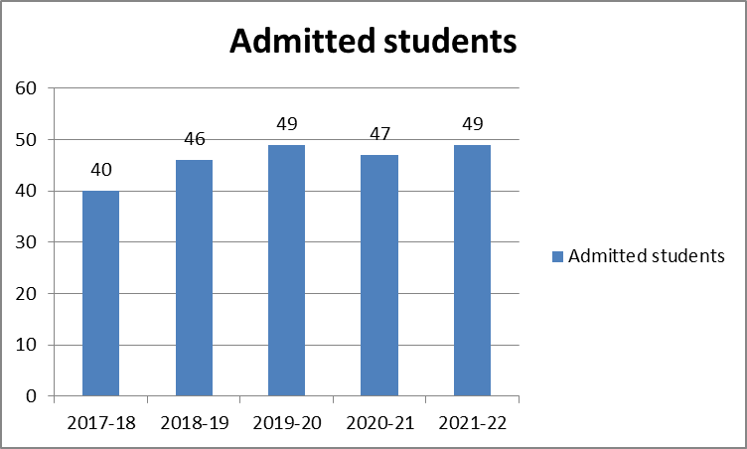
Teaching, Learning and Evaluation (contd..)
Students Strength and Diversity :
Academic Year | SC | ST | BC | OC | M | F | Total
²⁰¹⁷⁻¹⁸ | ⁰⁶ | ⁰³ | ²⁰ | ¹¹ | ¹⁵ | ²⁵ | 40
²⁰¹⁸⁻¹⁹ | ⁰⁶ | ⁰² | ³² | ⁰⁶ | ¹⁰ | ³⁶ | 46
²⁰¹⁹⁻²⁰ | ⁰⁶ | ⁰³ | ²⁴ | ¹⁶ | ⁰⁹ | ⁴⁰ | 49
²⁰²⁰⁻²¹ | ⁰⁷ | ⁰¹ | ²⁵ | ¹⁴ | ^{12+1*} | ³⁴ | 47
²⁰²¹⁻²² | ⁰⁸ | ⁰⁴ | ²⁹ | ⁰⁸ | ^{15+1*} | ³³ | 49
* International Students

Slide 21
Teaching, Learning and Evaluation (contd..)
Student Placements
Academic Year | Placements
2017-18 | 11
2018-19 | 27
2019-20 | 33
2020-21 | 35
2021-22 | 31

Slide 22
Teaching, Learning and Evaluation (contd..)
Students Categorisations (Advanced learners/Slow learners):
33/10
Programmes for Advanced Learners:
Orientation for NET/GATE and other competetive examinations
for higher studies and placements.
Offering Ph.D. Program

Slide 23
Teaching, Learning and Evaluation (contd..)
Programmes for Slow Learners: Conducting remedial classes, assignments, creating office hours for contacting the teachers individually for doubts clarification.
Mentor/Mentee System: Allocating a group of students to a teacher for counselling on regular basis.
Mentor/Mentee Report 2017-18
Mentor/Mentee Report 2018-19
Mentor/Mentee Report 2019-20
Mentor/Mentee Report 2020-21
Mentor/Mentee Report 2021-22

Slide 24
Teaching, Learning and Evaluation (contd..)
Slow learners
Program Code: 7-2-01 Year | Number of students appeared in the final year examination | Number of students passed in first semester examination | Number of students passed in fourth semester examination
2017-18 | 39 | 22 | 27
2018-19 | 43 | 34 | 35
2019-20 | 44 | 24 | 35
2020-21 | 46 | 35 | 36
2021-22 | 44 | 26 | 32
Motivated the slow learners by taking remedial classes, giving assignments, councelling
and obtained fruitful results at the end of IV semester. More than 82% students in the above
are obtained first class with distinction or first class.

Slide 25
Teaching, Learning and Evaluation (contd..)
Results analysis/Pass Percentage: Results Review Commitee meetings are conducted and results are analysed.
Graduate attributes/learning outcomes: LO’s are specified for each subject in the syllabus
PO’s achievement methods:
Classroom teaching
Continuous evaluation
Student seminars and assignments
Project work
Viva-Voce at the end of each even semester end examinations

Slide 26
Teaching, Learning and Evaluation (contd..)
COMPUTER LAB
Students in programing lab

Slide 27
LIBRARY
Teaching, Learning and Evaluation (contd..)
Students referring department library books

Slide 28
Research, Innovations and Extensions (contd..)
Papers Published:154 (during assessment period) . Most of the papers are published in Scopus indexed, Web of Science, Reviewed in AMS.( Publications List)
Publications Reflected in Various Platforms
Name of the Teacher | Vidwan | Scopus | Web of Science | Google Scholar | Research Gate
Prof. V. U. M. Rao | - | 101(24) | 36
Prof. K. Rajendra Prasad | 150(7) | 94(10) | 29 | 145(12) | 153
Prof. M. Vijaya Santhi | 78(6) | 41(14) | 23 | 69(18) | 78
Prof. P. Vijaya Laxmi | 96(5) | 65(11) | 2 | 56(14) | 76
Dr. T. Vinutha | 31(3) | 33(12) | 31 | 41(13) | 46
Dr. M. Tripathy | 4 | 4 | - | 4(3) | 4
Total | 359(21) | 338(71) | 121 | 315(60) | 357

Slide 29
Research, Innovations and Extensions (contd..)
Reviews Reflected in Various platforms
Name of the Teacher | Mathematical Reviews (A.M.S) | zbMATH
Prof. V. U. M. Rao | 28 | 36
Prof. K. Rajendra Prasad | 123 | 121
Prof. M. Vijaya Santhi | 11 | 78
Prof. P. Vijaya Laxmi | 42 | 56
Dr. T. Vinutha | 6 | 4
Dr. M. Tripathy | 4 | -
Total | 214 | 279
All the staff members are actively engaged in refereeing and reviewing articles

Slide 30
Research, Innovations and Extensions (contd..)
Some Journals
Astrophysics and Space Science
Applied Mathematical Modelling
Journal of Fractional Calculus and Applied Analysis
European Physical Journal Plus
Applied Mathematics And Computations
International Journal Of Information And Management Optimization
Asian European Journal of Mathematics
European Physical Journal C
Physics of the Dark Universe

Slide 31
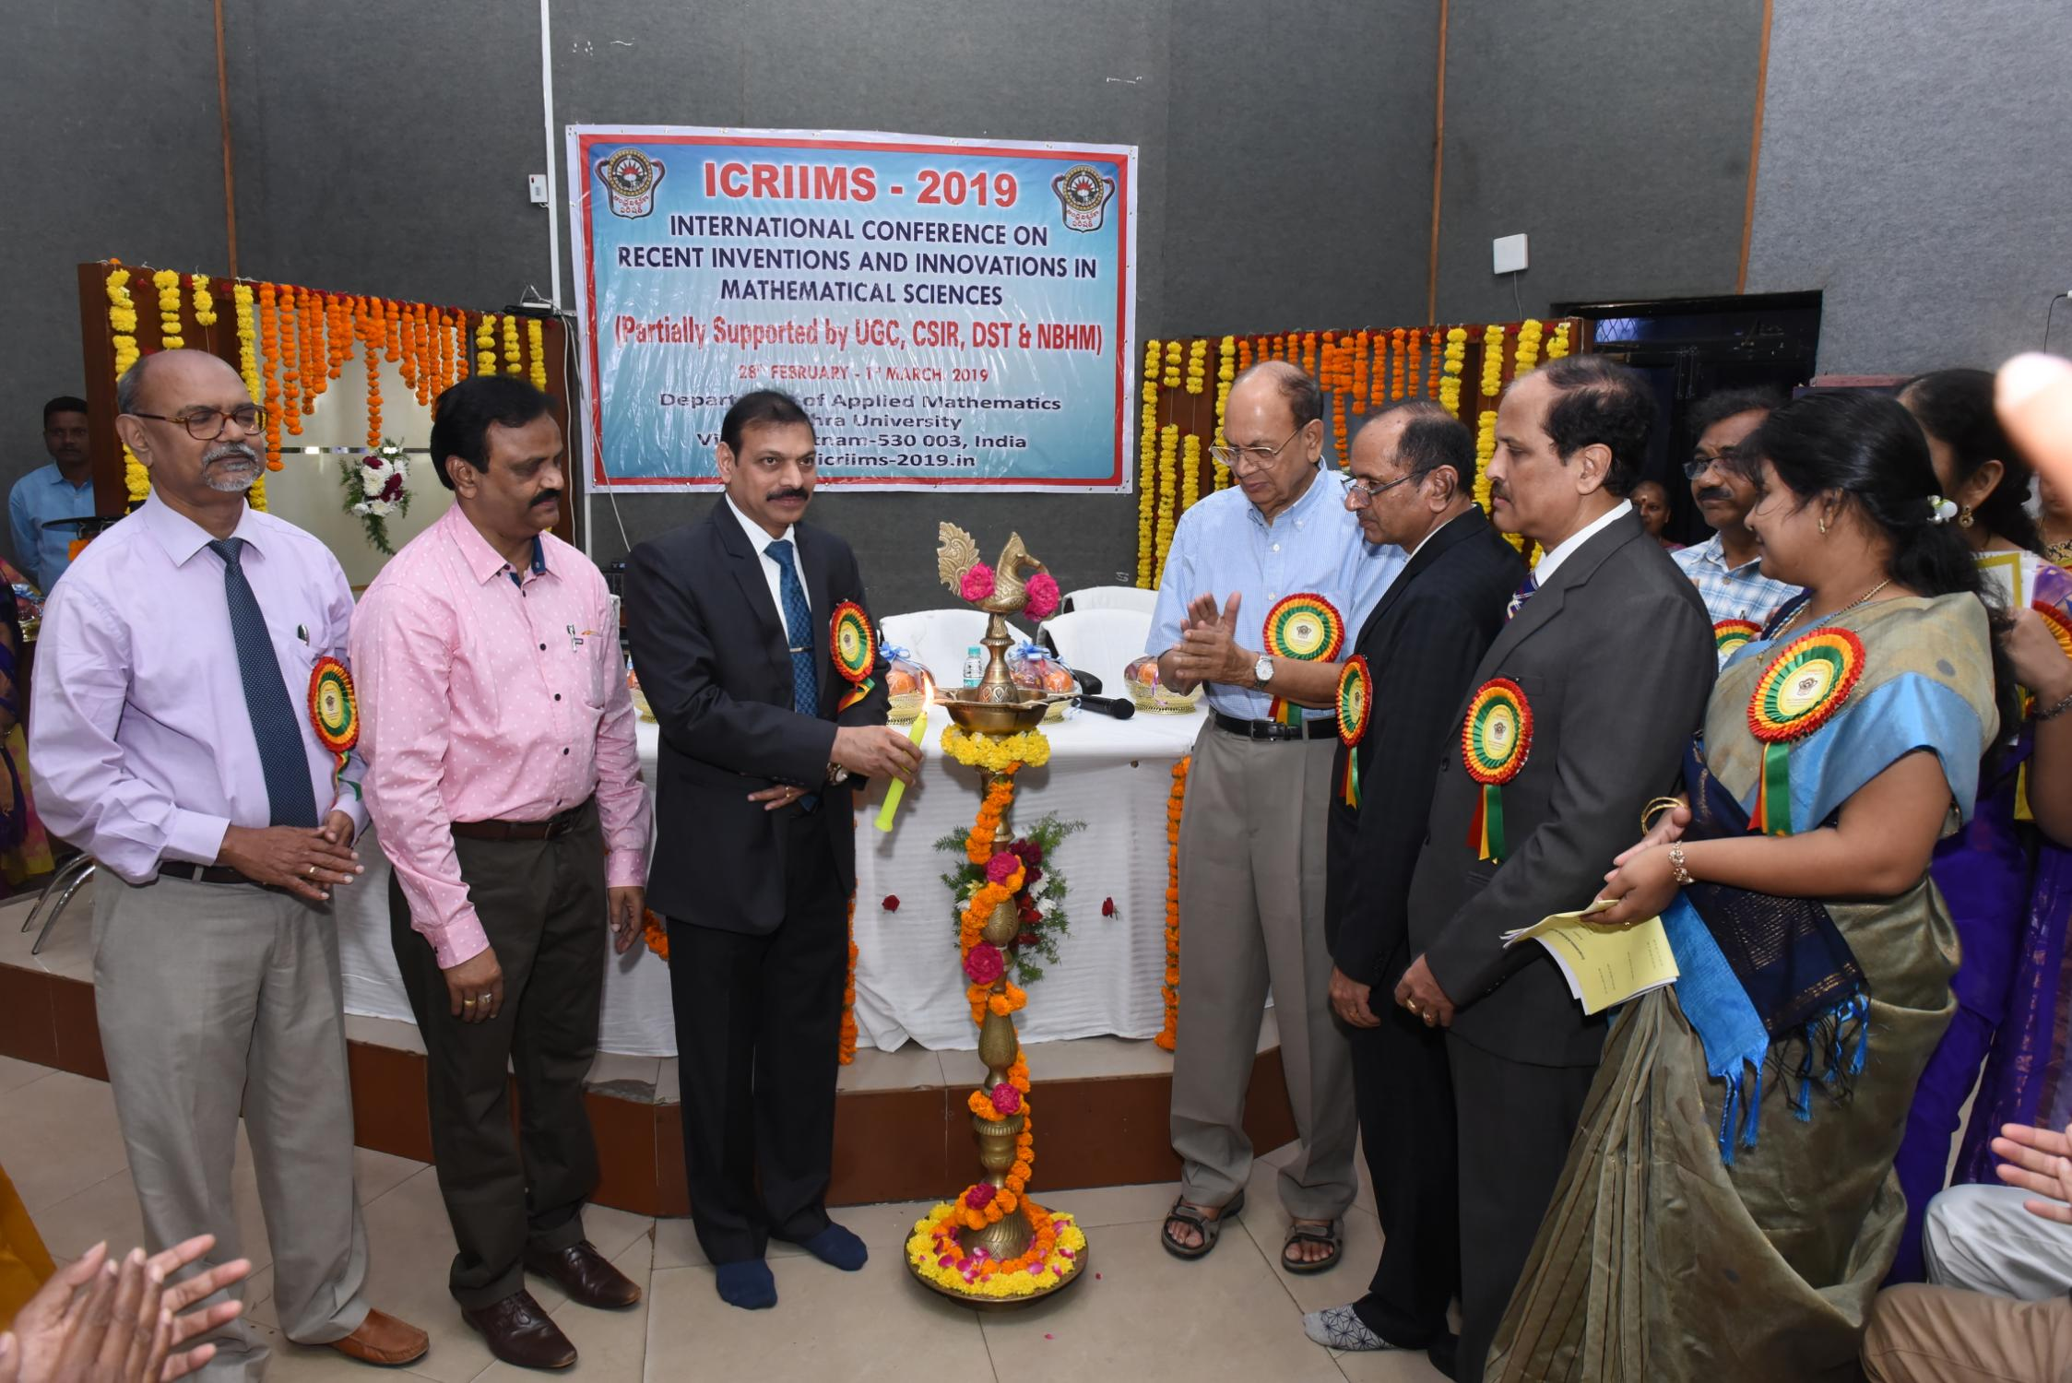
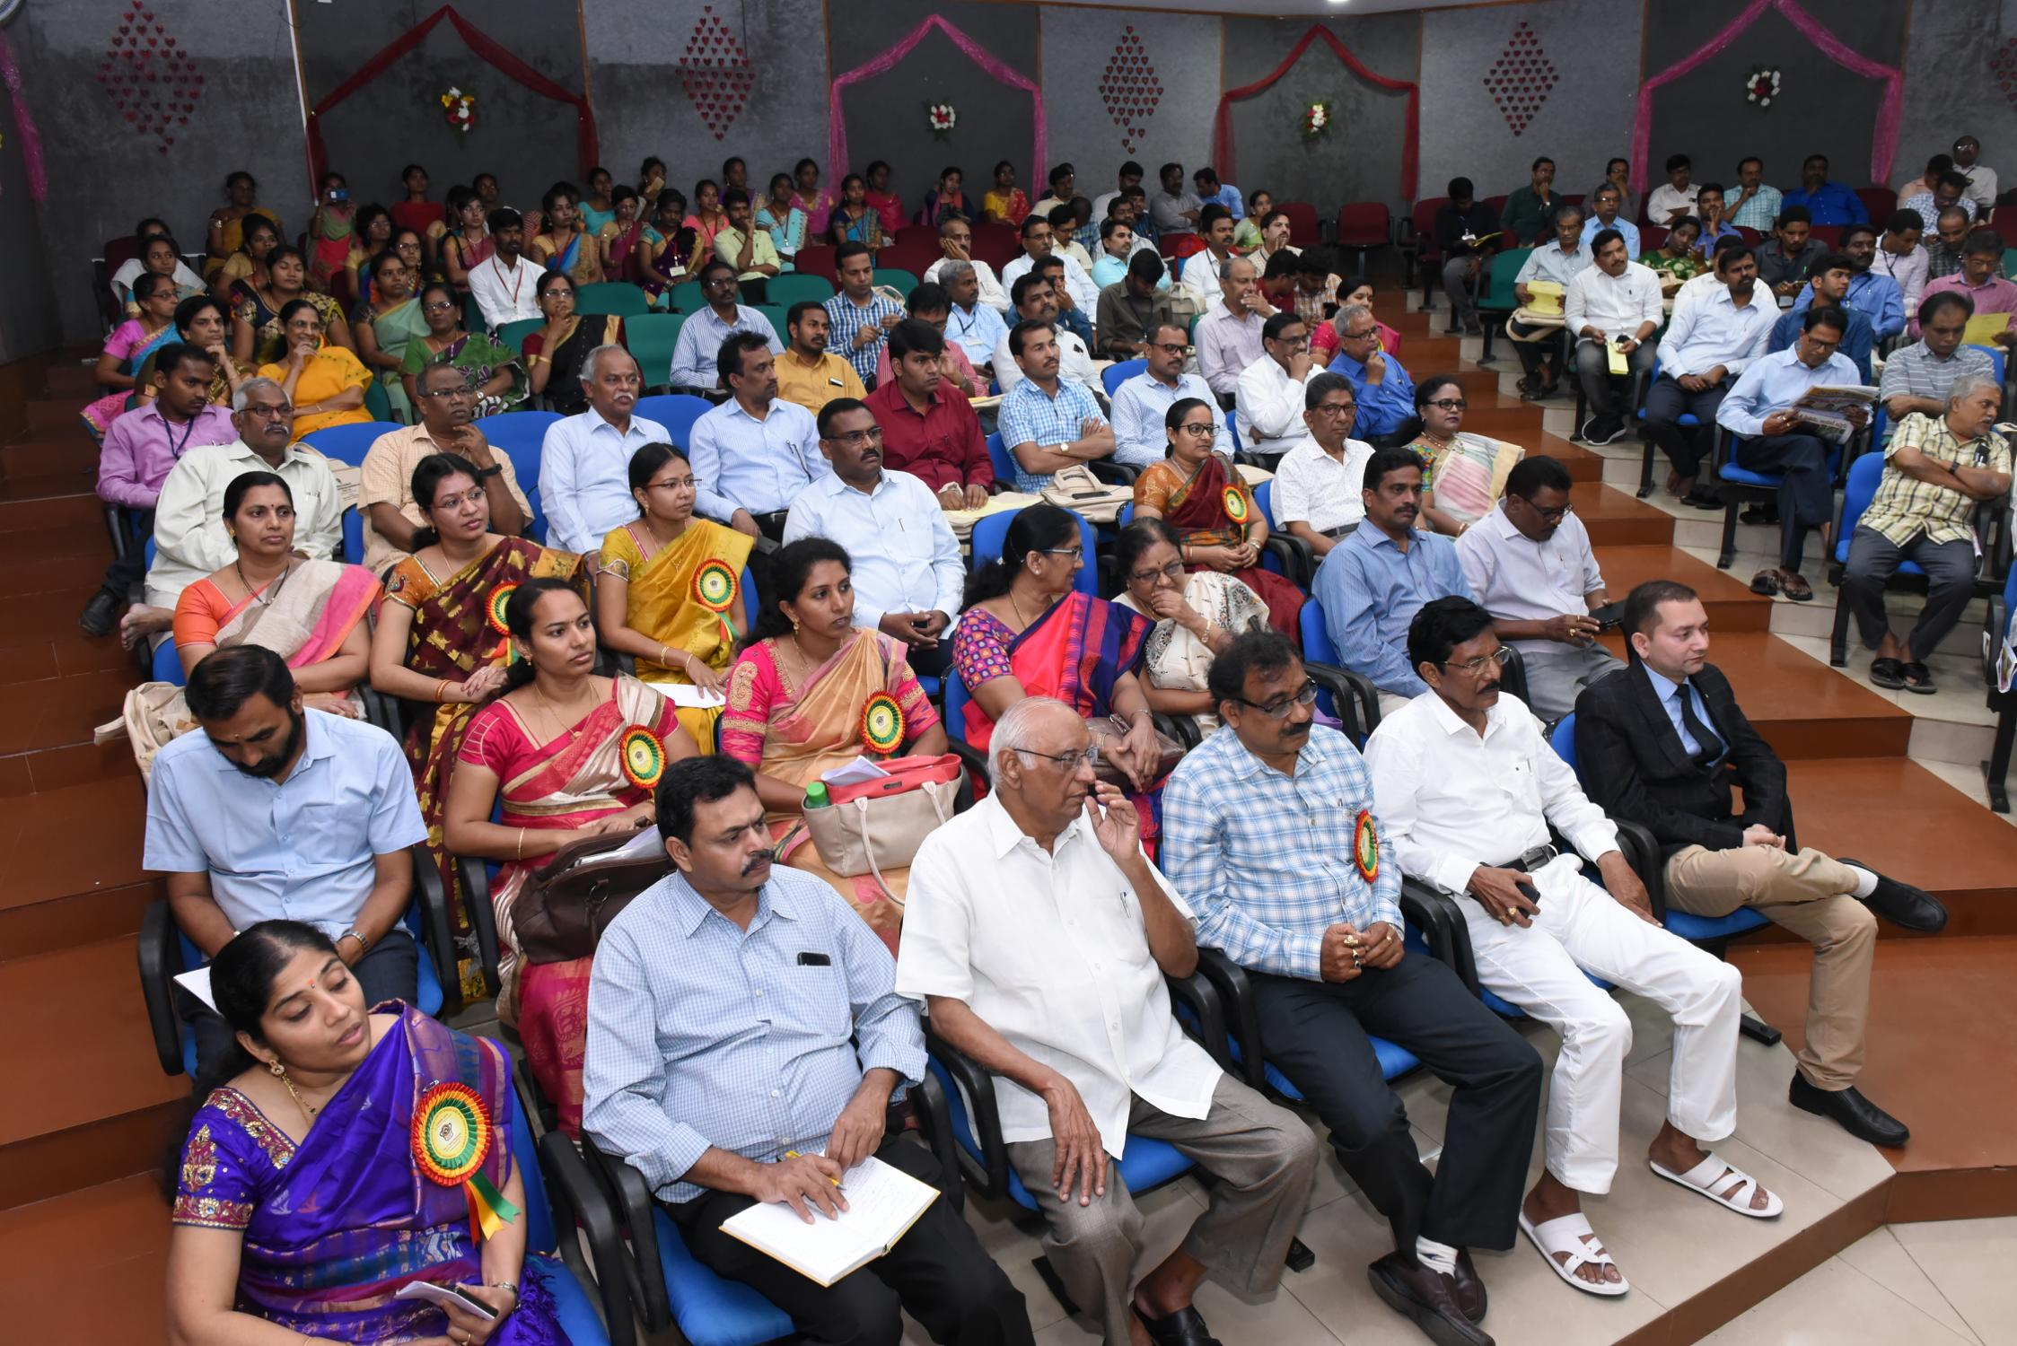
Research, Innovations and Extensions (contd..)
National Events: One International Conference was organized on Recent Inventions and Innovations in Mathematical Sciences (ICRIIMS- 2019).
MVS_0962
Workshop/Seminar/Conferences/Training programmes attended: 11 (Papers presented and chaired the sessions)

Slide 32
Research, Innovations and Extensions (Contd..)
Research Grants received: Rs. 181 Lakhs
Research Projects (ongoing):
DST-FIST Programme (Rs 38 Lakhs)
DST-SERB Project (Rs 24 Lakhs)
Two Assistant Professors in Faculty Recharge Programme sponsored by UGC
(Rs119 Lakhs for five years)

Slide 33
Research, Innovations and Extensions (Contd.,)
Ph.D’s awarded: 20
Number of Research Scholars on rolls year-wise:
2017-18: 14
2018-19: 15
2019-20: 18
2020-21: 17
2021-22: 15
Number of JRF/SRF/PDF/RA: 05
Research Laboratories/others:
Computer Lab sponsored by DST-FIST
Research Facilities: In addition to university sponsored books and Journals, e-Journals, we have combined Dept. library with 5432+ books sponsored by NBHM(Library)
https://www.andhrauniversity.edu.in/central-facilities/library.html
Computer Lab with internet facility

Slide 34
International Students Obtained Ph.D. Degrees
Wesen Legessa Takatel (2018)
Molla Mengesha (2019)
Bekele Getanesh (2020)
Daba Meshehagusu (2020)
Wondeswosen Kassahun Tegeghe (2020)
Andwilile Abrahamu George (2023)
Hasan Qrewi (Working)

Slide 35
Research, Innovations and Extensions (Contd..):
Teachers in administrative positions:
Prof. V.Uma Maheswara Rao, Registrar A.U.(2017,2018)
Prof. K. Rajendra Prasad:
Dean, Confidential Examination, 2017
Director, Directorate of Admissions, 2017, 2018
Convener, AP EdCET - 2023
Prof. M. Vijaya Santhi - Internal Auditor, IQAC
Prof. P. Vijaya Laxmi - Deputy Coordinator, IQAC
Dr. T. Vinutha - Womens’ Hostel warden

Slide 36
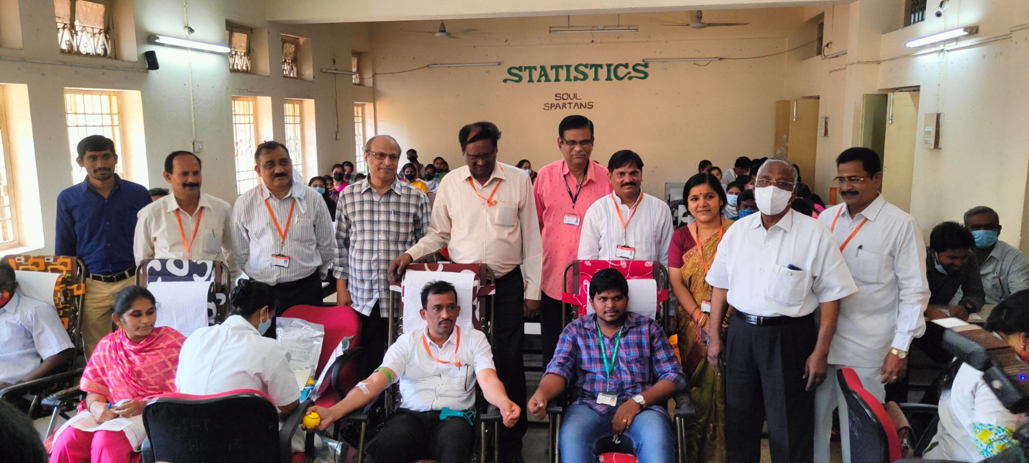
Research, Innovations and Extensions (Contd..):
Extension and out reach programmes organized and participated Photographs
Blood Donation Camp

Slide 37
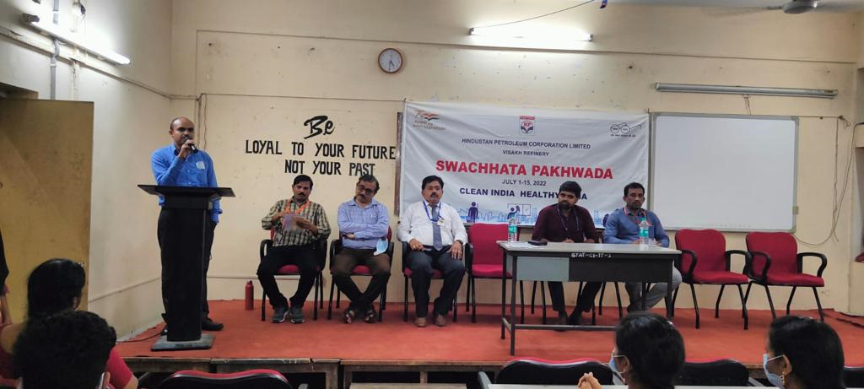
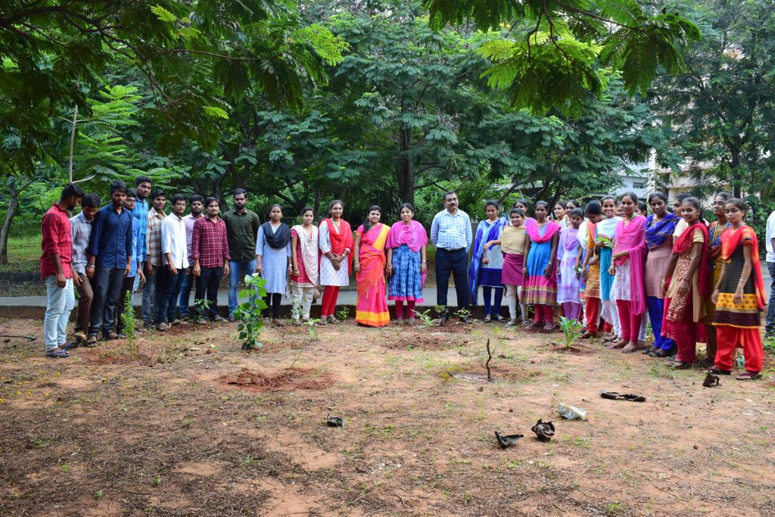
Research, Innovations and Extensions (Contd.,):
Swatchh Bharat Program
Plantation
Beach Cleaning Program

Slide 38
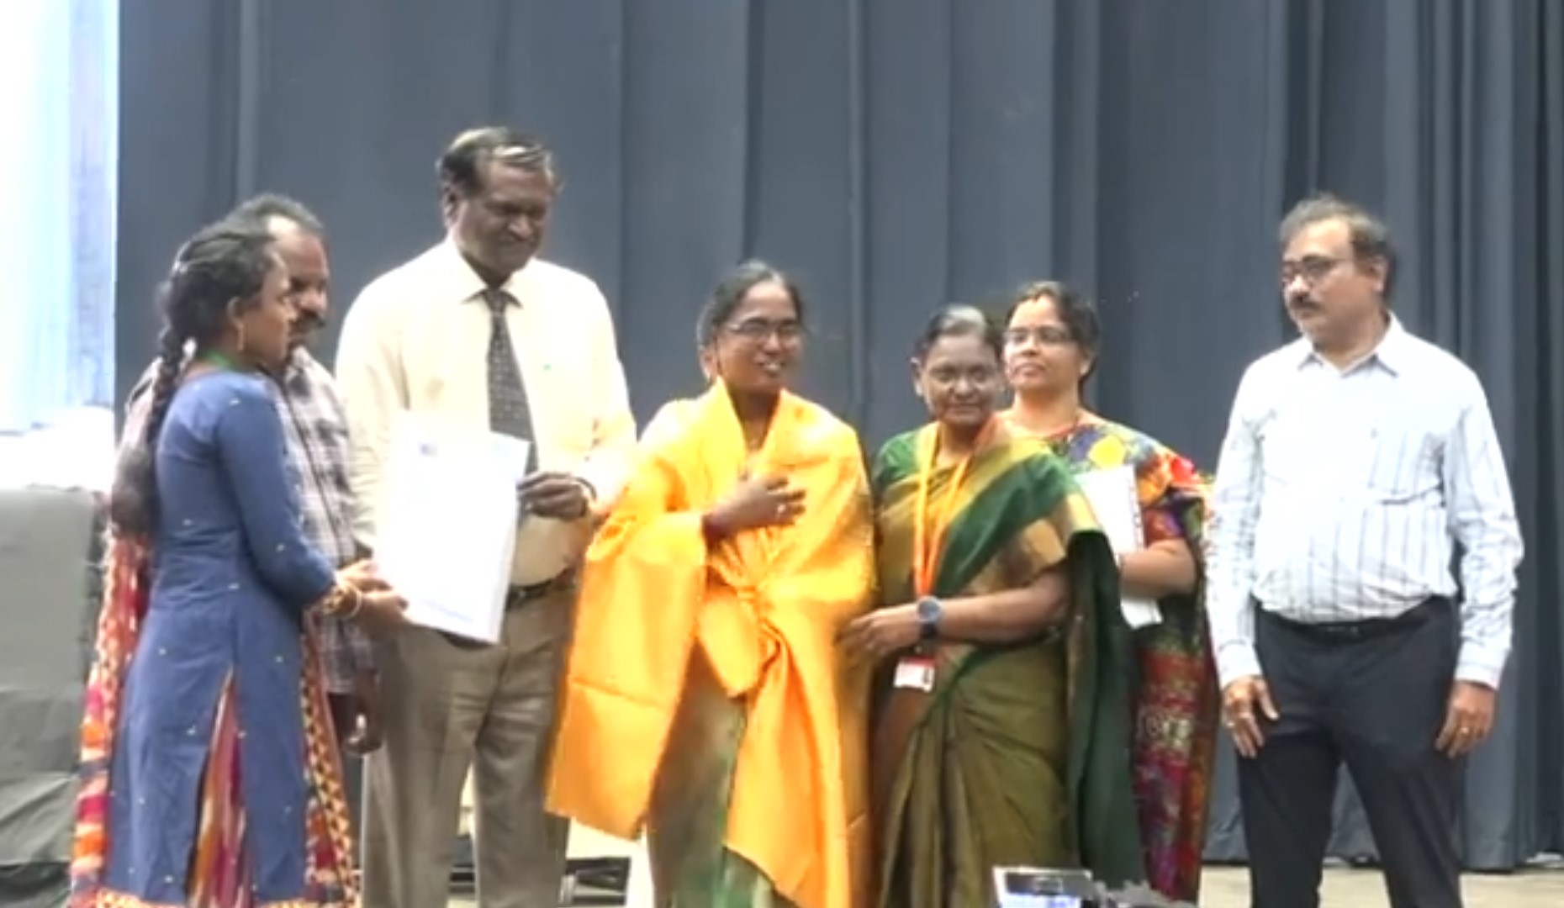
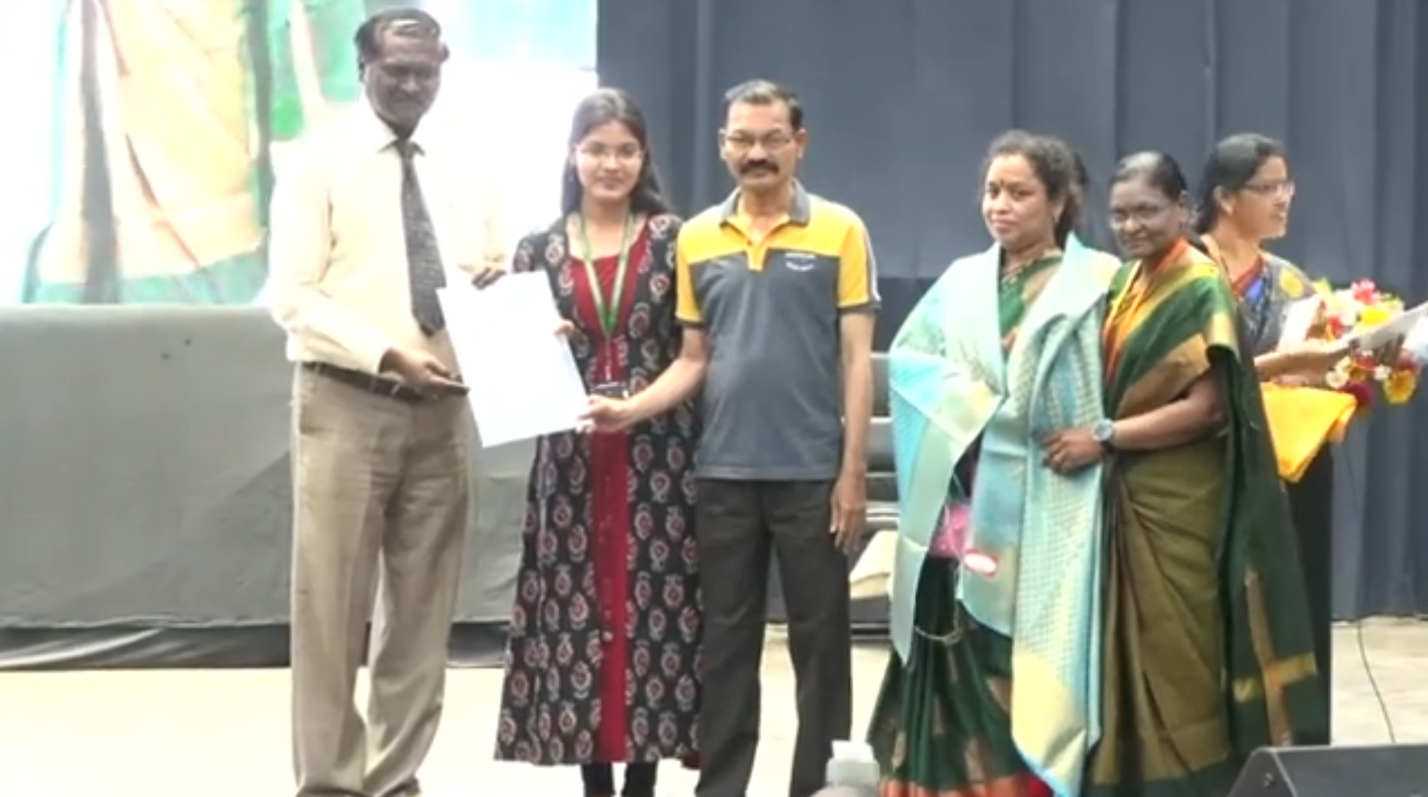
Research, Innovations and Extensions (Contd.)
Felicitation to the parents of the students who achieved the placement
on 28th April 2023 at the Achievers day Celebrations of College of Science and Technology

Slide 39
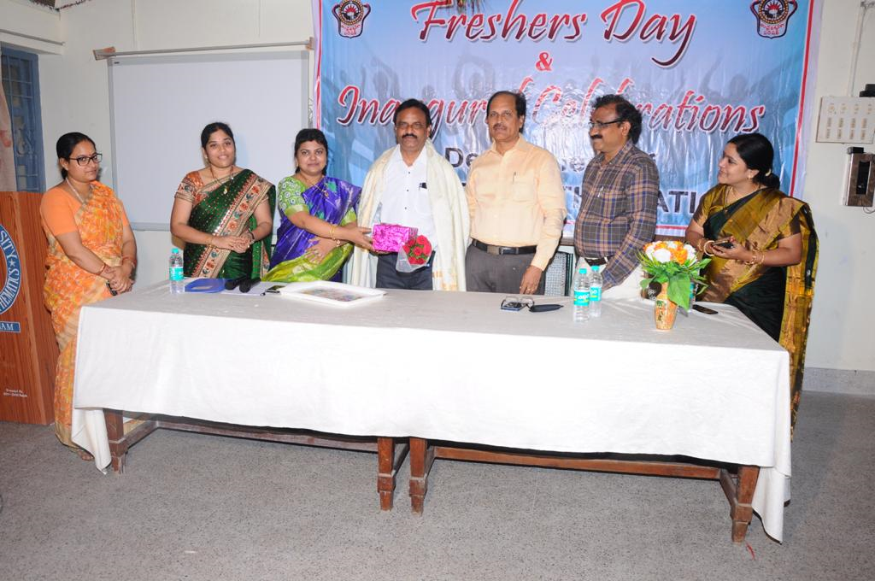
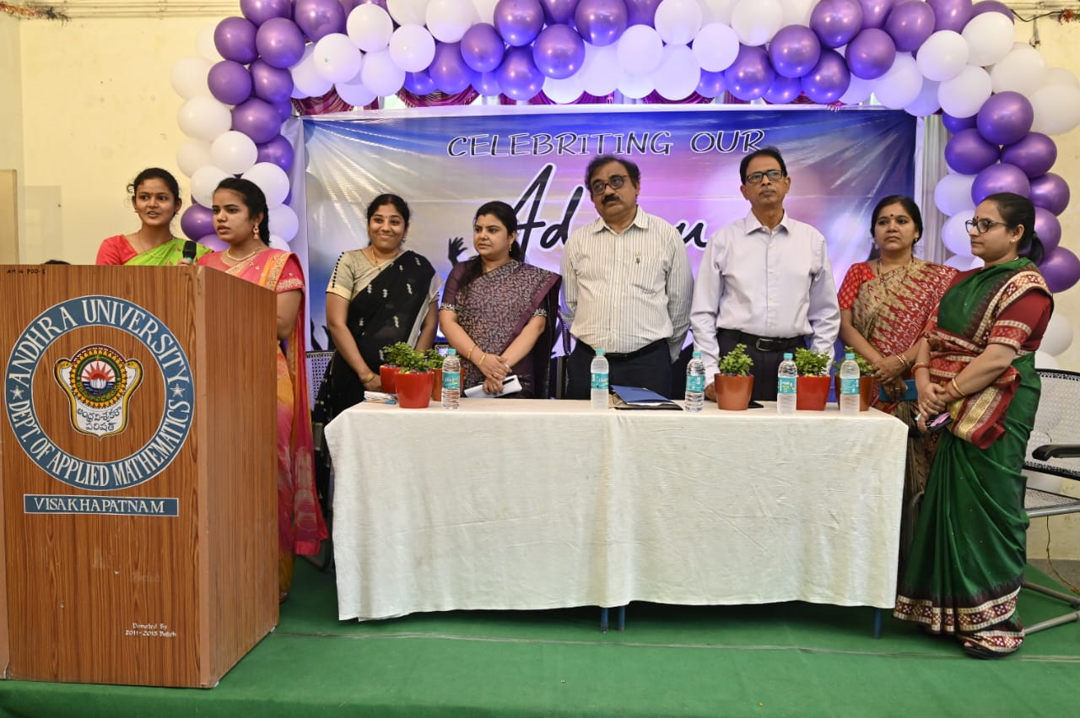
Inaugural & Freshers Day
Valedictory & Farewell Day

Slide 40
Prominent Alumni
A)Scientists in National/International Organizations
Dr. K. V. S. Rama Rao, NASA, USA.
Dr. I.V.V. Raghavacharyulu, Bhabha Atomic Research Center.
Dr. A. Venkata Rao,NASA, USA.
Dr. G. Sundara Rama Sarma, D L R Institute of Theoretical Fluid Mechanics, Gottingen, Germany.
Dr. V. Shyamala Devi, AT & T Laboratories, USA.
Dr. V. Adimurthy, Distinguished Scientist and Deputy Director Vikram Sarabhai Space Center, Thiruvanthapuram.
Dr. P. V. Subba Rao, Head, Applied Mathematics Division, Vikram Sarabhai Space Center.
Dr. N.V. Vighnesam, ISRO Satellite Centre, Bangalore. He was the part of the Chandrayaan-I in trajectory estimation S/W which is being used presently in Mission Chandrayaan -3 also.
Dr. S. Kishore Kumar, Group Director, DRDO, Bangalore.

Slide 41
Prominent Alumni
B) Teaching Positions
Dr. Raghava Rao, IIT, Madras.
Dr. A. D. Rao, Atmospheric Science, IIT, New Delhi.
Dr. V. Ch. Venkaiah, Professor, University of Hyderabad.
Dr. G. B. Sitaram, Life Sciences R & D, Tata Consultancy Services Ltd, Hyderabad.
Dr. V. C. Chenchuraju, University of Botswana.
Dr. Y. V. S. S. Raju, IIT, Madras.
Dr. M. A. S. Srinivas, JNTU, Hyderabad.
Dr. G. V. S. R Deekishtulu, JNTU, Kakinada.
Dr. T. Ragava, IIT, Bhubaneswar.
Dr. K.N. Murty, Visiting Professor, Florida Institute of Technology.

Slide 42
Prominent Alumni
C) In Civil and Other Services
Dr. V Vani Prasad, I.R.S., Govt. of India.
Sri T. Venka Reddy, I.A.S., Govt. of India.
Sri K. V. Ramana Murthy, I.R.S., Govt. of India.
Sri A. Veeraju, AGM, Syndicate Bank.
Sri A. Seetharamayya, Captain, Indian Navy.

Slide 43
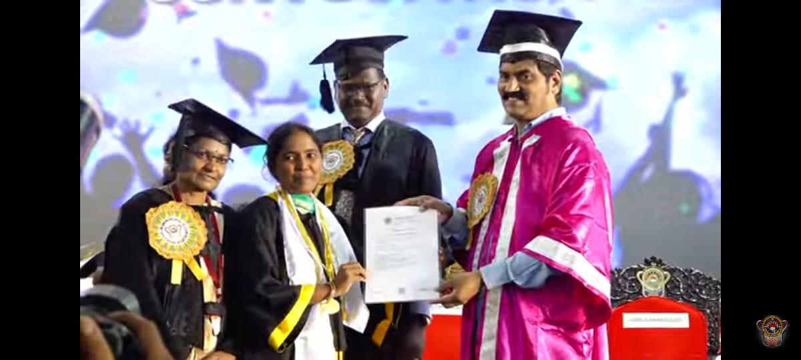
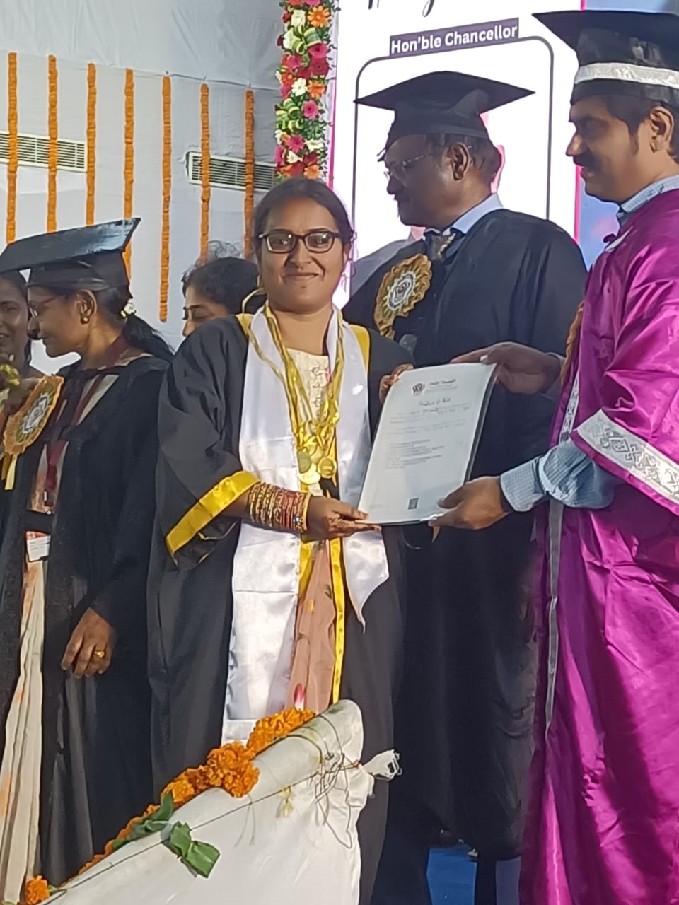
Recent Awards
The following students received awards in recent convocation
1.Kandregula Niharika (2018)
2.Butu Sravani (2020)
University awards in the name of the department:
Prof. T. Venkatarayadu Shastiabdipoorti Medal
Applied Mathematics Prize
Sri Iyyasomayajula Kameswara Rao Prize
Tengirala Venkata Rama Somayaji and Mrs. Venkamma Prize
Prof. T.S.G.Krishna Murty Shastiabdipoorti Prize
University awards:
Sripathi Medal M.Sc
Smt. Vegesina Neelamma and Sri Pedda Subba Raju Gold Medal
Smt. Vaddiparthi Seetha Ramamma garu Prize
T.Swamy Babu Medal

Slide 44
Applied Mathematics Foundation
To encourage and motivate students towards studies, the following are
implemented.
Established Applied Mathematics Foundation Trust (AMFT) in 2010.
Awards Sponsored by AMFT are:
Prof. T. Venkatarayadu Memorial Award
Prof. S. Meenakshi Sundaram Memorial Award
Prof. T.S.G.Krishna Murty Memorial Award
Prof. D.R.K. Sangameswara Rao Memorial Award
Two Awards sponsored by Prof. L.S.R.K. Prasad

Slide 45
FUTURE PLANS
To start a new PG programme in Computational Mathematics.
Plans for introducing new elective courses on Data mining, Industrial Mathematics, Mathematical Biology to acquire placement and research opportunities in different Organizations.
Introduce short term/ Diploma programs in Industrial, Financial Mathematics, Artificial Intelligence and its applications to Applied Mathematics.
To apply for UGC-SAP and second phase of DST-FIST.

Slide 46
Thank You

